Slide 1
Slide 1 – Convert Bullets Below to SmartArt
Bullet Point 1
Bullet Point 2
Bullet Point 3
Bullet Point 4
Bullet Point 5

Slide 2

Slide 2 – Add Animation
1. Add Wipe animation to each answer
2. Have each answer Wipe from the left on a click
3. Add Fade animation to the check mark to start on a click
Quiz Question:
You need to ensure that a slide doesn’t appear in a slide show, but you want to save it for later use. What should you do?
Delete the slide
Hide the slide
Copy the slide to another slide show
Move the slide to the end of the slide show

Slide 3

Slide 3 – Add a Reveal Transition

Slide 4
Slide 4 – Insert an Image from Stock Images

Slide 5


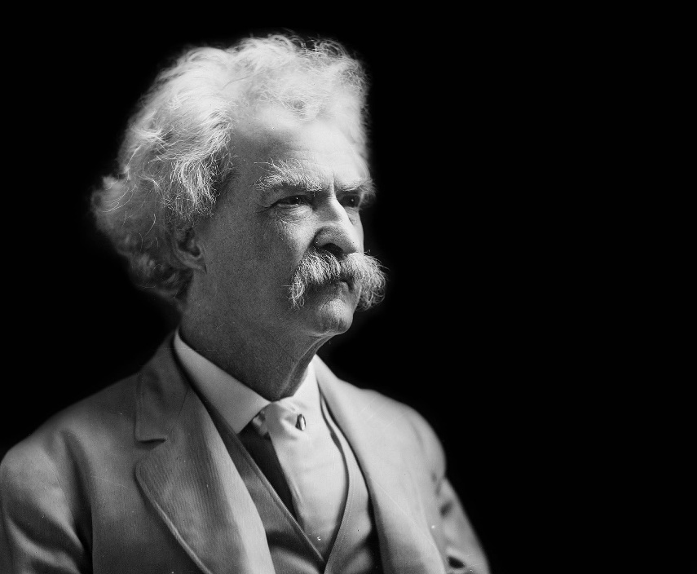
Slide 5 – Crop, Remove Background, Change Style
Crop
Remove background
Change style

Slide 6



Slide 6 – Make All Images Uniform

