Slide 1
Day 3
Inspector Discussion Groups
Notes:
1
4.7.2018
If time available, this is a good opportunity to get class input on issues of interest to them. Sometimes this works very well – sometimes not. Depends upon class.
I’ve suggested several topics (next slide) to stimulate discussion.

Slide 2
Group Exercise
Break up into groups
  Group 1 : Inspection Horror or Success Stories
  Group 2 : Impact of COVD 19 on Inspections
  Group 3 : New Technology for Inspections
  Group 4: Juggling numerous responsibilities
  Group 5: Virtual Inspections
Spend 30 min. in discussion groups
Reconvene and discuss each group’s report
Notes:
They can also come up with discussion issues of their own. Use a break out room if you can.

Slide 3
Group 1 (Horror/Success Stories)
Inspection Success Stories
As a senior inspector, describe either successful or horror inspections?
Can your success stories be replicated by other inspectors? If so how?
As a group, identify two areas that inspectors should spend more time evaluating during the inspection in order to have a “successful inspection”.
What training would make you a more successful inspector?

Slide 4
Group 2
Impact of COVD 19 on inspections
What did you do during COVD break?
Did any of you conduct virtual inspections? If so, how did you do them?
Do you see any long term impacts of COVD on your agency’s inspection program? If so, what would they be?

Slide 5
Group 3
New Technology for Inspections
During the past 2 years has your agency implemented any new technology for conducting inspections? If so, what were they?
Do you see any new technologies that will work to improve the efficiency or effectiveness of the inspection program?
Please provide examples.

Slide 6
Group 4
Juggling numerous responsibilities
How do you juggle the numerous responsibilities of your job?
What training could make you more successful?

Slide 7
Group 5
Virtual Inspections
Did you conduct virtual inspections during COVD-19?
If so, how was it and did you use a state developed SOP? If you did not use an SOP, what procedures did you use to conduct the virtual inspections?
Do you think virtual inspections are useful?

Slide 8





What to Know about Criminal Investigations

Slide 9


U. S. EPA and State Criminal Enforcement
Compliance Activities
Administrative Enforcement
Civil Enforcement
Criminal Enforcement

Slide 10
Environmental Enforcement
In the United States
Criminal
Criminal
EPA
Civil & Administrative
State/Territorial Civil and Administrative Enforcement
Actions

Slide 11
What Makes a Case Criminal?
CHEATING
LYING
$$$
STEALING
It is the decision of the federal, state and/or local prosecutor whether to file a criminal case
Notes:
It is not the agency’s decision whether or not a case is criminal, that is a prosecutor’s decision. It is our role as witnesses and investigators to let them know of possible crimes and then let them make the decisions they are elected to make.

Slide 12
Federal Statutes with Criminal Penalties
RCRA
  Haz waste mgmt.
CERCLA
  Superfund
CWA
  Surface waters
  Sewers
FIFRA
SDWA
CAA
  Asbestos
  Stationary sources
EPCRA
TSCA
Miscellaneous
  False Statements
  Conspiracy
  Mail Fraud
  Wire Fraud
Notes:
On the test question #1
Most states have state equivalents

Slide 13
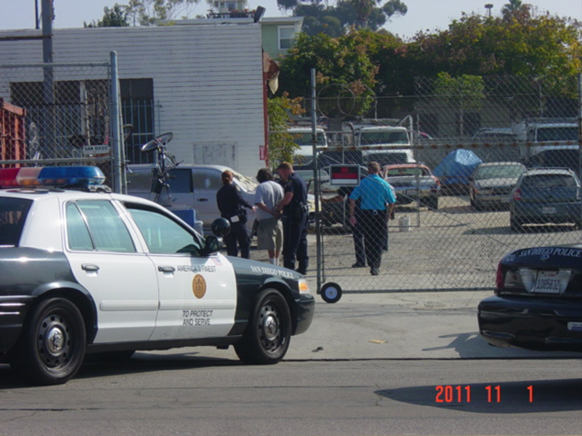
Criminal Enforcement
Knowing or negligent behavior
Significant and most egregious violators
Involve lengthy, complex investigations
Potential for fines and/or incarceration
Notes:
Don was involved in first EPA criminal case which we lost
Photo is of auto repair in San Diego

Slide 14
Factors in Case Selection
for Criminal Investigation
Concealment of misconduct
Data falsification
Tampering with monitoring equipment
Threatening witnesses
Deliberate misconduct and financial gain
Ongoing/continuous/repetitive discharges
Prior criminal or civil actions

Slide 15

Criminal investigators cannot direct a civil inspection
Information may be shared by civil and criminal with appropriate conditions (see parallel proceedings notes in later slides)
More severe penalties
  Loss of freedom, i.e. JAIL TIME
Notes:
Question on the test

Slide 16
“RED FLAGS” That May
Indicate Criminal Activities
Conflicting stories - management/workers
  Interviewed separately during warrant
  Motive (management makes money from event, not workers)
Unsubstantiated data or no data
  “It was hauled off site”…..MANIFESTS?
  Sample results to back up data
  Bench sheets to back up data
  Lab SOPs to back up data (calibration)
  Requirement to maintain data??

Slide 17
“RED FLAGS” That May
Indicate Criminal Activities
Data too good to be true
  What they tell you the data is vs. your observations (i.e. plant effluent)
Deliberate actions to violate
  Bypass pipe
  Mass accumulation of waste

Slide 18
“RED FLAGS” That May Indicate Criminal Activities
Conflicting data
  2 sets of books
  2 sets of reports (better set sent to regulators)
Claim ignorance about requirements
  yet have prior enforcement history

Slide 19
All environmental laws and requirements are subject to criminal actions
However, violations of other statutes can also be used in a criminal action

Slide 20
Federal Title 18 USC Offenses
False Statements
  Lying to agents
  False submissions
Mail Fraud
Wire Fraud
    Conspiracy
Obstruction of Justice
  Evidence Destruction
RICO
Many state have state equivalent crimes
Notes:
Misc. provision from Title 18 of the U.S. Code that can be used for environmental cases. Title 18 (Crimes and Criminal Procedures)
The Code of Laws of the United States of America (United States Code, U.S. Code or U.S.C.) is a compilation and codification of the general and permanent federal law of the United States
RICO is Racketeer Influenced and Corrupt Organizations Act

Slide 21
Where Do Criminal Cases Come From??
Disgruntled employees
Citizen complaints
Fed/state EPA civil personnel
Other Law Enforcement agencies
Other regulatory agencies
Fire Departments
Notes:
NRC reports?

Slide 22
LEADS………….
The sooner the information is received,
the better the case will be…...
Statute of limitations
Witnesses disappear
Witnesses forget
Evidence lost
Notes:
California for example has a one year statute of limitations on misdemeanors
Federal and most state statutes are longer

Slide 23
Prosecution of a Criminal Case
Federal Prosecution
  By the United States Attorney in the district where the offense occurred
State/County Prosecution
  Attorney General
  District Attorney
Notes:
At the discretion of the individual office

Slide 24
Corporate, Individuals, or Both
Corporations
  Fines
  Gov’t contract debarment
  Probation
  Based upon the actions of upper level mgmt
Individuals
  Fines, imprisonment and/or probation
  Based on participation, supervision, or lack of supervision

Slide 25
Some Do’s and Don’ts
Any information obtained during a properly conducted inspection may be shared with the criminal program.
Inspectors must never promise or state to a subject that evidence obtained by the inspector, including statements made by persons at the site of the inspection, cannot or will not be used in a criminal proceeding, or that the violations that are suspected can or will be addressed by civil enforcement only.
Notes:
You do not have to inform them if you know there is or may be a pending criminal investigation but you cannot lie if asked. You can also say those decisions are made by others (because they are).

Slide 26
Do’s & Don’ts
Civil inspectors must never use the threat of
criminal investigation to obtain consent or any other benefit in connection with an inspection or a civil enforcement matter.
Criminal investigators should not (and will not) “direct” inspectors as to where to conduct inspections.
Notes:
Last bullet added, its o the test # 9

Slide 27
Role of the Inspector
Identify potential criminal activity during the normal course of a civil inspection
Report information to the criminal investigator upon completion of the inspection
Continue with normal duties unless otherwise assigned
Notes:
Last bullet is on the test

Slide 28
F2022 Federal Environmental Criminal Enforcement Results
117 Criminal Cases Opened
353 Criminal Defendants Charged
$7.8 Million of Court Ordered Environmental Projects
$149 Million in fines/penalties
21 Years of Incarceration
Notes:
This is a huge dropoff from previous years

Slide 29
Asbestos Case
Demolition of a Chattanooga textile mill
2012: Men convicted of conspiring to violate the CAA in demolition without properly removing asbestos.
Violations: failure to wet material containing asbestos, & failure to containerize/dispose of material.
Prosecutors said 2 men fraudulently filed a false 10-day notice vastly underestimating asbestos amount.

Slide 30
Owner of Colorado Aircraft Painting Company Sentenced for Unlawfully Treating Hazardous Waste
Colorado Department of Public Health & Environment (PHE) directed Gold Metal Paint Co (GMP) to dispose waste, & clean tank & close drain to UST.
Instead GMP told workers to clean tank without PPE.
GMP treated hazardous waste by pouring it on the floor and letting it evaporate. Then they drilled open the trench drain so that the waste could again flow into the UST.
GMP owner pled guilty to illegally treating hazardous waste
Gold Metal Paint Co. owner sentenced to serve 6 months home confinement, pay $10,000 fine, and 2 years probation.

Slide 31
Ice Company Criminally Fined, Required to Remedy
Clean Air Act Violations
Company fined $90,000 and placed on federal probation for3 years by a federal court judge in Providence on March 22, 2021 for repeatedly failing to implement a Risk Management Plan (RMP) to be executed in the event of an accidental release of anhydrousammonia, an extremely hazardous substance.

Slide 32
Utah-based Company Sentenced for False Claims that Mold Inhibitor Can Kill COVID-19 Virus in the
State of Washington
PurEnvironment, a Utah-based mold remediation
company, pleaded guilty to environmental crimes
charges regarding the company’s false claims that
its products could provide “90+ day protection”
against COVID-19.

Slide 33
Maintenance Supervisor at a NY State Facility
Pleads Guilty To Violating The Clean Air Act
In April 2015, during the cleanout of the Hillcrest
Building, asbestos was released into the ambient air,
which negligently placed other individuals in imminent
danger of death or serious bodily injury.
On April 9, 2015, the defendant responded to the
Hillcrest Building and told the workers that a licensed
third-party testing Company had conducted the sampling
at the Hillcrest Building and that such sampling yielded negative
results for asbestos.

Slide 34
Law Enforcement Contacts
Your EPA Region Criminal Investigations Division?
Contacts for state law enforcement
Who are yours?
Notes:
Joe Smith
Assistant Special Agent in Charge
North Carolina State Bureau of Investigation
Diversion and Environmental Crimes Unit
Office: 984-204-2722 email: jesmith@ncsbi.gov
For NC, Alabama, Georgia & South Carolina
Andy Castro, Special Agent in Change, Region 4
Sam Nunn Atlanta Federal Center
61 Forsyth St SW, Atlanta, GA 30303 Phone: (404) 562-9795
For North Carolina (Regional Office):
6324 Fairview Road, Suite 525
Charlotte, NC 28210 (704) 366-3098
two agents in Charlotte and one in Raleigh
Andy Castro, 404 562-9815, Castro.Andy@epa.gov

Slide 35
QUESTIONS?

Slide 36
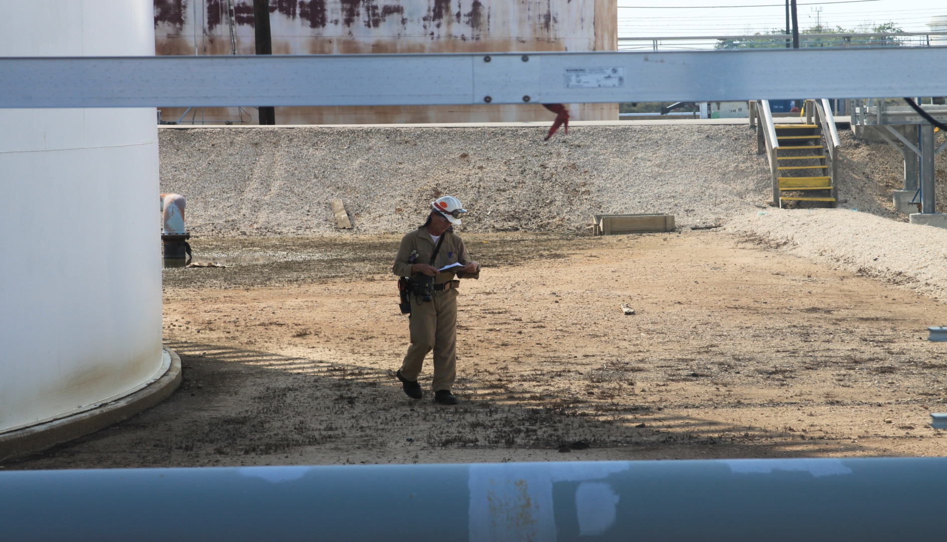
Using PIDs and FLIR Cameras:
Inspections and Case Development

Slide 37
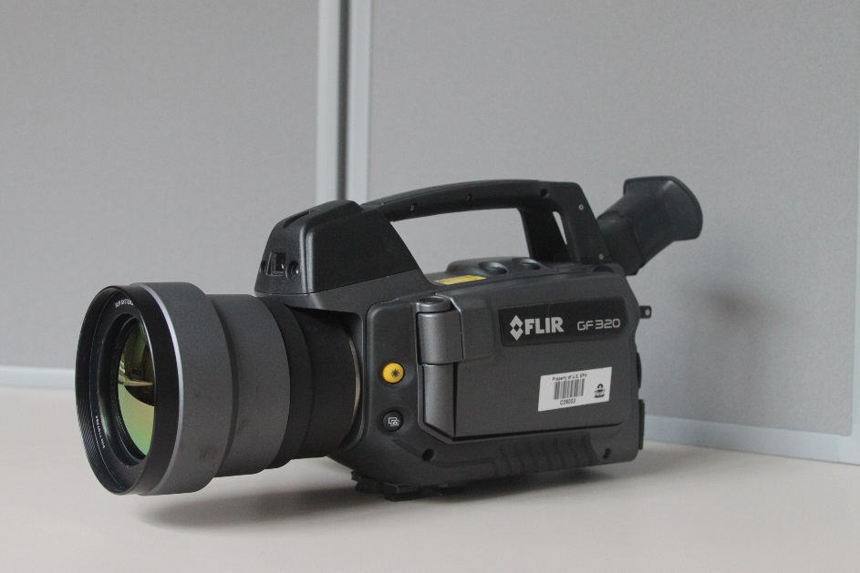
IR Camera
Hydrocarbons absorb and emit infrared energy at specific wavelengths within the IR spectrum
Camera sees IR energy, but has a filter to allow only IR energy in the 3.3 – 3.5 µm wavelength band to be detected
Hydrocarbons that absorb IR energy in that range will be detected and imaged as a visible plume
Benzene
Butane
Ethane
Ethanol
Ethylbenzene
Heptane
Hexane
Methane
Methanol
Octane
Pentane
Propane
Propylene
Toluene
Xylene
MEK
Common
chemicals detectable by
the camera

Slide 38
IR Camera as an Inspection Tool
The camera is good for seeing:
  Leak sources that were not previously identified/monitored
  Surveying for plumes (e.g. tank vents, flares, PRVs)
  Emission sources that can’t be easily reached or detected by traditional means

Slide 39
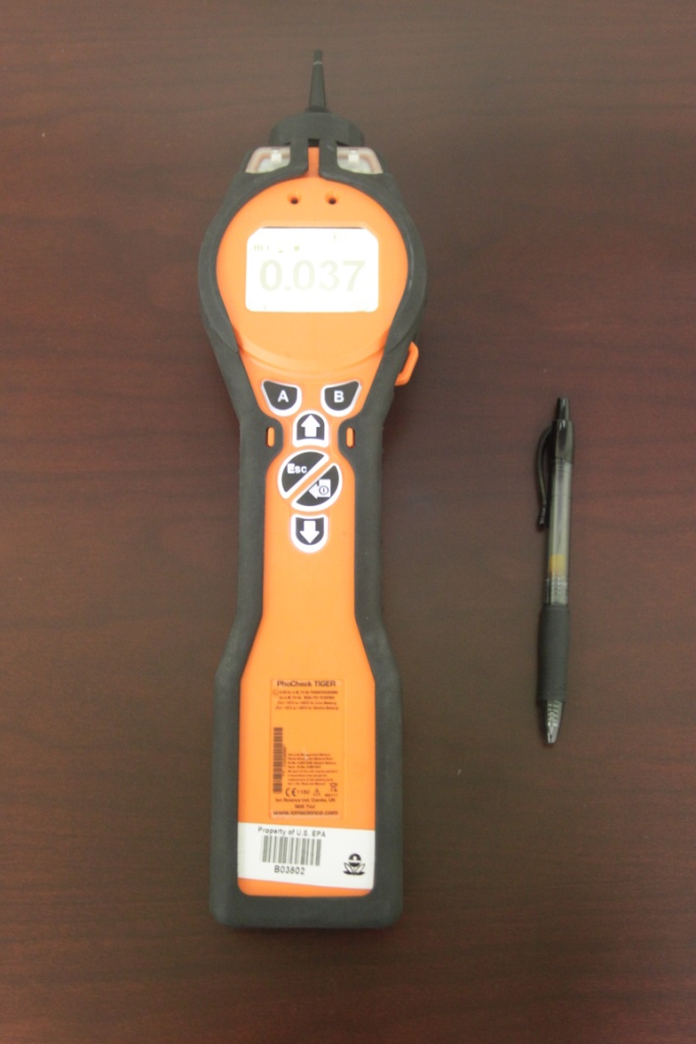
Photo-Ionization Detectors as Inspection Tools
[Ion Science PID – sensitive to 1 ppbV, most VOCs]

Slide 40
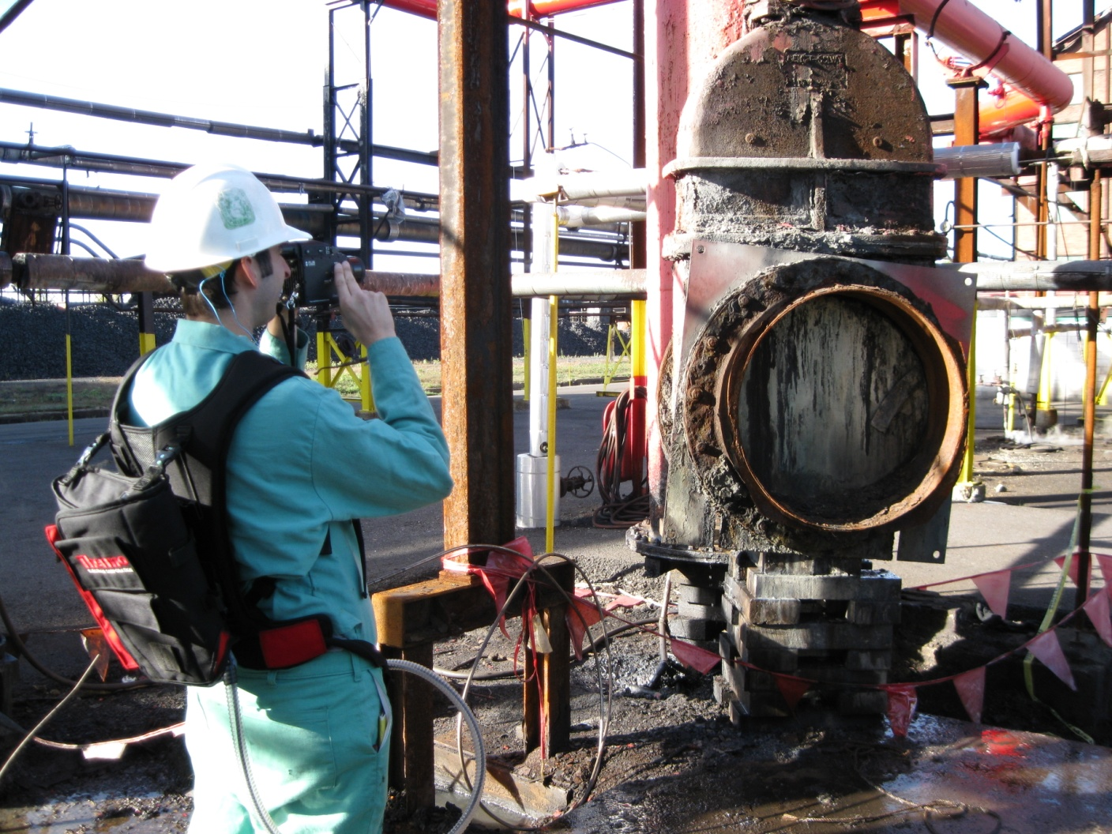
FLIR in Use at Tonawanda Coke
[Kosta Loukeris, Region 5]

Slide 41
PIDs…..
Detect many VOCs at low concentrations
Screen facilities and process units for follow-up investigations.
  “Strong” sources can be singled out for more detailed inspection (e.g., tanks, cooling towers, dryer vents, LDAR)
To determine when and where to take SUMMA samples.
To help locate sources for FLIR imaging.
To support NOV or FOV for emissions violations….

Slide 42
PID survey in a process unit with a broken PRV – would PRV have been found with FLIR alone?
The PID said “keep looking!” It took considerable time to find the leak with the FLIR camera because the PRV vent outlet was concealed from view

Slide 43
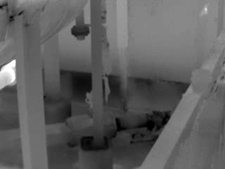
PID survey in a process unit with a broken pressure relieve valve cont’d…

Slide 44
PID/FLIR survey at crude oil tank farm
During a tank farm survey (Kern Oil, Region 9) PID readings upwind and downwind isolated an internal floating roof crude oil storage tank that was emitting vapors through the rim vents as later imaged using a FLIR GasFinder.
Tank inspection revealed that the top of the internal floating roof was covered with oil, in violation of the local air pollution regs…

Slide 45
PID survey at crude oil tank farm cont’d (IFRT)…
Notes:
Question: Is something wrong with this tank? A: Yes, the internal floater was under oil. Violation of CA APCD regulations.

Slide 46
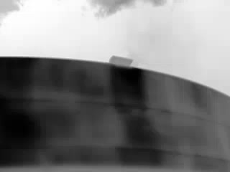
PID survey at crude oil tank farm cont’d…the FLIR video

Slide 47
Diesel Tank PID Survey (Weak Source)
Notes:
Is this a tank to worry about? No.

Slide 48
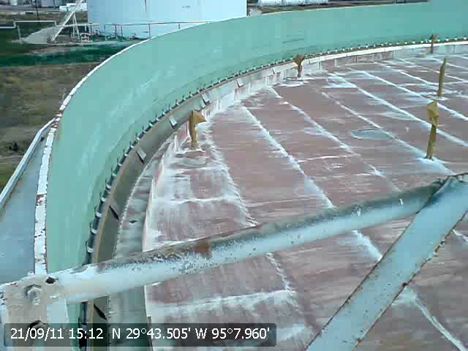
Diesel Tank A-309: Recent Controls

Slide 49
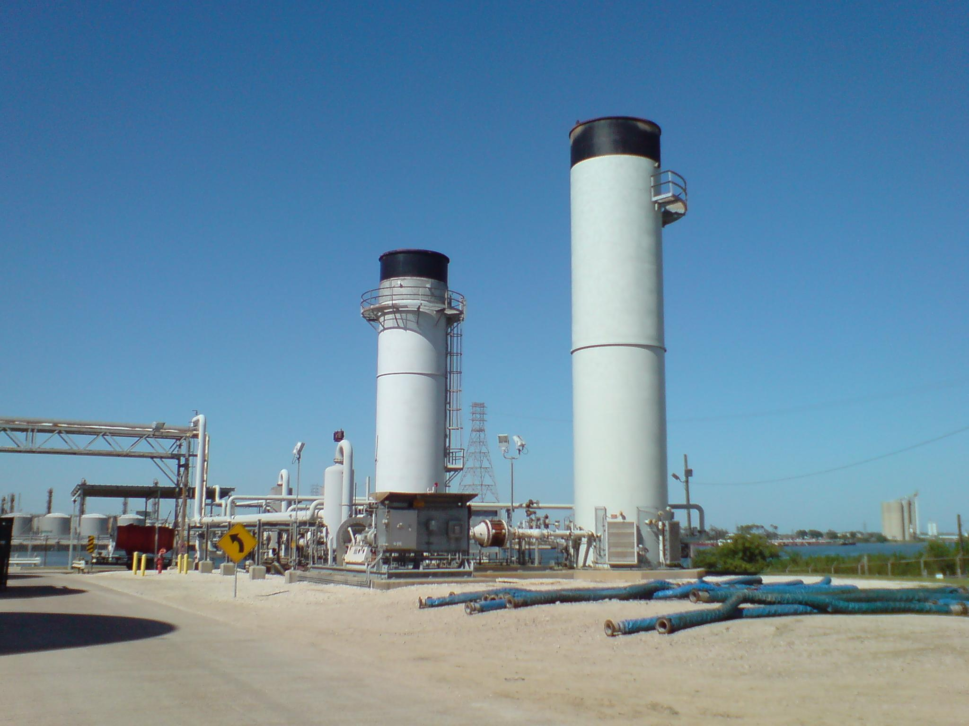
FLIR Survey – Enclosed Flares

Slide 50
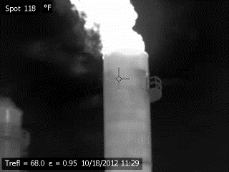
VOCs from Enclosed Flare

Slide 51
PID and FLIR Surveys…
… can locate strong sources in the midst of weak sources, e.g., storage tank farms.
… help us decide which of the many process units at a plant are the ones that we should focus our greatest attention on.
… “screen” process areas for LDAR comparative monitoring.
… in short, instrumental surveys are done to investigate a facility’s emissions and help us focus our enforcement authorities on the strongest sources.

Slide 52
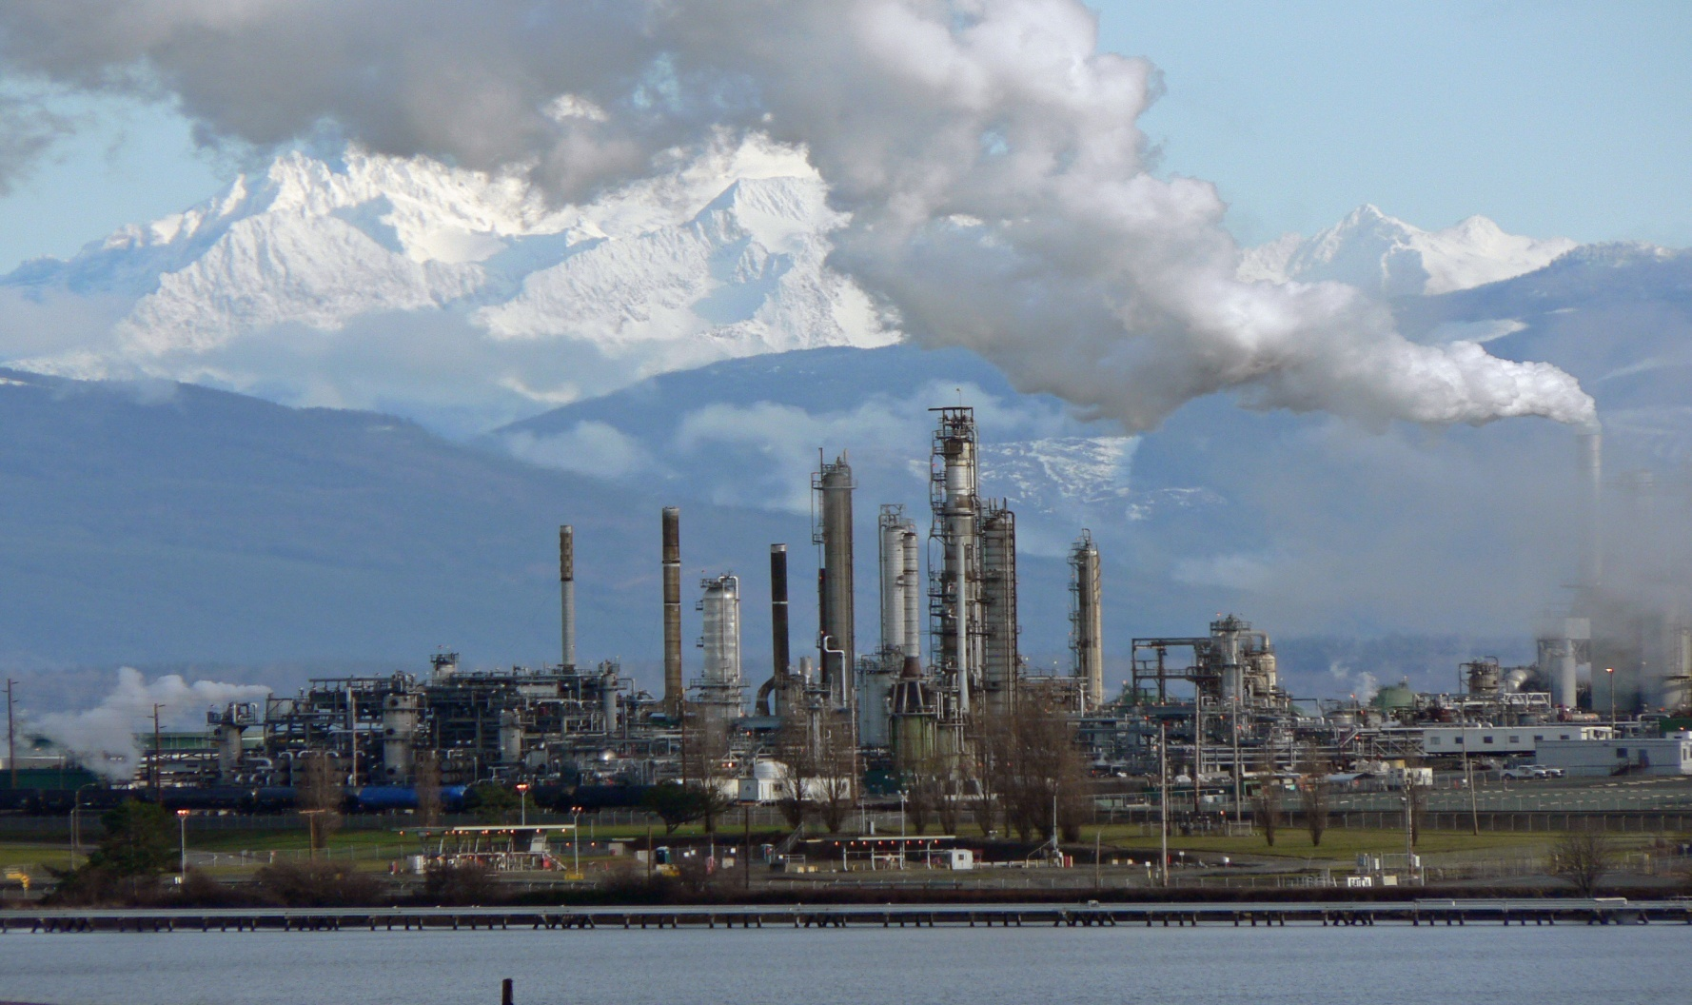
Leak Detection Monitoring
Notes:
Washington

Slide 53
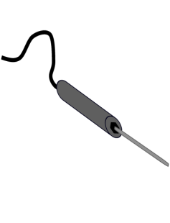
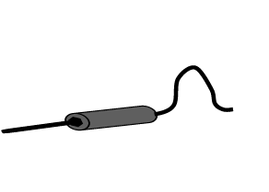
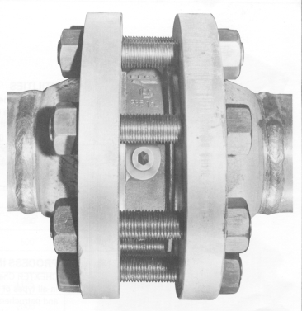
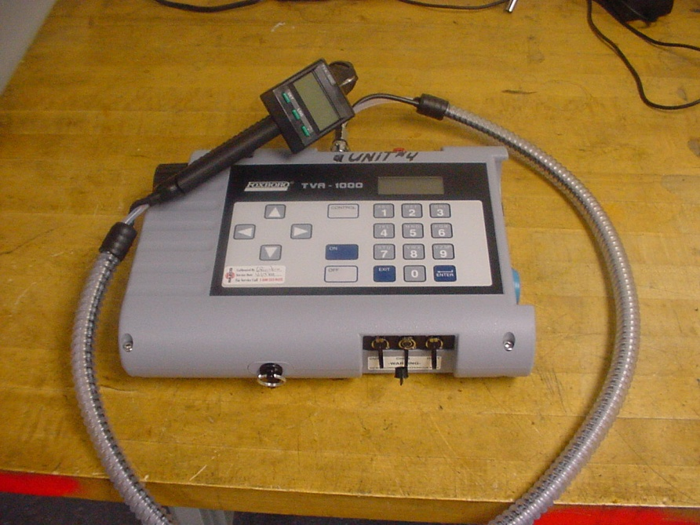


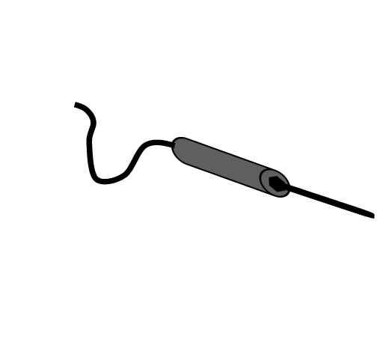
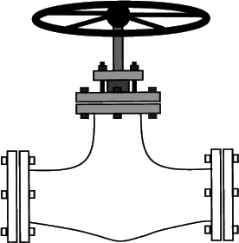

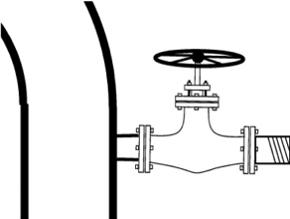

Leak Detection Monitoring
1000’s of valves and connections that must be monitored for leaks
90 to 99% of valves and connections are not leaking
Costly, monotonous, time consuming
Work is contracted out to lowest bidder, technicians often uneducated and complacent
Notes:
Federal regs to check for valves and flanges
LDAR Leak Detection and Repair required of facilities. Some states go out with them. NEIC found more leaks than the facility did.
Organic Vapor Analyzer (OVA’s) are difficult to calibrate and maintain.

Slide 54
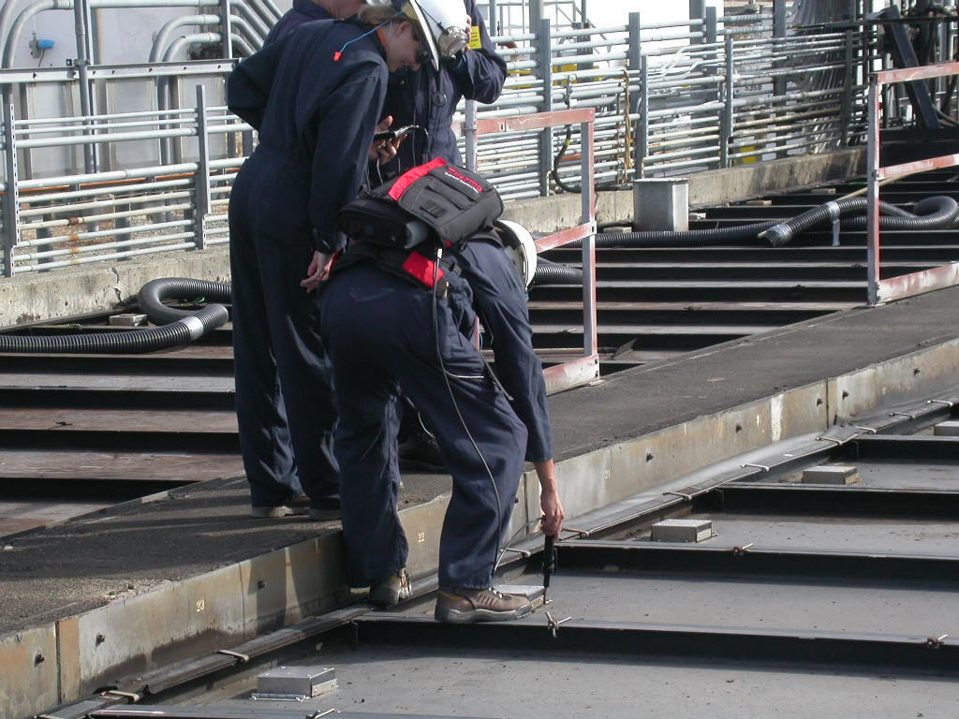
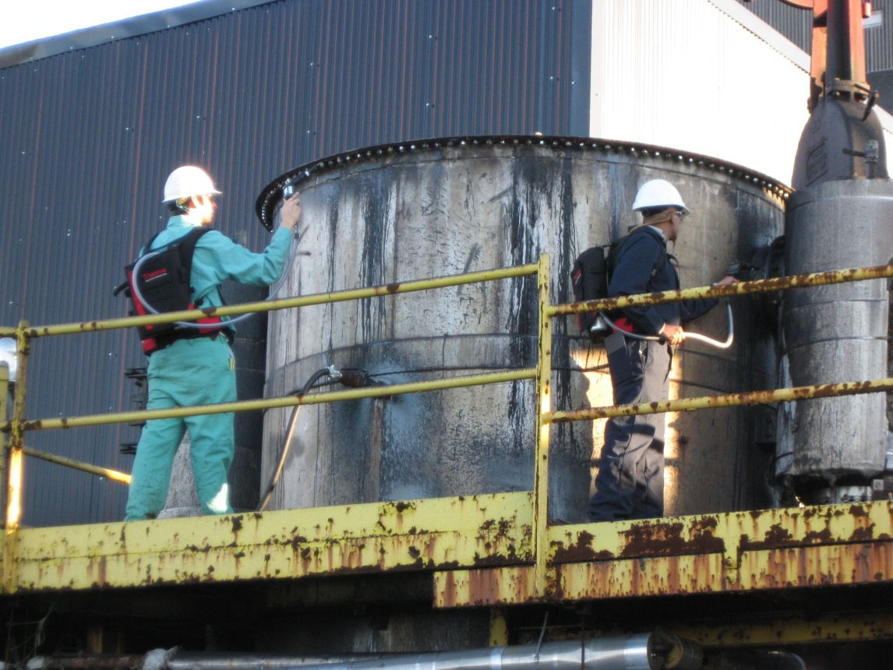
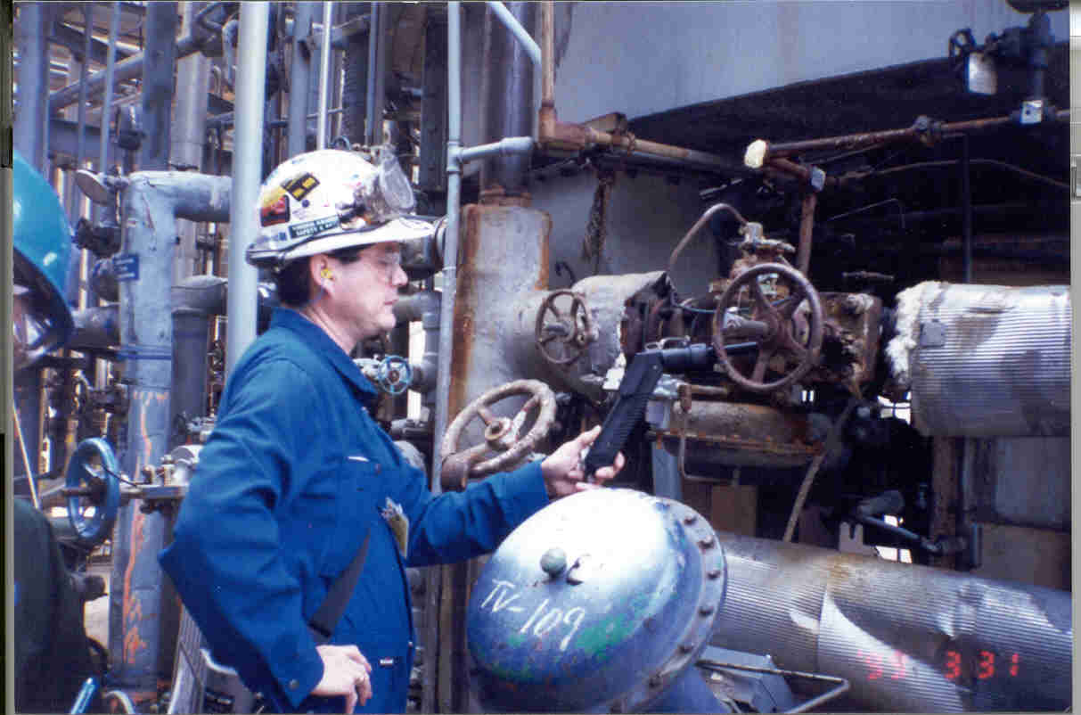
Leak Detection Monitoring
Notes:
Safety considerations

Slide 55
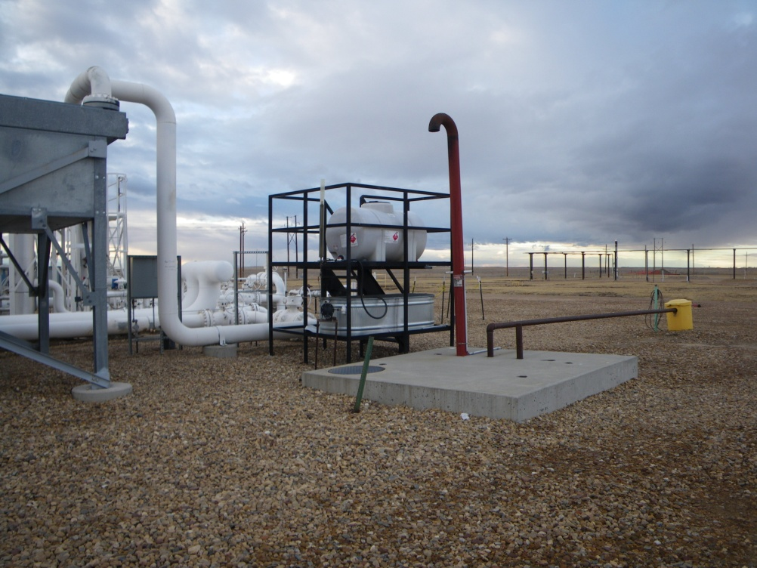
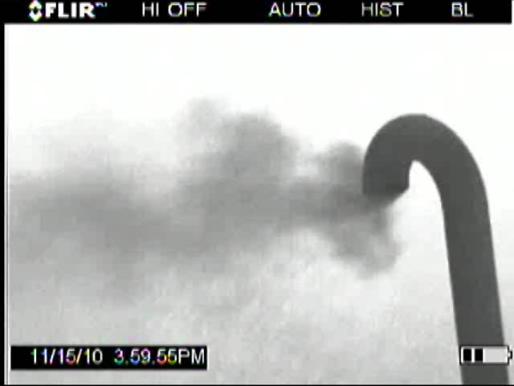
Examples From Real Inspections
Compressor distance piece oil sump at a natural gas compressor station
  Distance piece is designed to prevent lubricating oil from leaking into the compressor cylinder.
  Distance piece also acts as a process gas leakage control device
  Compressed gas was leaking passed the packing rings and carried over into the oil sump
Notes:
Landfills also emit methane

Slide 56
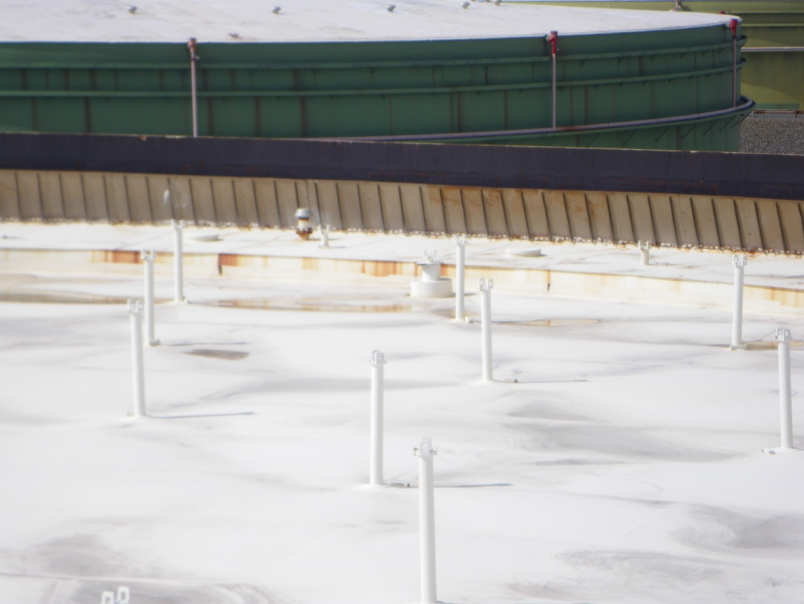
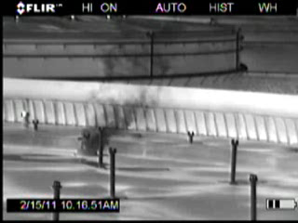
Examples From Inspections
Storage vessel bleeder vents must be closed at all times unless the tank roof is being landed or floated off the leg supports
Notes:
Floating tanks

Slide 57
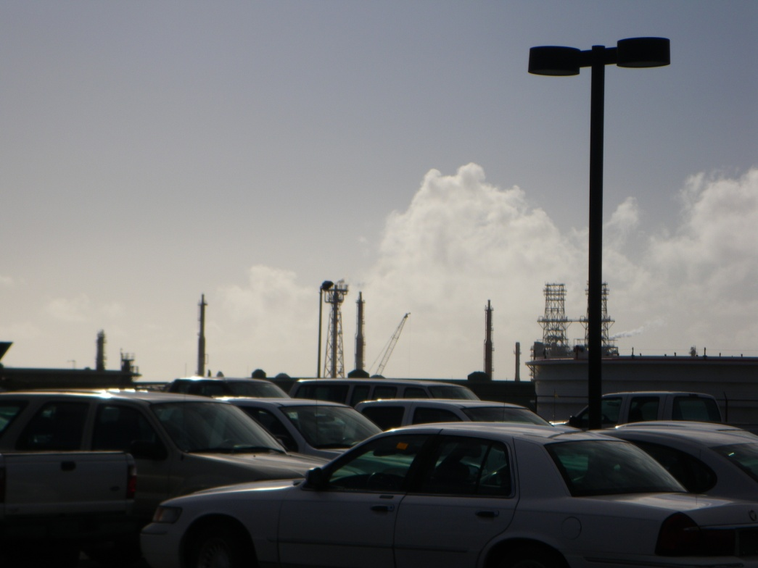
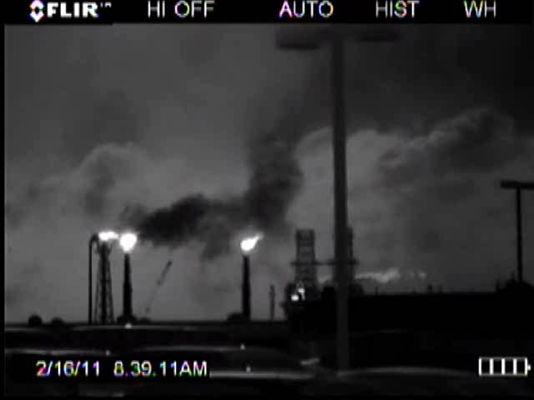
Examples From Inspections
Refinery Flare
  Excess steam = incomplete combustion of hydrocarbons
Notes:
Flares from petroleum refineries.
Also used on the Mississippi River to check for leaks from barges

Slide 58
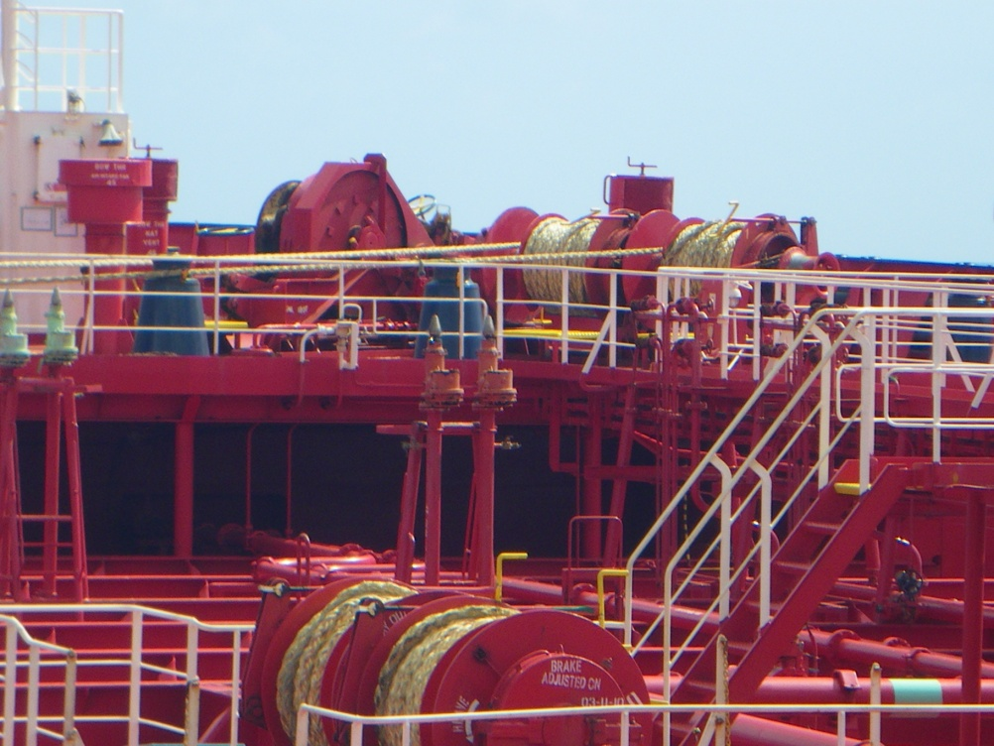
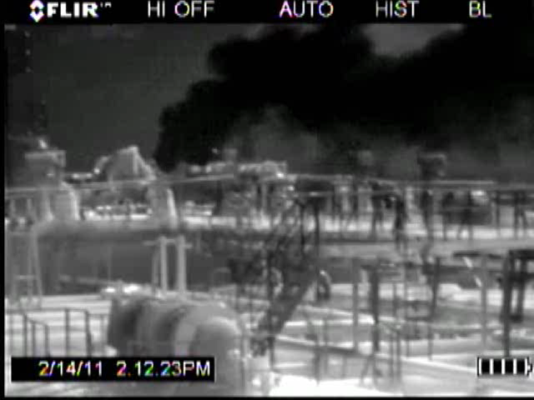
Examples From Inspections
Marine tank vessel loading operations at a refinery
Notes:
Marine vessels

Slide 59
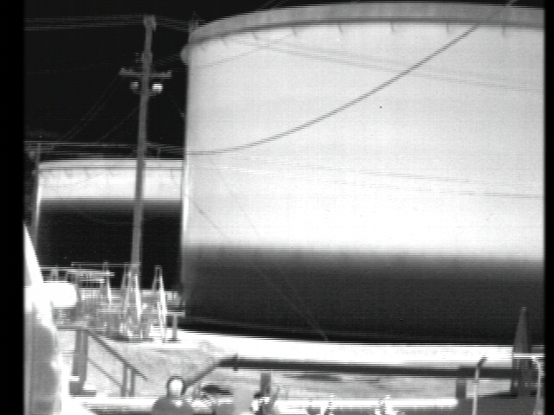
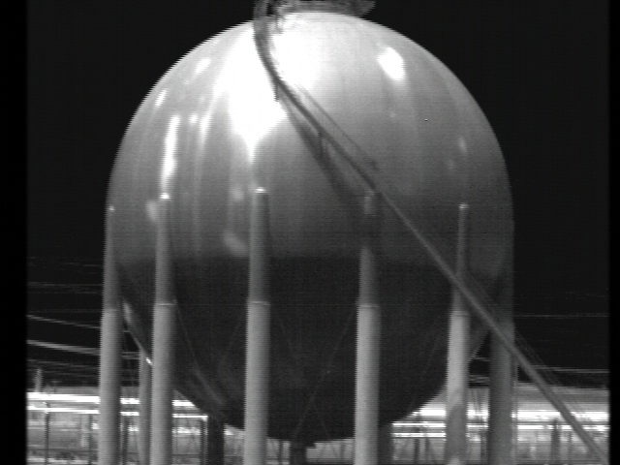
Tank Levels
Differences in temperature due to heat capacity of fluids
Notes:
Can be use to measure tank levels due to infrared signature

Slide 60
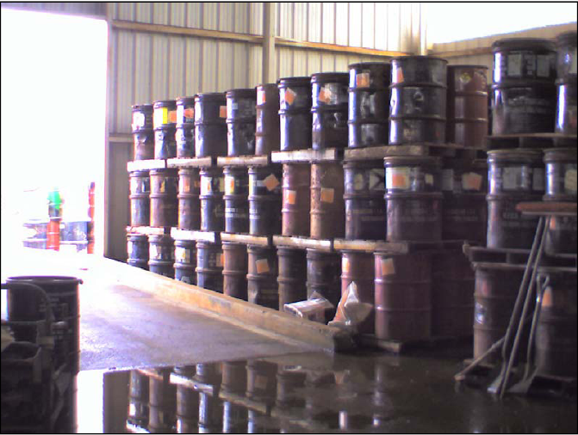
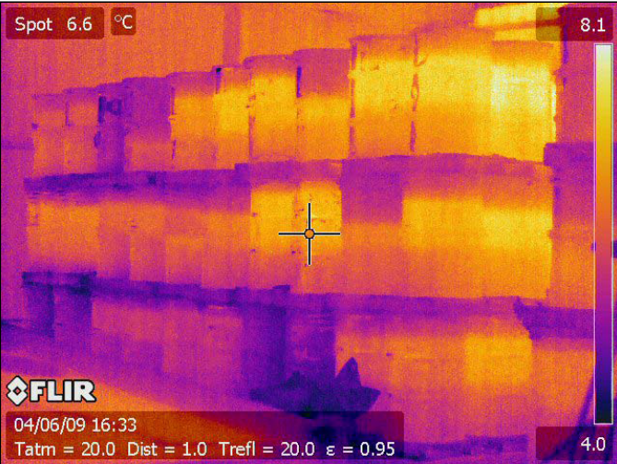
Drums

Slide 61
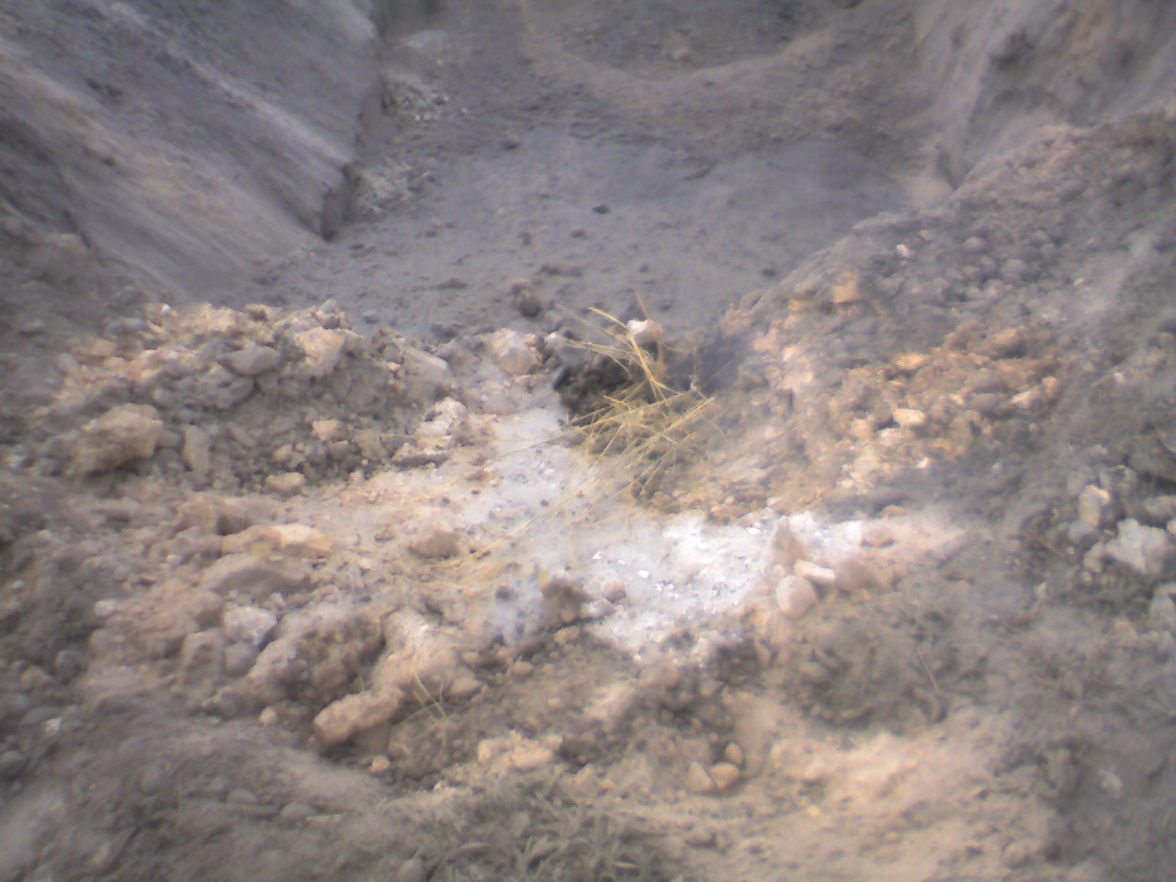
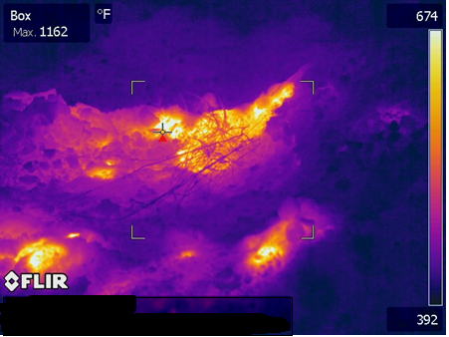
Temperature Readings
Fruit processing plant waste dumped in a pit
Exposure to air and decomposition caused it to heat up
IR camera used to see elevated temperatures
Notes:
Burning solid waste. A guy walking over this pit burned his feet

Slide 62
Any Questions?

Slide 63
Conducting Process-Based CAA Inspections and
Major Source MACT 101
US EPA NEIC
May 8, 2018

Slide 64
What’s This All About?
  The value of process-based inspections
  Focus on hazardous air pollutants (HAPs)
  Air Toxics/MACT general overview
  Major source requirements for HAPs
  HON case study
  Sources of industrial emissions and control requirements

Slide 65
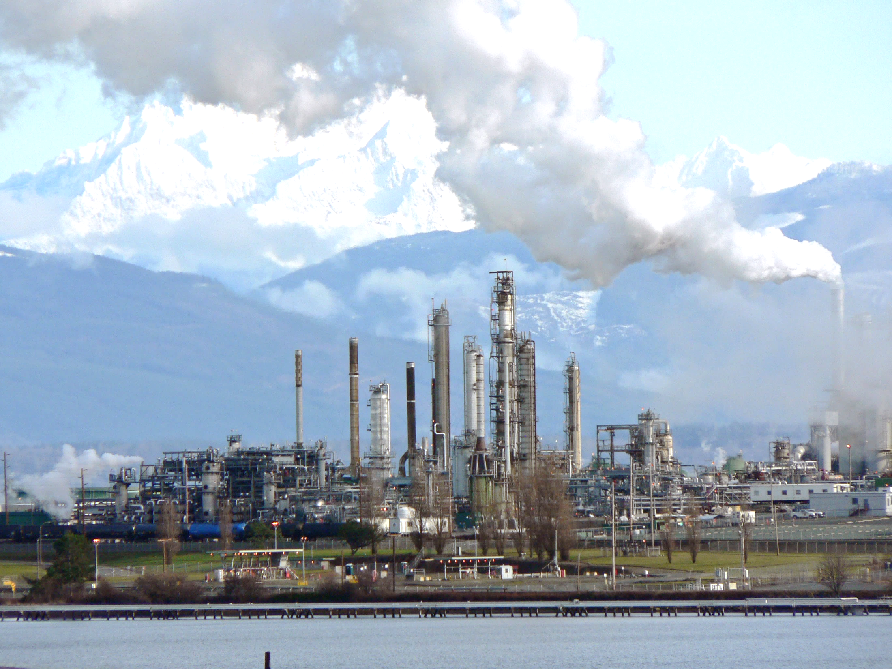
Overwhelmed?
How do you approach inspecting a facility like this??

Slide 66
Process-Based Inspections
Evaluation of compliance requires an understanding of both the regulatory requirements and their application
The purpose is to obtain an in-depth knowledge of facility operations and use this knowledge to make informed regulatory compliance evaluations.

Slide 67
Process-Based Inspections
Tracking the raw materials and identifying by-products, co-products, and products
Understanding how each piece of equipment is used
Identifying wastes that are generated
Determining how wastes are ultimately managed
FIRST you gain a comprehensive understanding of facility processes.
THEN you apply the regulation to the process.

Slide 68
MACT Standards
Maximum Achievable Control Technologies 40 CFR Part 63
AKA: National Emission Standards for Hazardous Air Pollutants (NESHAP) for Source Categories
1990 Clean Air Act Amendments passed under President George Bush
Congress provided a list of HAPs (now 187 of them)
EPA mandated to generate a list of categories of sources that emit HAPs (petroleum refineries, pulp and paper mills, hydrochloric acid production, etc.)
Regulations must be developed for each source category

Slide 69
MACT Standards
Developed as technology-based standards
  Emission standards for existing sources shall not be less stringent than the average emission limitation achieved by the best performing 12 percent of the existing sources (if more than 30 sources)
  New sources in a category/subcategory: not less stringent than emission control achieved by best controlled similar source
  8 years after implementation: EPA shall evaluate the residual risk to public health. If the residual risk is not protective to public health with an ample margin of safety, EPA must promulgate health-based standards for that source category to further reduce HAP emissions
  Less stringent standards are allowed for area sources

Slide 70
MACT Standards
Examples
  Subpart S – National Emission Standards for Hazardous Air Pollutants from the Pulp and Paper Industry
  Subpart LL – National Emission Standards for Hazardous Air Pollutants for Primary Aluminum Reduction Plants
  Subpart GGG – National Emission Standards for Pharmaceuticals Production
  Subpart XXXX – National Emission Standards for Hazardous Air Pollutants: Rubber Tire Manufacturing
  Subpart OOOOOO – National Emission Standards for Hazardous Air Pollutants for Flexible Polyurethane Foam Production and Fabrication Area Sources
  Subpart HHHHHHH - National Emission Standards for Hazardous Air Pollutant Emissions for Polyvinyl Chloride and Copolymers Production
More than 150 Source Categories!!!!

Slide 71
Common Elements of Major Source MACT Standards
Applicability
  Defines the boundaries of the source regulated by the rule (i.e., specific activities or a certain process within a plant site)
  Major source – Potential to emit 10 tons per year (tpy) of a single HAP or 25 tpy of a combination of HAPs
40 CFR Part 63 Subpart A – General Provisions
  Each standard has a reference table identifying which parts of the general provisions apply (e.g., continuous monitoring system [CMS] requirements)
  Each rule may have its own CMS requirements, or reference the general requirements in Subpart A
Definitions
  Defines all the terms used in the specific regulation

Slide 72

Common Elements of Major Source MACT Standards
The Emission Standard
  Specifics on how much emissions need to be reduced and how to do it (facility can choose from list of compliance options)
Notifications
  Notify EPA and the state that facility is subject to specific regulation and how they will comply
Recordkeeping
  Results of performance tests, analytical results, engineering estimates, continuous monitoring data, etc.
Reporting
  Periodic reports are required to be sent describing SSM events, excess emissions, non-compliance, results of any testing, process changes, etc…

Slide 73

MACT - Choose your own adventure
MACT rules developed with industry and public feedback, and there is more than one way to reduce emissions for a given chemical
  For many source categories, facilities can choose a control technique (e.g., a condenser, an incinerator, or a flare)
  Depending on the choice of control technique, the parametric monitoring, performance testing, and recordkeeping will vary
  The choices made by the facility need to be included in the facility’s Notification of Compliance Status Report (NOCSR) and also should be described in the facility Title V permit (if it’s well-written)

Slide 74
MACT Case Study: HON
40 CFR Part 63 Subpart F – National Emission Standards for Organic Hazardous Air Pollutants from the Synthetic Organic Chemical Manufacturing Industry
Subpart G – National Emission Standards for Organic Hazardous Air Pollutants from the Synthetic Organic Chemical Manufacturing Industry for Process Vents, Storage Vessels, Transfer Operations, and Wastewater
Subpart H – National Emission Standards for Organic Hazardous Air Pollutants from the Synthetic Organic Chemical Manufacturing Industry for Equipment Leaks
All three of the above make up the Hazardous Organic NESHAP, or “the HON”

Slide 75
HON Case Study
This rule gets a special call-out… it was one of the first MACT standards, and encompasses a very large category of the synthetic organic chemical manufacturing industry
Standards established in the HON are referenced by several subsequent MACT standards (i.e., Polymers and Resins IV, MON, PAI, and Pharmaceuticals). However, each individual MACT standard has slightly different requirements due to the evaluation of the top 12% best performers in each source category

Slide 76
HON Case Study
HON controls emissions of organic HAPs by requiring facilities to identify each process vent, wastewater stream, transfer operation and storage vessel and determine the “Group Status” of each
Group 1
  Generally requires add on controls (Control devices and/or control techniques)
  Requires performance testing/engineering estimates to determine control device efficiency
  Requires parametric monitoring to ensure proper operation of control devices
Group 2
  Generally needs no additional controls
  May require inspections
  Requires re-evaluation when process changes occur
  May require monitoring and recordkeeping
HON also controls fugitive emissions (equipment leaks) through the work practice standard of leak detection and repair (LDAR)

Slide 77
HON Case Study – Process Vents
Definition
A process vent is the point of discharge to the atmosphere (or point of entry into a control device) of a gas stream meeting the following criteria:
  Some or all of the gas stream originates as a continuous flow from a reactor or distillation unit
  The discharge to the atmosphere is either directly from the reactor or distillation unit, or after passing through one or more recovery devices
  And other criteria not needed to illustrate the point…
    Recovery device means a piece of equipment capable of and normally used for the purpose of recovering chemicals for fuel value, use, reuse…

Slide 78
HON Case Study – Process Vents
Once each process vent is identified, facility must either calculate a Total Resource Effectiveness (TRE) value to determine Group Status or can designate a process vent as Group 1 without calculating TRE.
TRE ≤ 1 → Group 1 process vent
TRE > 4 → Group 2 process vent
TRE > 1 ≤ 4 → Group 2 Process Vent requiring monitoring to ensure no change in group status
Group 1 process vent → must control total HAP emissions 98% or achieve 20 ppm outlet concentration
If halogenated stream is combusted – control hydrogen halides and halogens by 95-99% (dependent on date of installation of controls)

Slide 79

HON Case Study – Process Vents
Recovery device
or control device?
Point of discharge
from distillation unit
Unreacted raw material/water/final product
Vent to atm
steam
Final
product
Organic chemical
raw material
water
Liquid is collected and recovered
= process vent location → where TRE value must be determined

Slide 80
HON Case Study – Process Vents
Recovery device or control device?
Organic byproduct/
water/final product
Vent to
atm
steam
Final
product
Organic chemical
raw material
water
Organics to haz waste incinerator
Liquid is not recovered
= process vent location → where TRE value must be determined

Slide 81
Any Questions?

Slide 82
CBI Notice During Inspections
February 11, 2021
Notes:
Welcome slide

Slide 83
General Principles and Statements
Principle: Facilities should make every effort to make timely CBI claim to EPA or State Agency
Agency and States have an obligation to:
  notify inspected facilities of their right to claim CBI
  Address CBI as much as possible on the front end of the process
  Ensure proper handling of CBI
  Reduce potential for inadvertent release
  Identify false claims

Slide 84
Purpose of This Training
To prepare inspectors in using the CBI notice forms by:
  Familiarizing inspectors with the Forms’ components;
  Explain procedures for distributing the Forms;
  Confirm understanding through knowledge checks and hypothetical situations; and
  Discuss document management issues and opportunities for feedback.
Notes:
Chad

Slide 85
Background
Why are we doing this - Goals:
  Ensure consistency in conveying CBI requirements to facilities;
  Eliminate inadvertent release of CBI-claimed information; and
  Meet statutory, regulatory, and policy requirements for handling CBI.
Why now?:
  Concerns on CBI raised across EPA during development of Inspection Report Timeliness Policy and commitment to address them; and
  Alignment with other EPA efforts (e.g., rule and directive).
Notes:
Chad

Slide 86
Hypothetical Inspection
During the Inspection
An inspector visits a facility to conduct an inspection.
An inspector completes the inspection and hands the CBI Notice Form to the facility representative without any explanation.
The facility representative asks many questions that are unanswered. In response, he/she asserts a CBI claim over all of the information that was shared with the inspector.
After the Inspection
The inspector is now required to handle all of the information as CBI-claimed information. In completing the inspection report, the inspector is finding it difficult to write the report without including the CBI-claimed information and cannot release much of the inspection report in Enforcement and Complianc History Online(ECHO).

Slide 87
TRAINING AGENDA
What is and is not CBI
CBI Notice Forms
Reference Material
Implementation and Addressing Questions
Inspection reports and ECHO uploads
Audience Q&A

Slide 88
What is CBI?
Statutory: Exemption 4 of the FOIA, 5 U.S.C. § 552(b)(4), protects two categories of information:
trade secrets; and
commercial or financial information obtained from a person [that is] privileged or confidential.
Regulatory: 40 C.F.R. 2.201(c)
any information that pertains to the interests of a business,
developed or acquired by that business
received from any person, firm, partnership, association or other public or private organization, or legal entity (including a foreign, State or local government)
which contains trade secrets or commercial or financial information that is privileged or confidential

Slide 89
What is potential CBI generally:
Sales or marketing strategies
Formulas, processes, or devices
Manufacturing or quality control processes
Description of technology used at a facility
Industrial process descriptions, plans, drawings or other schematics
Production volumes of chemicals
Importing or processing information
Financial data
Contractor information or other third-party information
Customer and supplier lists
Profit and loss data

Slide 90
What is not CBI (generally)
Information that is available to the public
Information submitted to EPA without a CBI claim
Information determined to be not entitled to confidential treatment

Slide 91
What Is Not CBI (by statute)
The following is public information under the statutes listed below:
Clean Air Act (CAA): emissions data
Comprehensive Environmental Response, Compensation, and Liability Act (CERCLA): physical properties of hazardous substances, and geologic, hydrogeologic, and groundwater monitoring data
Clean Water Act (CWA): effluent data
Resource Conservation and Recovery Act (RCRA): material safety data sheets and manifest data
Federal Insecticide Fungicide and Rodenticide Act (FIFRA): names of pesticides, active ingredients, information concerning the effects of the pesticide, and data on safety to fish and wildlife, humans and other mammals
Toxic Substances Control Act (TSCA): health and safety data

Slide 92
Knowledge Check
What items may not be CBI?
Facility equipment
Facility layout
Number of workers
Pictures of the facility taken from the street
Monitoring devices
Pictures of discharge pipes
Facility address
Chemicals used on site
Mass quantity of raw materials and products
Safety protocols

Slide 93
Procedures and Timing for
Asserting a CBI Claim
Procedure and Method Sections
  Provides three options for asserting a CBI claim.
    Timing: CBI claims should be asserted at the time of the inspection, within 10 days after the inspection, or at the time of submission if submitted before or after the inspection.
    Method for asserting a CBI claim.
  Describes the consequence for not asserting a CBI claim.
Other CBI Considerations Sections
  Substantiation
  Certain information not entitled to confidential treatment
Notes:
Remember that we are going over the form. The implementation section of this training will go into further detail.

Slide 94
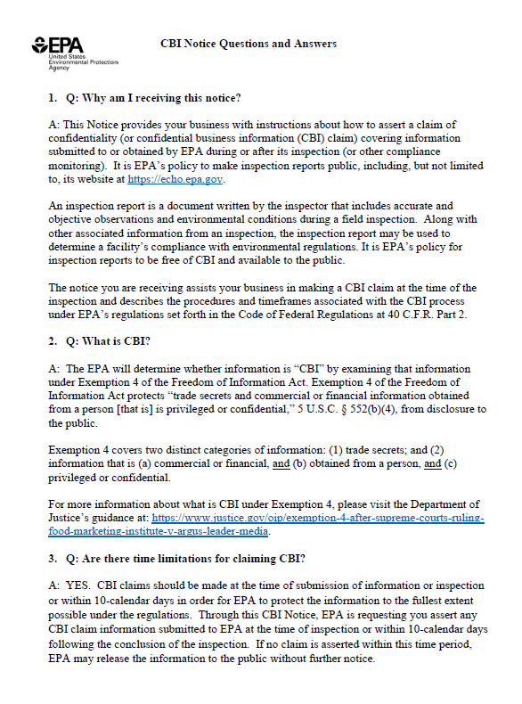
Question & Answer Document (on Wiki)
Purpose
To help inspectors respond to facilities’ questions about the Forms.
Provide consistent and accurate responses to affected businesses.

Slide 95
Question & Answer Document
Q&A Topics
What is and is not CBI?
EPA’s authority to collect CBI.
EPA’s CBI handling procedures.
Methods of asserting CBI claim.
Consequences of making and not making a CBI claim.
Consequences of not signing form.
Who is authorized to make CBI claims.

Slide 96
Knowledge Check
Question – An inspector thinks to themselves that I know nothing here will be CBI because they are a municipality facility, therefore I do not need to provide them a CBI notice. Is this a correct assumption?
Yes/No, Why?

Slide 97
Knowledge Check
Answer – No. An inspector must provide a CBI Notice Form at each inspection.

Slide 98
When to Raise the CBI Issue?
Options:
Prior to an announced inspection, as appropriate
    Include a point of contact for questions about the form
    Provide the Form in the written communication (if there is any)
During an opening conference (for announced or unannounced)
    You can use scripted language
    You can provide the Form at the opening conference
During the closing conference (for announced or unannounced)
    If you haven’t already, you must provide the form and answer questions no later than closing
    Include the Q&A documents with the notice as appropriate
      If you think that it would be information overload, then you can send that Q&A before or after the inspection or at the closing conference

Slide 99
Script when providing the Forms
Announced Inspections:
  At the Opening Conference:
    “Any information that we may discuss or any documents you may provide, I will have a form for you to make any confidentiality claims. The reason I am making you aware of this up front is because if we do get into anything that you would consider confidential, I ask that you please make me aware of it at that time so I can make a note of the specific CBI claim.”
Unannounced Inspection: Same language as “Opening Conference” dialogue.

Slide 100
Knowledge Check – Timing
Question – An inspector thought to save time upfront on an inspection by deciding to wait to mention the CBI topic during the exit conference. Do you think the inspector made a wise and efficient decision?
If Yes/No, Why?

Slide 101
Knowledge Check - Timing
Answer – The Workgroup does not recommend this approach.
  You should provide the CBI Notice Form at the opening conference—this allows the facility rep to make the inspector aware throughout the inspection of any CBI the inspector is collecting.
Waiting to the end can cause confusion and delay:
  The facility rep will have to try and recall all that was stated and photographed during the inspection and may request to review your inspection notes and the documents they provided to you

Slide 102
Knowledge Check (cont.)
Practice Tip: If you have a good rapport with the facility representative you could discuss the reasons for the CBI claim as you go through the inspection, for example:
  Any stated information obtained during discussions (e.g., those ingredients I just told you are CBI);
  Documents the inspector asked for (e.g., this document contains my pricing information which is CBI); and/or
  Photos (e.g., that container you are taking a photo of contains my customer’s names which is CBI).

Slide 103
Scenarios for Assertion of CBI Claims
  No CBI claims asserted
    Check “do not make any CBI claims” box.
    No response.
  CBI claims asserted
    Authorized Representative completes the form with the inspector.
    Authorized Representative does not complete the form but promises to send it within 10 days.

Slide 104
Handling CBI or Potential CBI
When a CBI claim is asserted on the Notice Form
  While onsite: Identify, safeguard, and follow existing procedures.
  When back in the office
    Follow existing document control procedures for your program.
    Do not include CBI (or Personally Identifiable Information-PII) in the public version of the inspection report.
    Consider whether any or part of the information needs to undergo a confidentiality determination.
Within the initial 10-days
  Note the file as containing information that may be entitled to a confidentiality claim and track the 10-day time frame

Slide 105
How to Respond to Questions
Related to CBI Claims
  Notice and Q&A describe generally what type of information is entitled to a confidential treatment and what is clearly not entitled to confidential treatment
Related to Notice Form and/or Q&A
  Familiarize yourself with both documents
Provide point of contact information

Slide 106
Unanticipated Issues or Questions
QUESTION: What do you do if you encounter an issue or question that is not addressed in the Q&A Document or Implementation Questions?
ANSWER: Contact your Agency point of contact or attorney.

Slide 107
Knowledge Check – Identifying
CBI for Proper Handling
Scenario
The facility rep explains the facility’s manufacturing process including the raw materials used and a general description of the process steps used.
The inspector took notes in his/her logbook of what was stated and took some photos inside the warehouse where the raw materials are stored.
Later during the inspection, the inspector was provided a document that contained a brief description of the process and a list of the raw materials used and their concentrations. The facility rep listed this document on the CBI Notice as CBI.
Question: What will the inspector have to handle as CBI?

Slide 108
Knowledge Check – Identifying CBI for Proper Handling
Answer – Anything stated/shown on a document that was claimed CBI would have to be handled as CBI in EPA’s notes and/or photos.
Practice Tips:
  When a specific document that was claimed as CBI contains information that you noted or photographed, mark your notes and photos with a CBI claim
  Ask the facility rep to include your notes and photos documenting the information on the Notice Form that they sign and use the opportunity to get specifics on the scope of the claim. For example, maybe it is not the name of the raw materials that is CBI but their concentrations.

Slide 109
How do you handle the information during the 10-day period?
If no form has been received and the authorized representative has not checked the no CBI box:
Then you have a 10-day embargo period.
  MEANING: Do not disclose any information or the inspection report during this time. This includes not disclosing to anyone at EPA who does not have a need to know the information, and take appropriate steps to prevent the disclosure.
What can you do during the 10-day embargo period?
You can write your inspection report and proceed to getting it finalized.
NOTE: Please do not disclose this information to anyone without a need to know the information, but especially the public.
Check or confirm whether the facility has any CBI claims.

Slide 110
Knowledge Check – Late Claims
Scenario: The facility rep marked form to indicate they were not making CBI claim. Five days after the inspection, the facility rep calls the inspector and states that management has decided they wanted to claim one of the documents as CBI.
Question: What should the inspector do?

Slide 111
Knowledge Check – Late Claims
Answer – This is a late claim, and a regulation that applies, 40 CFR 2.203(c) says:
  “If a claim covering the information is received after the information itself is received, EPA will make such efforts as are administratively practicable to associate the late claim with copies of the previously-submitted information in EPA files (see § 2.204(c)(1)). However, EPA cannot assure that such efforts will be effective, in light of the possibility of prior disclosure or widespread prior dissemination of the information.”
Steps:
Inform the rep that this is a late claim and request they send an email asserting the CBI claim.
Start handling the info as CBI and get the contact info for the correct person and send the form to them for signature.
Advise that EPA will take “administratively practicable” efforts, but we cannot assure they will be effective.

Slide 112
LATE CBI CLAIMS:
What is administratively practicable?
Within or close to 10 days?
Prior notice of late submittal?
Inspection report already finalized?
Included in the final inspection report?
Large/complex claim or minor/insignificant?
Made before uploading?
Associated workload/availability of the inspector?
Clearly not entitled to confidential treatment?
Already disclosed?

Slide 113
Approaches for Late CBI Claims
Submitted After 10 Day Period
Inspector should
Consult with Office of Regional Counsel (ORC) about whether EPA is able to take "administratively practicable" measures to protect the information.
Inform the facility this is a late claim and advise that EPA will take “administratively practicable” efforts, but we cannot assure they will be effective.
Start handling the info as CBI and if claim is not in writing, get the contact info for the correct person and send the form to them for signature.
ORC should
Assist the inspector on whether the information can still be protected as CBI-claimed information.
Inspector should
If administratively impracticable, then you must work with ORC to inform the submitter that we are unable to protect the information falling within the late claim.
If it is administratively practicable to protect the information, then redact the information.
Continue writing the inspection report, concurrence and signature process.
Upload final inspection report.

Slide 114
Possible Administratively Practicable Approaches for Late CBI Claims
Submitted after inspection report is uploaded, but within the 3 business days
Inspector should:
  • Remove the posted report from ICIS/ECHO
  • Consult with ORC
  • Provide a limited timeframe to provide more information if necessary
  • Redact information if necessary
  • Re-route the revised inspection report for signatures as necessary
  • Upload the revised inspection report and resend notice to facility

Slide 115
Appendix: Additional Resources
CAA Emissions Data

Slide 116
CAA: Emissions Data
CBI Regulations 40 C.F.R. 2.301: “emission data” or “standard or limitation” are not eligible for confidential treatment.
56 Fed. Reg. 7042: emission type, emission rate, concentration, density of the emission stream and facility identification fall within the definition of “emission data.”
Prior Determinations: examples include Generating Availability Data Systems (GADS) data, FLIR camera data, LDAR data, defeat devices, process materials e.g., coal content and material balance.

Slide 117
Questions?

Slide 118
Review the National Air Compliance Training (NACT) Schedule for your State.
This is the LAST SLIDE!

