Slide 1
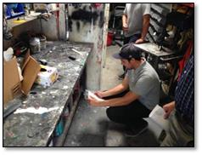
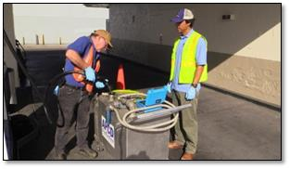
Welcome
Advanced Inspector Training
NACT 355
Notes:
Rev date 10.18.16 by Lisa Brown
Handouts the first day: PowerPoint, ECHO print out for the local area
Possible examples of the EPA compliance assistance, inspector sector notebook
Titles are Calibri; slide text is Arial; bullets and all text are white (some are blue?); background design suppressed
Need flipchart
List of materials for practical exercise is separate

Slide 2
Instructors/Facilitators
Mary Boyer
4mboyer@gmail.com
Lisa Brown
lisafbrown16@gmail.com
Notes:
Introduce yourselves

Slide 3
Administrative
Facilities
  Rest Rooms, Emergency Exits
Schedule/breaks
Lunch
Sign-In Sheet

Slide 4
Ground Rules
Ask questions
Participate
Provide instructors with benefit of your experience
Be on Time
Feedback on Evaluations - Online
Notes:
Deleted slide describing materials

Slide 5
Required to Receive Certificate
Sign in every day
Must fill out evaluation

Slide 6
This Course
Lecture/seminar/facilitated discussion
Participation is critical - this is your class
To develop/expand existing skills/knowledge
New materials and enhanced refresher training
Does not focus on any one program or set of regulations - provides fundamentals for all programs

Slide 7
Course Agenda
Day 1
Introduction/Purpose of Course
Inspect Like a Veteran
Photography
Practical Exercise (interviews, sampling and report writing)
Day 2
Review Group Inspection Reports
Entry/Evidence Elements
Interviewing Skills and Practical Exercise
CEMS Basics
EPA Field Technology
How To Be An Effective Witness
Day 3
Inspector Discussion Groups
Description of Criminal Program
IR Cameras/LDAR/Process-Based Inspections
Confidential Business Information
Review and Course Feedback

Slide 8
Policies, Procedures, and Practices
Course presents “best” practices
Inspectors must adhere to their AGENCY’s policies and practices
Consistency is crucial to creditability of the inspector and admissibility of evidence
Notes:
Emphasize that his course presents best practices, not necessarily the only way to proceed and individuals should follow agency policies and procedures.
Consistency and adherence to agency policies and procedures is paramount.
Inconsistency and non-adherence to agency policies and procedures is what destroys witness credibility and evidence admissibility.

Slide 9
Audience Introductions
Your name
Your agency and program
Years of experience (with agency & other)
Number of inspections you have done
Any issues you would like to discuss?
Notes:
Make notes of 2 senior inspectors to have as the role players unless other staff is going to do that.
Alternative is to have them count off 1-4 (how ever many groups you need for the practical exercise) and have them re seat according to groups. Have them interview the person next to them and then they introduce the person they interviewed to the class. This gets them broken up from the people they work for and gets an early start on the groups for the exercise in the afternoon. Also makes this an interviewing exercise.

Slide 10
Inspect Like a Veteran . . . Right From the Start!

Slide 11

I’ve been assigned to inspect a facility!! Now what??
Perhaps you had this feeling on your first week as an inspector!
Here are the steps to review in inspection preparation:
  Assemble/Review Background Information;
  Develop Inspection Plan and Checklists;
  Review Health and Safety Needs.

Slide 12
Once we have reviewed the basics,
. . . Here are a few ways to make your inspections more expert, right from the beginning.
Tip #1:
Remember you are in charge during the inspection
Never pretend expertise you don’t possess
Feel free to request additional information
Ask any questions you need to ask, and
Maintain an air of respectful confidence with facility representatives.

Slide 13
It can be tricky to seem confident when you are starting out, but the alternative is acting like you know everything when you are actually new to the job.
Goal: balance honesty about your level of expertise with setting clear expectations about what information you need to verify compliance.
Convey the sense that you and the facility are working for a common goal (assure compliance with environmental requirements)

Slide 14

Getting to know you . . .
Review the facility permit, and any available permit-writing documents.
The permit tells you what the facility does, what conditions it must meet, and what regulations apply to the facility.
Be alert to how many permits apply to your inspection period and whether anything has changed at the facility recently.
The permit/s provide the primary basis for your evaluation of compliance.

Slide 15

Remember!
An inspector must have concrete evidence of compliance or non-compliance. Look for the basics:
  compliance monitoring,
  recordkeeping, and
  reporting
What requirements are in permits to identify what you must verify at the inspection.

Slide 16
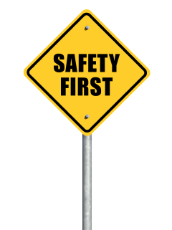
Your final pre-inspection step: Prepare equipment and a safety plan.
Create a written list of all required equipment and safety gear.
Check the status of equipment—functioning, batteries charged, backups, personal gas monitor active?
Do you have your PPE ready (e.g., fluorescent vest, safety glasses/goggles, respirator, gloves, etc.)

Slide 17

The following items are things an expert looks for in a permit.
Knowledgeable Equals Confident!
If you have more than one permit for the time period covered by your inspection, it is imperative to know if any conditions or regulatory requirements have changed during that period.
Keep track of changes to verify you are checking facilities for the correct conditions at the right time.
Determine if you can address regulatory requirements more efficiently using a checklist. An expert tries not to go over the same ground twice.
The permit conditions may not be adequate to address all relevant portions of a certain regulation.

Slide 18
Things to look for, (cont’d)
Be alert for permit language that translates enforceability. Be aware up front what is clear in a permit and what may not be enforceable.
If you think there is an error in permit language, consult with the permit writer to determine if a permitting change is needed.
Remember that you must inspect against the current permit for the inspection!

Slide 19

Rules “is” rules, buddy . . .
Regulations define in large measure how the facilities you inspect must operate. Review the state, federal and local regulations that apply to the facility.
Keep in mind that you’ll need to address all relevant regulations in your permit checklist or your individual regulatory checklists.

Slide 20
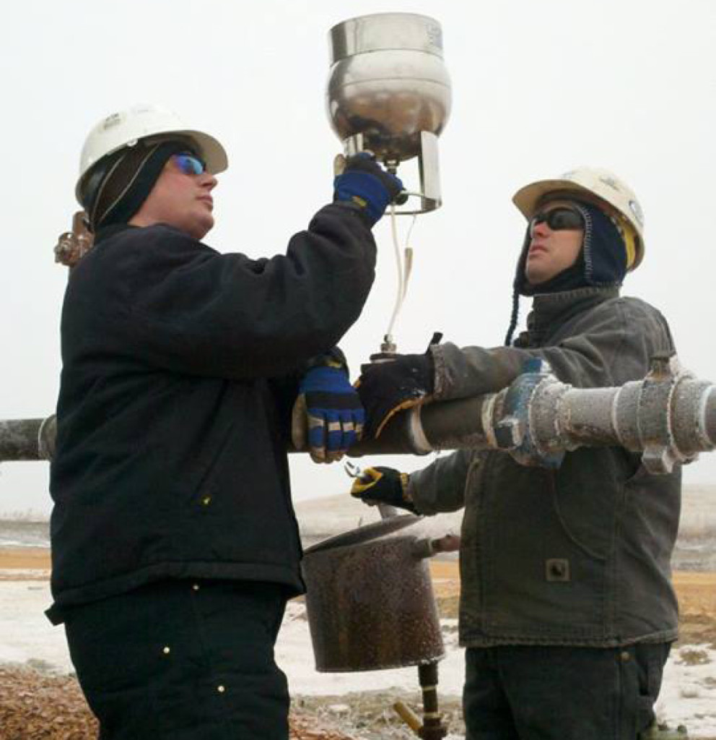
Some things an expert keeps in mind regarding regulations:
Tip #2:
Be alert to regulatory testing requirements, and how these may or may not agree with permit required testing. It is important to check to see that scheduling and test method stipulations are acceptable for both.
Tip #3:
Regulations are difficult to read and comprehend!
Keep a cheat sheet that specifies equipment type, dates of installation, source type (major, minor, etc.).
This will help you identify regulatory paragraphs/sub-paragraphs that actually apply to your facility.

Slide 21

MORE TIPS ON REGULATIIONS
Tip #4:
Ask how the facility complies with specific regulations.
During the inspection verify if the facility follows these practices. This will make it easier to pinpoint anything that seems to be out of compliance.
Tip #5:
For complex regulations, carry a hard copy or an electronic file of the full regulation in the field. If there is any question or disagreement about facility compliance, you will have a reference to check.

Slide 22
The past is a key to the present.
Review the facility compliance history:
Past enforcement actions;
Past inspection reports;
Compliance test reports, notifications;
Permit modifications or equipment changes;
Compliance orders.

Slide 23

Expert inspectors branch out from the basic permit.
Dig deep!!
Review of additional documents may show other conditions that must be assessed during the onsite inspection such as:
compliance orders,
active enforcement documents may have special conditions submitted for consent decrees

Slide 24
An expert gleans everything possible from reports submitted by the facility before going in the field:
Tip #6:
Check that recordkeeping and reporting requirements are being met to the letter.
If you identify potential recordkeeping violations, pay special attention to that part of the facility’s process, in case there is a more extensive problem.

Slide 25

Once all background information has been assembled and reviewed per your agency’s inspection guidelines . . .
. . . Go to the next part of inspection preparation:
  creating an inspection plan (written or non-written), and
  create checklists.
Questions:
Does your agency have standardized checklists for regulations or permits, or do you create your own, for Title V or NSR permits?
Does your agency have standard inspection plans?
Tip #7:
If your agency allows, fill in parts of checklists confirmed via facility reports before going into the field.
This will help you ask questions about potential problems or anything that is unclear to you about the facility process.

Slide 26
Your final pre-inspection step: Prepare equipment and a safety plan.
Create a written list of all required equipment and safety gear.
Check the status of equipment—functioning, batteries charged, backups, personal gas monitor active?
Do you have your PPE ready (e.g., fluorescent vest, safety glasses/goggles, respirator, gloves, etc.)

Slide 27
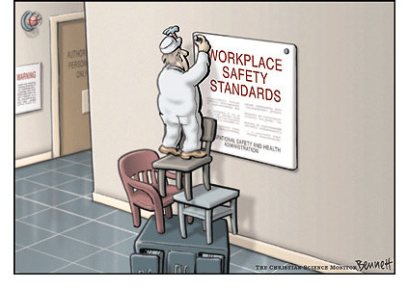
An expert does not assume nothing can go wrong based on past work
Tip #8:
Field conditions can change unexpectedly. Have all items that could be needed—better more than less!
Clear plan if you encounter unsafe or difficult working conditions (e.g., numbers for supervisor, or other staff at the office to track your whereabouts and well-being.
Take reasonable onsite safety training/briefing that a facility may require.
Obey facility staff’s safety warnings, but be prepared to exit an unsafe situation anytime you recognize a hazard, regardless of what others may do.

Slide 28
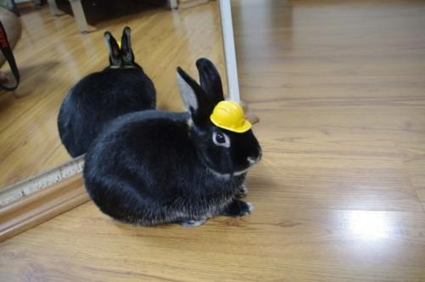
One final slide on inspections and on safety:
It’s is easy to become complacent! It happens to everyone.
Take time to remind yourself that there is nothing else is as important as your personal safety.

Slide 29
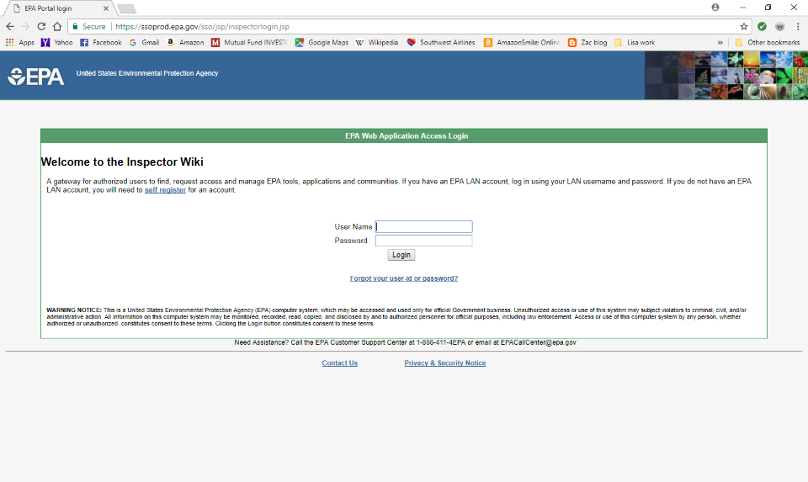
EPA Inspector Wiki
EPA Inspector Wiki URL https://inspector.epa.gov
Contact EPA staff email to sign up: use Tracy Back (Back.tracy@epa.gov)
Notes:
Email: back.tracy@epa.gov
Phone: 202-564-7076

Slide 30
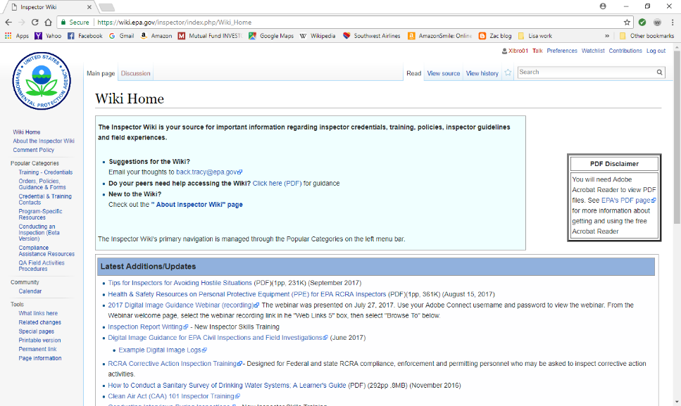
Wiki Website
Notes:
New slide

Slide 31
Questions??

Slide 32

Evidentiary Photography
For Civil Inspections
Notes:
2018 EPA & Region 6 States National AIR Inspector / Enforcement Officer Training Workshop

Slide 33
QUESTION
THE PHOTOS I TAKE IN GATHERING EVIDENCE FOR COMPLIANCE PURPOSES WILL STAND UP IN COURT?
TRUE OR FALSE?
IF FALSE, WHY TAKE THEM?

Slide 34
Digital Photography
What are digital images?
  Digital still images are files that are sampled and bitmapped as a grid of rectangular dots, picture elements (pixels) or points of color.

Slide 35
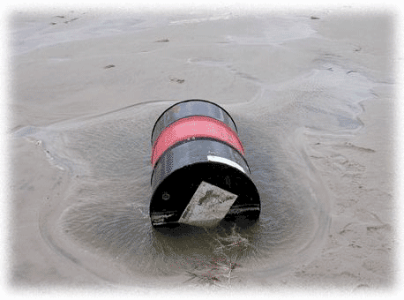
Why is Photography Important?
Preservation of scene at a particular moment
Destruction of evidence
Exposure to elements
Tells story with photos
Recreate events
Evidence in court

Slide 36
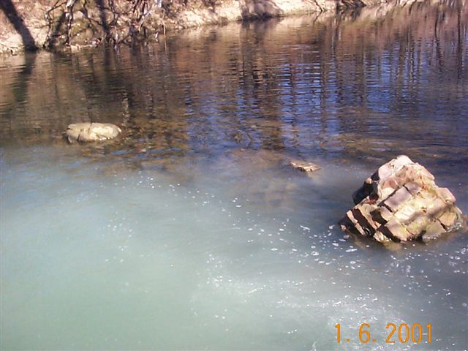
Admissibility of Evidence
Is it relevant?
Can it be authenticated?
  Fair and accurate representation of what you saw?
Easily manipulated

Slide 37


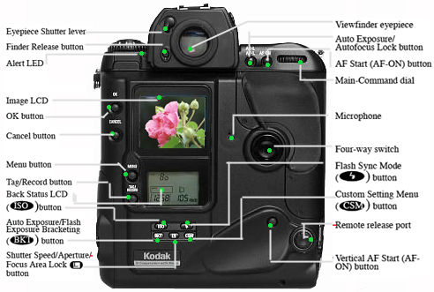

Digital Cameras
Point and Shoot?
Learn how to use the camera
Read the manual
Extra battery, memory cards

Slide 38
Photography Basics
Shutter Speed (controls light and motion)
Aperture (depth of field)
ISO (formerly film speed)
Resolution (concentration of pixels)

Slide 39

Shutter Speed

Slide 40
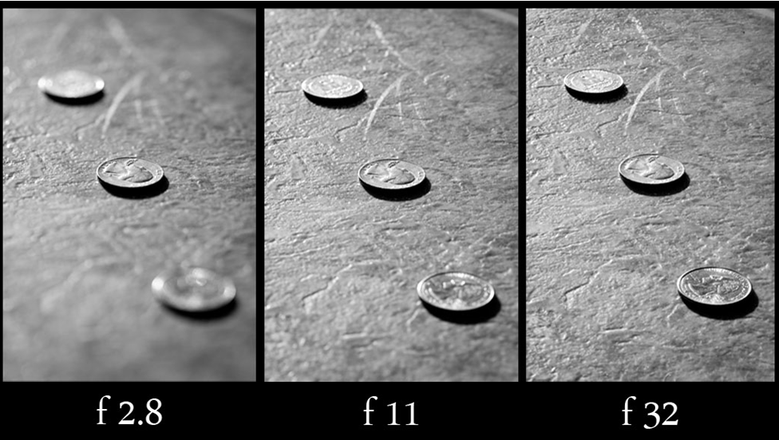
Aperture

Slide 41

ISO

Slide 42
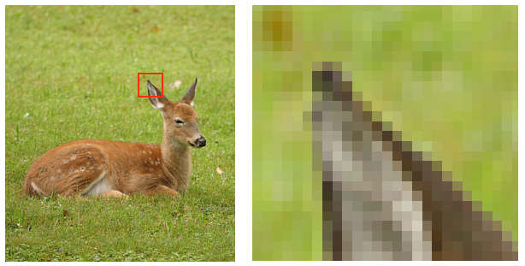

Resolution: PPP(Pixels Per Picture)
Lower setting:
  more photos per card
  Fewer cards to buy, store or carry around
  Poor image quality if enlarged (pixelated)
Higher setting:
  Fewer photos per card
  Better quality when enlarged

Slide 43
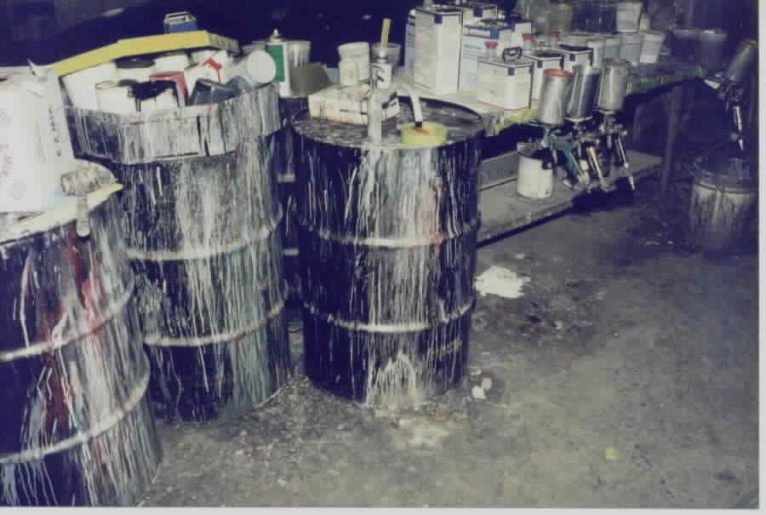
What Should You Photograph?
Object- stack, baghouse, ESP, pipe, monitoring equipment, vehicles, etc...
Place- facility operations and equipment, creek/river/ lake, parking lot, storage areas, office, etc…
Event- inspection, smoke release, complaint, clean-up, etc…
Stacks and Fugitive
Emissions

Slide 44

More specifically…
Suspected violation
  Quantities
  Chemical labels and placards
Samples collected, sampling methods
Exterior of building with company logo
Air monitoring equipment (gauges, flow charts, meters, etc.)
Discharges/Emissions

Slide 45
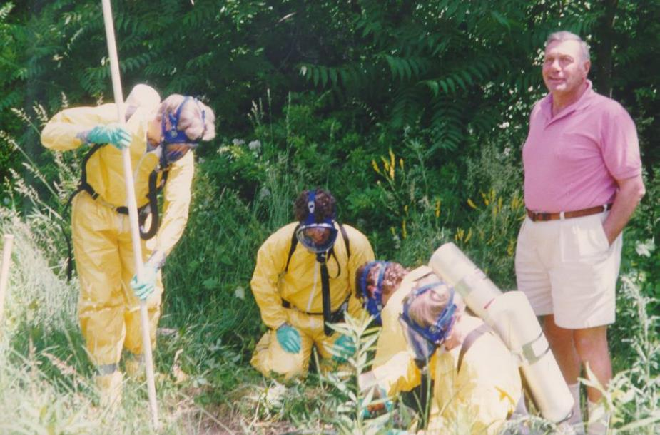

Slide 46
Approach for Using Photos to Document Violations
Your photo should tell a story using a systematic progression
  Establishing shot
  Subject shot
  Detail shot

Slide 47
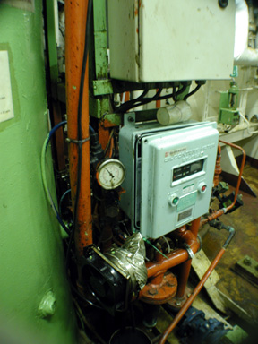
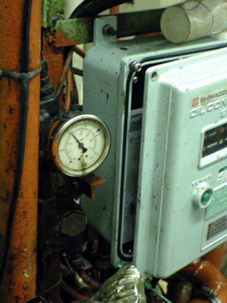
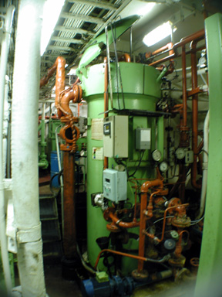
Which image accurately depicts the scene?

Slide 48


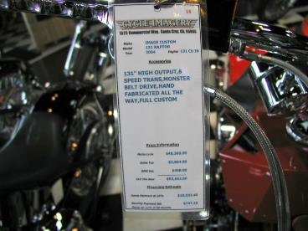
Establishing shot Subject shot Detail shot

Slide 49
Perspectives
Overall: Establishes where the violation occurred or where the event took place
Intermediate: Acquires the relationship of the items within the overall scene
Close-up: Documents the individual details of each item

Slide 50
Considerations for Close-Up
Utilize full frame
Minimize angular distortion
  90 degree angle
Compose item squarely in viewfinder
Introduce scales and markers
  Standardized reference points

Slide 51
Best Practices
Setting time/date on camera
  Date stamp
Review pictures for clarity/resolution
Utilize different memory cards
GPS capabilities
NEVER delete photographs
Document “as is” before moving anything
Reformat card between uses

Slide 52
US EPA Digital Camera Guidance
epa.gov/compliance/guidance-digital-camera-guidance-epa-civil-inspections-and-investigations
Photo evidence standard
  Authenticity
  Relevance
Notes:
New version June 2017 is 33 pages
Photography is one of the best yet poorly utilized tools. Some common problems are:
Too few photographs to accurately represent violation
Poor quality photographs
Lack enough identification of the subject(s) to establish proof
Thus, an inspector has to ensure that each photo is authentic, representative, and relevant

Slide 53
USEPA Digital Camera Guidance (cont’d)
Capture
  sufficient quantity, clarity and detail
Handling on-site
  Photos taken should never be deleted
  Confidential Business Information (CBI)
Logging – Field notes
  Name, date, location, comments
Notes:
USEPA Digital Camera Guidance
- Is a Guidance, not a policy
- EPA policy is that photos should NEVER be deleted: meta-data will show that photos have been deleted, and attorneys would argue that the evidence has been tampered with
-But if your agency has a policy, follow that (some require some photos be deleted)
Oftentimes the facility may state that the pictures taken contain Confidential Business Information (CBI)

Slide 54
USEPA Digital Camera Guidance (cont’d)
Closing conference
  Sharing photos with the facility
  Reviewing photos for CBI claims
Preservation
  Save the “originals” as soon as practical on share drive or other storage
  Do not delete any photos
Only edit copies
Notes:
Should you share photos with the facility? Yes and no. Never let the facility employees tamper with your camera, but it is a good idea to burn them a copy of the photos taken
Do NOT give them the memory chip to copy

Slide 55
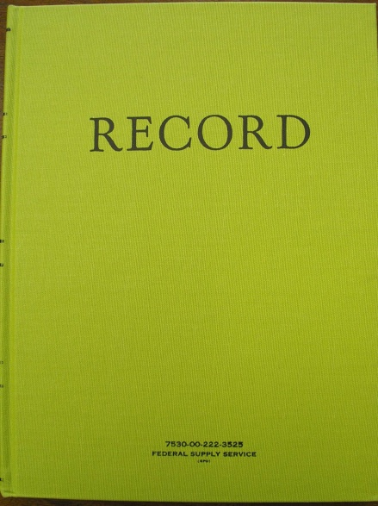
Elements of Photo Log
Photographer Identity
Date
Time
Location
  Physical address
  Latitude/Longitude
  ID numbers
Description of photos
It can be a list of the photos noted in the field notes, a separate photo list, or a separate Photo Log.

Slide 56
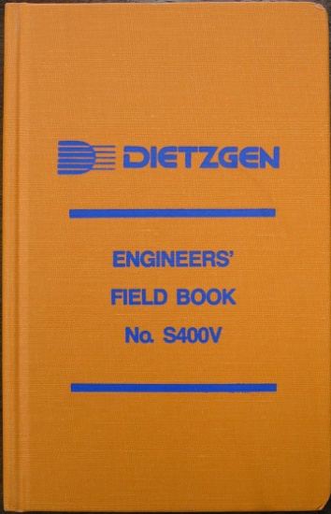
Elements of Photo Log (cont’d)
Always write photo log at the site
Restrict colorful language
State observations not conclusions
Exclude extraneous notations
Eliminate unrelated commentary

Slide 57
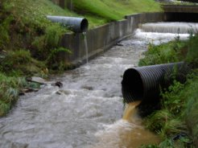
Preservation of Photos
Archival copy
Make a working copy
Transfer the archival copy

Slide 58


Archival Copy
Write-once media
  Burn directly from original media
Don’t rename photographs
Verify contents, file size
Re-format SD card

Slide 59
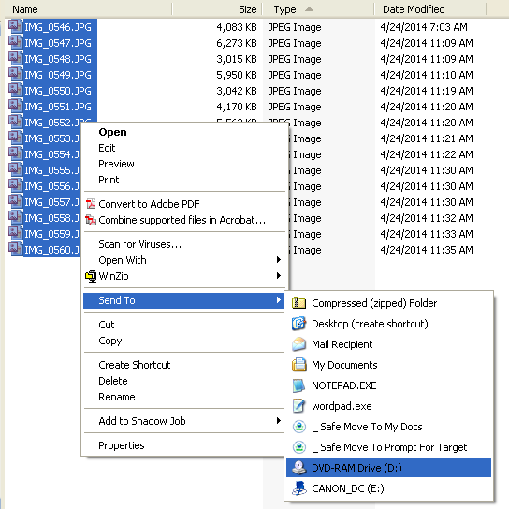
What does that mean?

Slide 60
Best Practices
Label disk
  Name of facility/site
  Date
  Time
  MASTER or Archival copy
Print out photo log and keep together
Don’t write directly on disks

Slide 61
Working Copy
Made directly from SD
Stored on hard drive or write once media
Clearly identify as Working Copies
  Can be renamed
  Can be paired down
  Can be processed

Slide 62
What is Photo Processing?
Reveals image detail that may be obscured by distracting background, poor definition, lighting issues, or color contrast
Reduction/enlargement
Cropping
Contrast
Brightness adjustments

Slide 63
Processing Photos
“Processing” preferred over “manipulation”
Create separate working copies of photos
Rename as needed
Document processes for later recreation
  Who
  What
  When
  How
Save each change as separate image file

Slide 64
Take Away Points
Check date/time before each use
Create a photo log as you take them
Preserve original files
Create archival/master CD for originals
Establish consistent practices, treat every site the same
Utilize government-issued equipment
Take lots of photos
  No additional cost
  Value added may be identified after the fact

Slide 65
Things to Remember About Photos
Notify facility personnel of intent to take photos
Provide copies to facility if requested
  Do you give them your camera or sim card? NO
Document location and subject of each photo
Prepare photo log including all photos

Slide 66
Practical Exercise

Slide 67
Acme Chemical Company

Slide 68
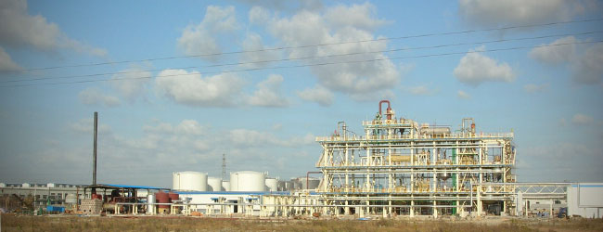
The Practical Exercise Scenario
Acme Chemical Company (ACC) produces pesticides
ACC has all required permits from the Commission on Environmental Protection (CEP)

Slide 69
The Practical Exercise
The CEP receives an anonymous tip reporting that asbestos demolition had been occurring.
CEP decides to conduct an unannounced inspection of the ACC plant
Closely review the Facility Background sheet to learn what happened during the inspection

Slide 70
Today’s activities
The class will be divided into inspection teams that will each independently investigate the anonymous tip.
Each team will investigate a disposal site, take both pictures and samples, interview a plant manager and a gate guard, take notes, and prepare an inspection report.

Slide 71
Each group needs
Laptop with thumb drive
Camera or phone to upload photos to the laptop for the inspection report, then to the thumb drive
Sampling kit: procedures, sampling spoon and containers, labels, gloves, scotch tape, and scissors)
Tyvek suit
Duct tape for wrists and feet
Evidence locker/chain of custody
Notes:
New slide

Slide 72
Prepare for exercise before lunch
Determine team roles
Review background materials, sample procedures, asbestos description & regulations
Prepare for:
  interview of Gate Guard
  interview of Plant Manager
  taking samples (PPE provided)
Notes:
New slide

Slide 73
Each Groups Needs
Team Leader
Interviewers (at least two). All team members must be present to observe the interviews.
Sampler
Photographer
Note Taker
Entire team MUST work together to prepare the inspection report
Notes:
Have the students count off
Try not to have more than 5 to a group
Use flip chart to show which activity each group goes to
Give them a time deadline to prepare

Slide 74
By the end of today
Complete two interviews
Take photos
Complete sampling
Prepare and complete inspection report
Notes:
New slide

Slide 75
Tomorrow
The class will review and provide feedback on the interviews and sampling activity, and
Each inspection report will be presented and discussed with the class

