Slide 1
Visual Examples – Part 1

Slide 2
Bullets = Lists

Slide 3
Timeline – Example 1
Date 1
Rule Change
Date 2
Rule Change
Date 3
Rule Change
Notes:
Here’s one that’s straight out of SmartArt.
For this example, select Accent Process from SmartArt choices.

Slide 4
Timeline – Example 2
Email Notice Sent
Comments Due
Rule Becomes Effective
Date 1
Date 2
Date 3
Notes:
You can also let SmartArt get you started and then add some other basic PowerPoint shapes to customize your timeline.
For this example:
Select Circle Process from SmartArt choices to create the event shapes/markers
Insert shapes to create the timeline:
Straight line with shape outline width of 6 pt. for main timeline
Straight lines with shape outline widths of 3 pt
Insert text boxes for dates
Of course, for both of these examples, you can ungroup and add animation.

Slide 5
Timeline – Example 3
Date 1
Date 2
Date 3
Notes:
This is the same as the timeline in Example 2, but instead of text in the circles, I added icons.

Slide 6
Timeline – Example 4
July 2019
Rule becomes effective
Notes:
A really simple way to showcase dates is also just through a simple calendar image with icons added to show what will occur or be due on specific dates. If necessary, you can have a text box or callout animate in with the icon to provide additional information.

Slide 7
Process or Sequence
Step 1
Step 2
Step 3
Step 4

Slide 8
Process or Sequence – Example 1
Step 4
Step 3
Step 2
Step 1
Notes:
SmartArt – Closed Chevron Process diagram
Use Convert to Shapes feature to make each shape an individual object (right click on SmartArt diagram to display menu)
Change shape colors (click Shape Format tab and select color from Shape Styles group)
Ungroup again
For each shape, change shape distance from ground under 3-D rotation (Right click on group to display Format Shape pane then click on pentagon shape at top of pane) in 20 pt. increments
For each shape, change shape Presets to Relaxed under 3-D rotation
For each shape, change material to metal and lighting to freezing under 3-D format (also found on Format Shape pane/under pentagon shape)
For each shape, change shape depth color under 3-D format to a darker blue
For each shape, change shape depth under 3-D format to 20 pt.
Give each individual shape a shadow and move each shadow into place
Can you animate this or use morph to simulate animation? Absolutely!

Slide 9
Process or Sequence – Example 2
1
Add text here
2
Add text here
3
Add text here
Notes:
Another example shows how you can use basic shapes (triangles, an arc, and ovals) and some basic animation that uses degrees of rotation. The gear image was added to show that this is an engineering process. This is helpful if you’re dealing with a process that’s based on timing.
Select the isosceles triangle shape for the needle
Duplicate the triangle and flip it vertically
Place the flipped triangle directly underneath the first triangle
Remove the fill and outline on the bottom triangle
Group both shapes
Add a circle to the center point of the group and re-group everything to include the circle
Rotate the group 52 degrees (Shape Format tab > Size & Properties icon > Size > Rotation)
Select the arc shape for the outline of the clock face. Increase the arc shape by holding down the Shift key and moving the mouse.
Pull the yellow handle on the arc to extend its length
Change the needle colors to desired colors
Add ovals/circles to the arc shape to create the stop points, steps, etc.
Select the needle and add 30 degrees to its rotation (Shape Format tab > Size & Properties icon > Size > Rotation)
Add a straight line out to the right as a visual cue for placement of next stop point
Add another 30 degrees of rotation to the needle (Shape Format tab > Size & Properties icon > Size > Rotation)
Add a straight line out to the right as a visual cue for placement of next stop point
Place needle back at original starting point (52 degrees)
Add wipe from bottom animation to needle
Add zoom animation to first stop point (after previous)
Add wipe from left animation to text (after previous)
Add spin animation to needle (Effect = 30 degrees custom amount; Duration = 0.5 seconds)
Select first stop point and text, hold down Ctrl key, and move to center of first cue line
Repeat last two steps for any additional stop points

Slide 10
Process – Example 3
Compressor
Sales
Gas
Gas
VRU
Flare
Separator
Crude
Tank 1
Tank 2
Incoming Product
Crude Pipeline
Notes:
This diagram is made up of basic shapes with arrows to illustrate a process flow, and everything is straight from PowerPoint.
This one includes animation to help show different stages of the process and guide and focus the audience.

Slide 11
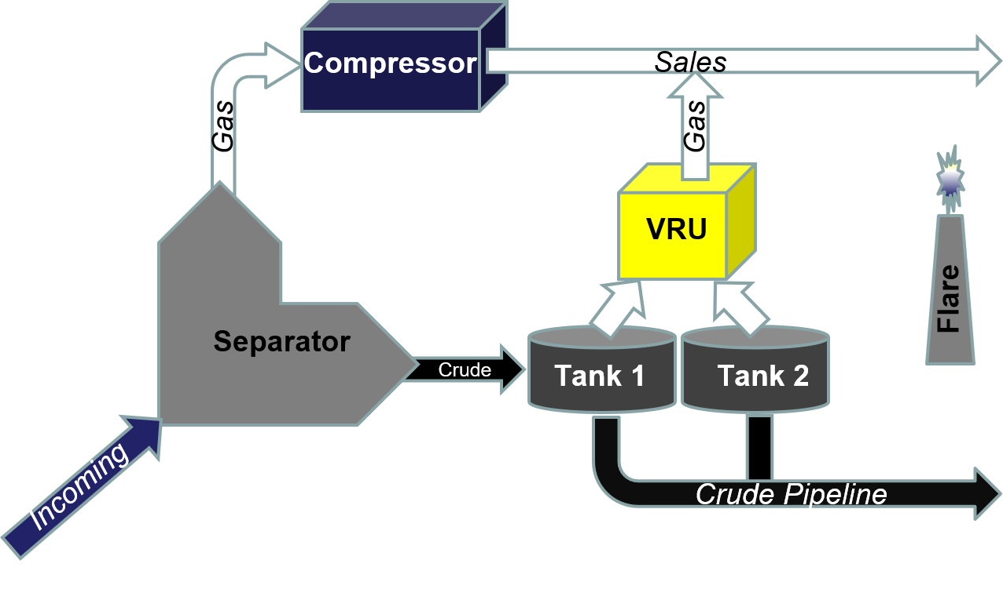
Process – Example 3a
From PowerPoint Shapes
Notes:
….and here’s the same flow chart demonstrating the Morph transition. This slide initially focuses attention on the separator.

Slide 12
Process – Example 3a
From PowerPoint Shapes
Notes:
Here, the audience’s attention is moved from the separator to the vapor recovery unit using the Morph transition.

Slide 13
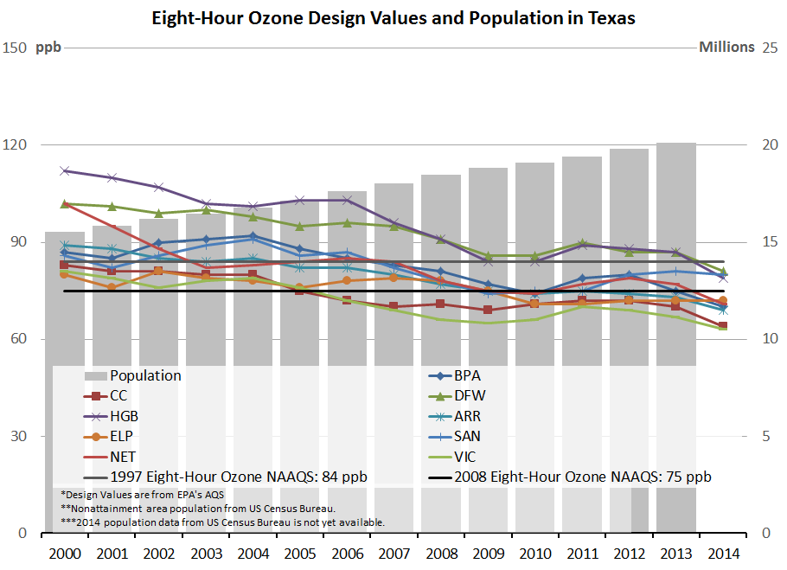
Eight-Hour Ozone Design Values and Population in Texas

Slide 14
Decrease in 8-Hour Ozone Design Values
101 ppb
87 ppb
1997 Std.: 84 ppb
2008 Std.: 75 ppb
By 2014, only three areas were above the 2008 8-hour ozone standard of 75 ppb, even as population increased from 17 MM to 21 MM.
Full Graph

Slide 15
Only Three Areas Above 2008 8-Hour Ozone Standard in 2014
HGB
DFW
BPA
84 ppb
1997 Std.: 84 ppb
2008 Std.: 75 ppb
2000
2014

Slide 16
Adding Graphs and Charts
Notes:
To insert a chart or graph:
Click the Insert tab
In Illustrations group, select Chart to display the Insert Charts dialog box
Select a chart category in the left pane of the dialog box to display the chart variations in the right pane
Select the chart type you want to create and click OK to insert a sample chart and open its associated Excel worksheet containing the plotted data
In the linked Excel Worksheet, enter the values to be plotted, following the pattern of the sample data
If the chart data range defined by the colored outlines doesn’t automatically expand to include new data, drag the blue handle in the lower right corner of the range to expand it
Close the Excel window
Once the chart is on the slide, you can modify it by editing the applicable chart elements (axes, axis titles, chart titles, data labels, data tables, error bars, gridlines, legend, lines, trend line, and up/down bars) for the type of chart found on the Chart Design tab, which is activated when the chart is selected
To insert a chart from Excel:
In the source workbook, click the chart border to select it
Copy the chart to the clipboard
Switch to PowerPoint, display the slide you want to insert the chart on, paste the chart from the clipboard
Close the Excel window
Once the chart is on the slide, you can modify it by editing the applicable chart elements (axes, axis titles, chart titles, data labels, data tables, error bars, gridlines, legend, lines, trend line, and up/down bars) for the type of chart found on the Chart Design tab, which is activated when the chart is selected

Slide 17
Adding Tables
Notes:
To insert a table:
Click the Insert tab
In Tables group, select Table to display the Insert Table menu
Select the number of rows and columns from the cell grid to indicate the size (in rows and columns) of the table you want to create OR select Insert Table… and enter the numbers of rows and columns in the Insert Table dialog box OR select Draw Table to create a single cell OR select Excel Spreadsheet to enter an actual Excel spreadsheet
To insert a table from an Excel worksheet (these same procedures can also be used to insert a table from Word):
Open the workbook in Excel and locate the table or data range that you want to insert on the slide
Select the table or data range and copy the selection to the Clipboard
Switch to PowerPoint and display the slide you want to insert the table on
Paste the copied table from the Clipboard to the slide
If you don’t want the table to match the slide formatting, click the Paste Options button and then on the Paste Options menu, click the desired paste option

Slide 18
Visual Examples – Part 2

Slide 19
Chunking
Point 1:
Subpoint 1
Point 2:
Subpoint 2
Point 3:
Subpoint 3
Point 4:
Subpoint 4
Point 5:
Subpoint 5

Slide 20
Flip Images Horizontally

Slide 21
Use Custom Layouts
Notes:
The fastest way to incorporate this into your slide show is to make these custom layouts part of the slide master. To do this:
Create a new slide
Open the Slide Master on the View tab
Duplicate one of the child master layouts
Rename the layout
Insert the placeholder
Select Picture
Insert the placeholder
Move the title to the desired location on the slide to not interfere with the image
Go back to Normal View and choose the newly created layout to insert the picture

Slide 22
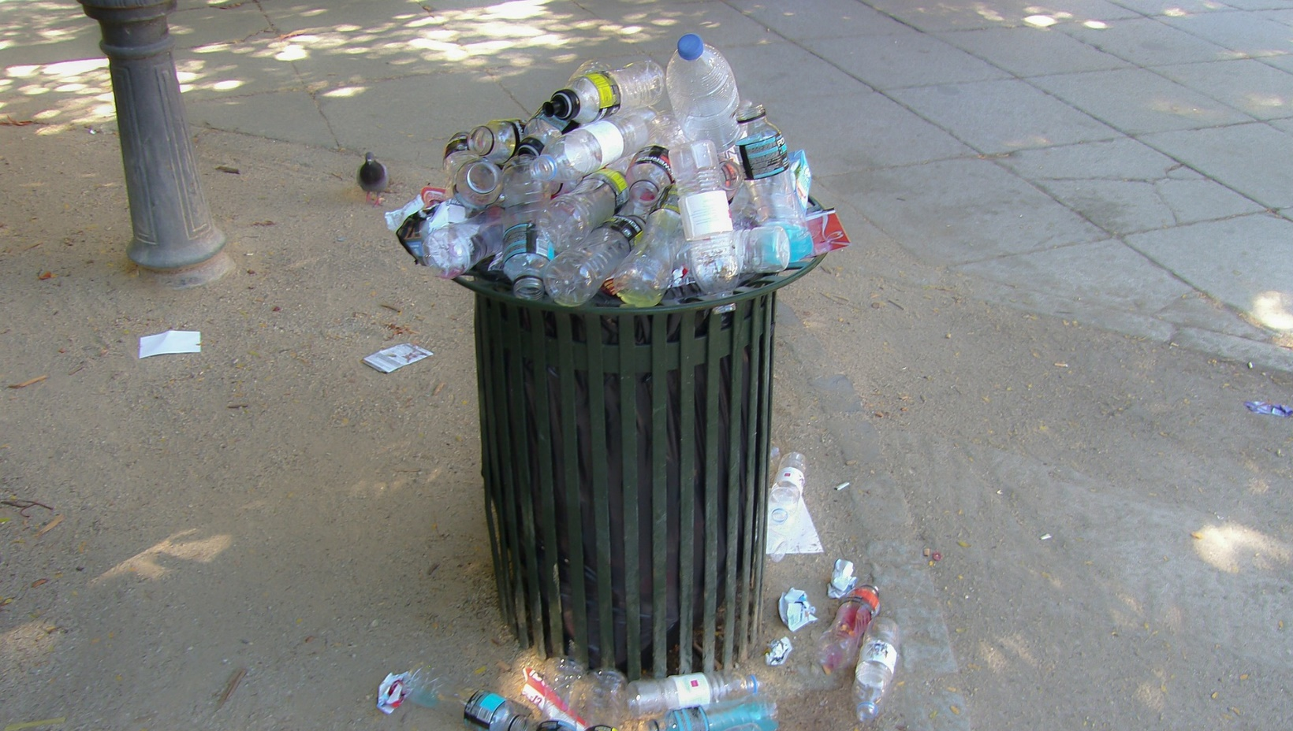
Annotate an Image
Remember to Recycle
Notes:
Annotating an image creates impact and the illusion of a lot of movement with very little work, essentially the addition of just a simple Grow/Shrink animation to the image. You can customize the duration, delay, and size to get the effect you want.

Slide 23
Use a Transparent Gradient Over Image
All engineering begins with a good foundation.
Notes:
To add a transparent gradient:
Click the Insert tab
Select Shapes to display the shapes available
Select the desired shape (in this example, the shape is a Rectangle)
Create the gradient……in this example:
Use black as the shape fill color
Choose the Linear Down variation
Choose More Gradients to display the Format Background pane
Create two stops
Make the first stop 100% transparent
Make the last stop 5% transparent
Make the middle stop 10% transparent and a position of 25%
Move the last stop to whatever location provides the best contrast

Slide 24
Turn Bullets Into Icons or Photos
Remember the Senses
Sight
Sight
Hearing
Touch
Smell
Taste
Hearing
Sight
Hearing
Touch
Touch
Smell
Taste
Smell
Taste
Notes:
To Turn Bullets Into Icons:
Highlight text, right click to display menu, and select Convert to SmartArt from the menu
Select Vertical Bullet List
Resize SmartArt diagram
Change the SmartArt colors and text color to black
Ungroup the SmartArt diagram then align the shapes vertically
Insert icons
Image Attributions:
Eye by suib icon from the Noun Project
Hearing by Symbolon from the Noun Project
Touch by iconsphere from the Noun Project
Smell by heathersabrina from the Noun Project
Taste by Iacopo Neri from the Noun Project

Slide 25
Connect High-Content Slides With a Transition
Notes:
This is one for those slides that are going to have text, no matter what, and it is effective for numbered lists or long lists that don’t fit on one slide. It shows that the information is related/continued, and it allows you to break up the information and stick to three words per bullet or the 6x6 rule.
To add this type of transition:
Complete the bulleted/numbered list
On the second and any additional slides, highlight the text, right click to display the menu, and select Numbering
In the Numbering menu, select Bullets and Numbering…
In the Bullets and Numbering dialog box, under the Numbered tab, type the number which you want the list on that slide to start
Apply a Push or Pan transition to the slide(s)

Slide 26
Create a Quick Numbered List With SmartArt
First Step
Second Step
Third Step
Fourth Step
Fifth Step
1
First Step
2
Second Step
3
Third Step
4
Fourth Step
5
Fifth Step
Notes:
To create this list with SmartArt:
Highlight text, right click to display menu, and select Convert to SmartArt from the menu
Select Vertical Block List
Open the text box in the SmartArt diagram by clicking the arrow on the left side of the diagram
Type in the number and hit the Return key to create a sub-bullet
On the sub-bullet hit the Tab key
Resize SmartArt diagram if necessary
Change the SmartArt colors and text color if necessary
Ungroup the SmartArt diagram if you want the shapes to be individual objects and to remove the bullet preceding the text

Slide 27
Putting It All Together

Slide 28
Time for a Makeover

Slide 29
Texas Electricity Generation: 2012
Coal generation: 138.7 MMWh
Emissions rate: 2,239 lbs CO₂/MWh
NGCC generation: 148.0 MMWh
Emissions rate: 837 lbs CO₂/MWh
OG steam generation: 20.9 MMWh
Emissions rate: 1,377 lbs CO₂/MWh
2012 fossil fuel emissions rate:
1,420 lbs CO₂/MWh

Slide 30
TX Electricity Generation: 2012 Emissions Rates
Coal: 138.7 MMWh
Emissions rate: 2,239 lbs CO₂/MWh
NGCC: 148.0 MMWh
Emissions rate: 837 lbs CO₂/MWh
OG steam: 20.9 MMWh
Emissions rate: 1,377 lbs CO₂/MWh
2012 fossil fuel emissions rate:
1,420 lbs CO₂/MWh

Slide 31
TX Electricity Generation: 2012 Emissions Rates
Coal: 138.7 MMWh
2,239 lbs CO₂/MWh
NGCC: 148.0 MMWh
837 lbs CO₂/MWh
OG steam: 20.9 MMWh
1,377 lbs CO₂/MWh
2012 fossil fuel emissions rate:
1,420 lbs CO₂/MWh
Notes:
I let SmartArt get me started. This is the Vertical Block list.
Colors were changed, and a bevel was added.
The font sizes in the title and the diagram were adjusted.
SmartArt was ungrouped twice to get individual objects, which were custom animated to control the narrative.
This is where colors can be easily changed since these are now individual shapes.

Slide 32
2012 Texas Electricity Generation
OG Steam: 20.9 MMWh; 2,239 lbs CO₂/MWh
Fossil Fuel:
1,420 lbs CO₂/MWh
Coal: 138.7 MMWh; 2,239 lbs CO₂/MWh
NGCC: 148.0 MMWh; 837 lbs CO₂/MWh
Notes:
The grid was created by dividing the horizontal dimension by three and dividing the vertical dimension by two. Once the horizontal and vertical dimensions for each square were determined, a rectangle shape was inserted and specifically sized by typing in the dimensions in the Size group under the Shape Format tab. Each rectangle was given a white outline with a weight of 3pt.
Every other square was filled with a picture, and text boxes were added. For the squares without pictures, I selected colors from one of the TCEQ logos.

Slide 33
2012 Texas Electricity Generation
OG Steam: 20.9 MMWh; 2,239 lbs CO₂/MWh
Fossil Fuel:
1,420 lbs CO₂/MWh
Coal: 138.7 MMWh; 2,239 lbs CO₂/MWh
NGCC: 148.0 MMWh; 837 lbs CO₂/MWh
Notes:
Animation was added to control the narrative.

Slide 34
260 CenSARA
http://www.censara.org/
Notes:
http://www.censara.org/

