Slide 1
PowerPoint Basics – Part 2

Slide 2
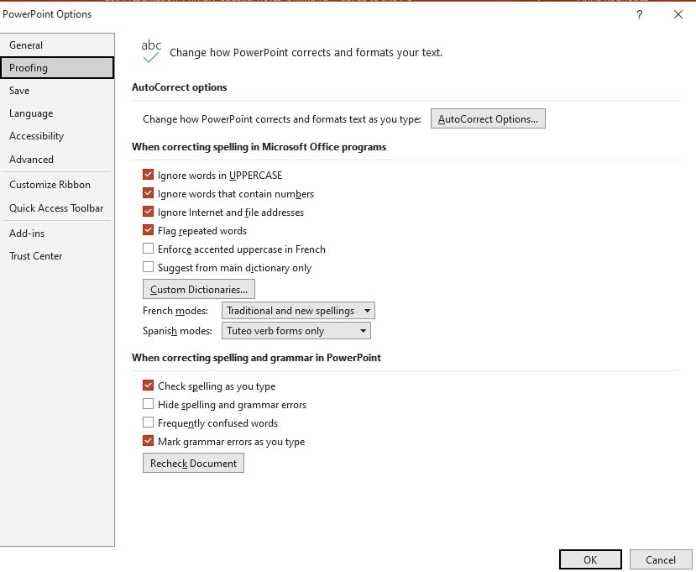
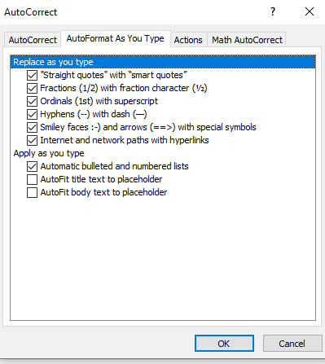
AutoFit Feature
Notes:
To get to this view:
Click the File tab
Select Options
Select Proofing
Click the AutoCorrect Options… button
Click the AutoFormat As You Type tab
Make sure the AutoFit title text to placeholder and AutoFit body text to placeholder boxes are unchecked
Once you set your Autoformatting once, it should come up that way every time you open a new slide show. However, I would recommend that you make it a practice to check it each time you open a new slide show, just to be sure.

Slide 3
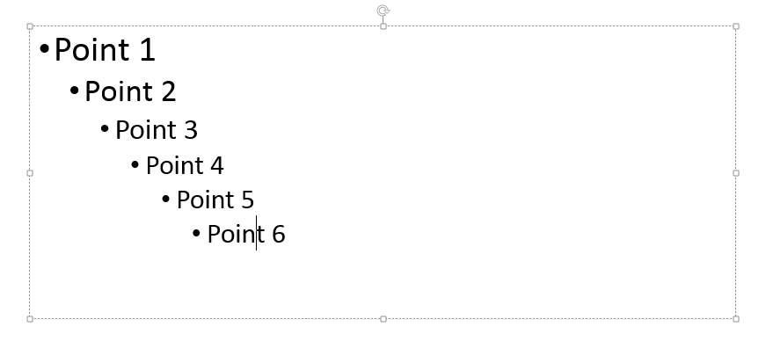
Entering Text and Tab Levels
Notes:
To demote the current text by one level, with the cursor at the beginning of the paragraph:
Press Tab or
Click the Home tab then select Increase List Level in the Paragraph group
To promote the current text by one level, with the cursor at the beginning of the paragraph:
Press Shift+Tab or
Click the Home tab then select Decrease List Level in the Paragraph group
You can enter text in the placeholder in Normal view or in Outline view.

Slide 4
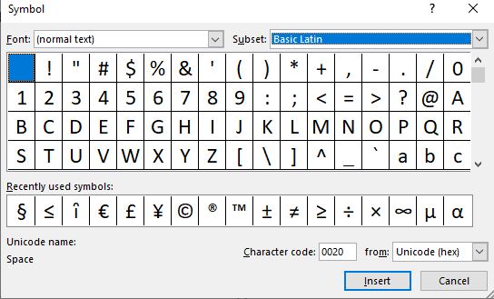
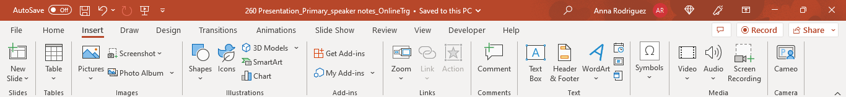
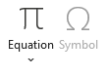
Inserting Symbols
Notes:
To add a symbol (the one that readily comes to mind is the section symbol):
Position the cursor where you want to insert the symbol
Click the Insert tab
Click Symbols to see the pull-down menu and then select Symbols to open the Symbols dialog box
In the dialog box, click the Font list, and then click a symbol font such as Symbol, Webdings, Wingdings, etc. to display the characters of that font; scroll the character pane up and down to display additional characters
Select the symbol you want to insert and then click the Insert button (or you can double-click on the symbol)
Some fonts offer a list of Subsets, which will reveal more symbols
**Most symbols that you need are under (normal text) Basic Latin Subset.**

Slide 5
Inserting a Text Box
Notes:
To add a text box:
Click the Insert tab
In Text group, select Text Box
Click the location on the slide where you want the text box to appear and then enter the text

Slide 6
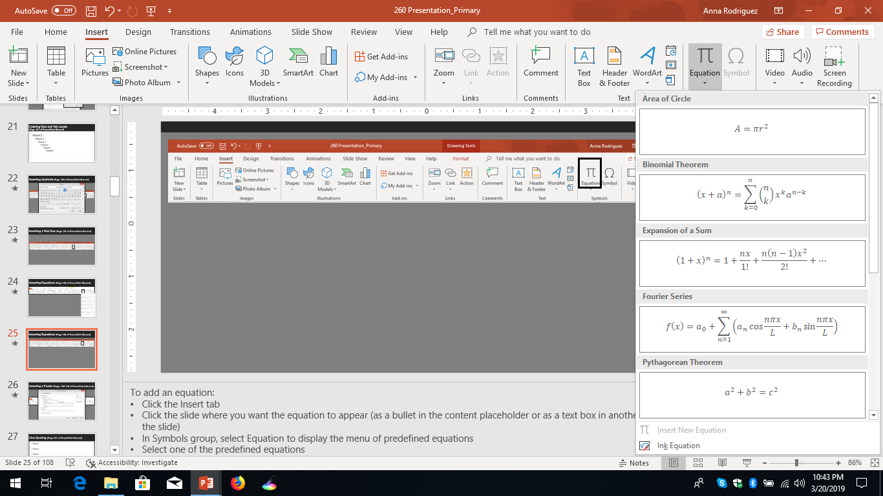
Inserting Equations
Notes:
To add an equation:
Click the Insert tab
Click the slide where you want the equation to appear (as a bullet in the content placeholder or as a text box in another location on the slide)
Click Symbols to see the pull-down menu and then select Equation to display the menu of predefined equations
Select one of the predefined equations
If you need something other than these standard equations, you can build your own equation with symbols by:
Clicking the Insert tab
Clicking the location in the content placeholder where you want the equation located
Clicking Symbols to see the pull-down menu and then selecting Equation to display the menu of predefined equations
Selecting Insert New Equation at the bottom of the menu
Building the equation using the symbols and the commands in the Equation ribbon that appears after Insert New Equation is selected

Slide 7

Practice Activity 4
Turn AutoFit off
Enter text
Insert text box
Insert symbol
Insert equation or create an equation

Slide 8
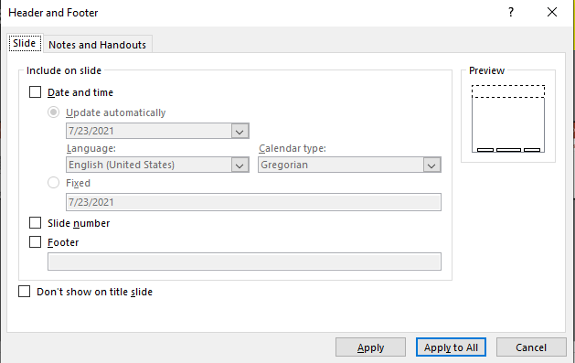
Inserting a Footer
Notes:
To add a footer:
Click the Insert tab
In Text group, select Header & Footer to display the Slide tab of the Header and Footer dialog box
In the Include on slide area, check the Date and time box to either update the date, language, and calendar type automatically (each time the slide is opened) or to fix the date; check the slide number box if you want the slide number displayed; check the Footer box to activate the text box that will allow you to enter the information you want to appear in the footer; check the Don’t show on title slide box if you don’t want any of this information to appear on the title slide; click the Apply to All button to have this information appear on all slides in the slide show
This method puts the footer on the slide surface. This is a good method if you want to place the footer over your background. If you want to make the footer part of the background and then hide it, it’s best to add it in the slide master. From there, you can hide it by checking the Hide Background Graphics box.
To add a footer in the slide master:
Click the View tab
In the Master Views group, select Slide Master to display the slide master(s)
Make any changes to the footers on the parent slide if they will apply to all the slides or to each slide layout slide if they will be different
While still in the Slide Master, click the Insert tab
In the Text group, select Header & Footer to display the Slide tab of the Header and Footer dialog box
In the Include on slide area, check the Date and time box to either update the date, language, and calendar type automatically (each time the slide is opened) or to fix the date; check the slide number box if you want the slide number displayed; check the Footer box to activate the text box that will allow you to enter the information you want to appear in the footer; check the Don’t show on title slide box if you don’t want any of this information to appear on the title slide; click the Apply to All button to have this information appear on all slides in the slide show

Slide 9
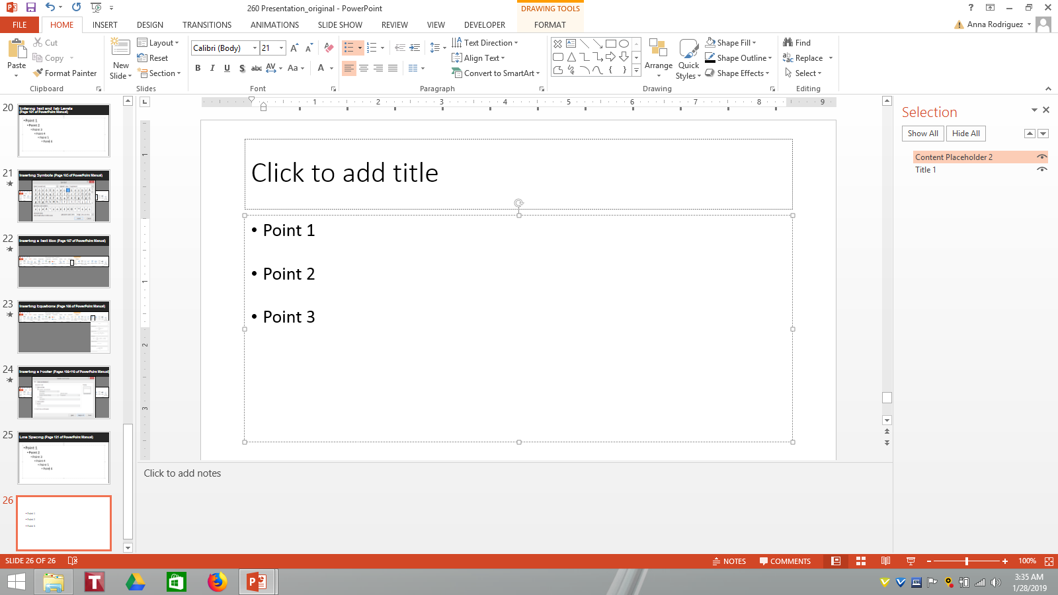
Line Spacing
Notes:
To Change Line Spacing:
Click the Home tab
On the Home Ribbon, in the Paragraph group, select the Line Spacing button to display the line spacing menu
Select the desired line spacing from the list
OR
Click the Home tab
On the Home Ribbon, in the Paragraph group, select the Line Spacing button to display the line spacing menu
Select Line Spacing Options… to open the Paragraph dialog box
In the General area, change the Alignment setting to Left, Centered, or Right
In the Indentation area, enter a number and any Special settings
In the Spacing area, enter a number in the Before or After box
In the Spacing area, change the Line Spacing setting
Another way to open the Paragraph dialog box is to place the cursor in the content placeholder and then right-click.

Slide 10
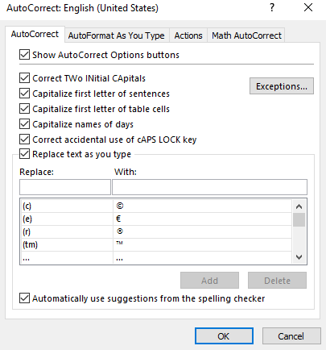
AutoCorrect Feature
Notes:
To get to this view:
Click the File tab
Select Options
Select Proofing
Click the AutoCorrect Options… button
Click the AutoCorrect tab
Make sure all boxes are either checked or unchecked as desired
To add a word to AutoCorrect list, type the word you want to replace in the Replace: box, type the word you want to replace it with in the With: box, and click the Add button
Click OK
To reverse an AutoCorrect change:
Immediately after AutoCorrect makes the change, click the Undo button or press Ctrl+Z OR
Point to the AutoCorrect change, point to the bar that appears below it, then click the arrow to display the AutoCorrect Options menu; on the menu, select the appropriate correction option

Slide 11
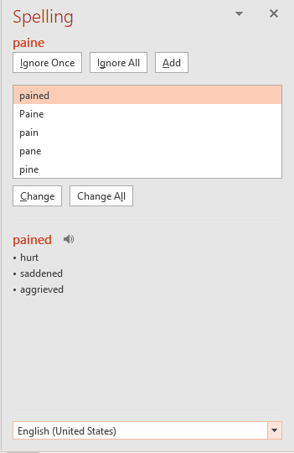
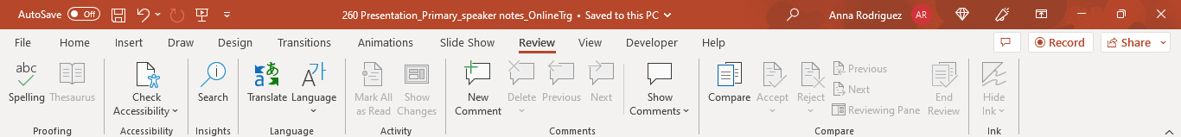
Checking Spelling
Notes:
To check spelling:
Click the Review tab
In Proofing group, select Spelling to display the Spelling pane
Any words that PowerPoint designates as misspelled will appear, and you can choose to ignore the word once by clicking the Ignore button, ignore the word throughout the entire slide show by clicking the Ignore All button, or select any of the suggested corrections to replace the word then click the Change button or click the Change All button to change the word throughout the entire slide show
This feature checks spelling in the slides and the notes.

Slide 12
Practice Activity 5
Add a footer
Set line spacing at 12 pt before the line
Add key words to AutoCorrect
Conduct a spell check

Slide 13
Presentation Development – Planning

Slide 14
Before you write a word…..
Know that few people will envy your role as a speaker. Most people are just glad _________________________.
Realize the audience wants you to be good. No one ever says: “I hope the speaker is _____.
Realize what the audience will remember. Twenty-four hours from now, you will forget ___________________. Forty-eight hours from now, you will forget ___________________.

Slide 15
Before you write a word…..
Determine your objective. Four main possibilities are _________, _________, ________, ___________.
Get comfortable with your personal credibility. Your goal is to be the most knowledgeable person in ___ ____ , on ___ ___, about ___ ______.

Slide 16

3 Essentials of Effective Presentation Skills
Planning the Presentation
Preparing the Presentation
The Delivery

Slide 17

Planning the Presentation
Identifying the Purpose
Analyzing the Audience

Slide 18

Identifying the Purpose
Why this specific presentation?
What should the participants be able to do or understand when you’re done?
How should the participants react at the end of your presentation?

Slide 19

Analyzing the Audience
Determine the no. of participants
Identify objectives and priorities
Identify level of detail required
Choose your format

Slide 20

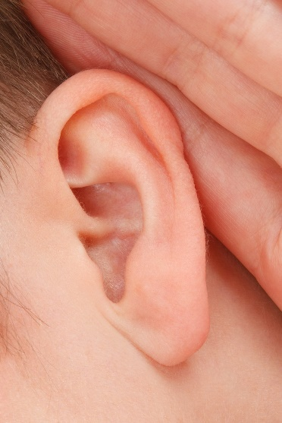



Remember the Senses
Sight
Hearing
Touch
Smell
Taste

