Slide 1


260 CenSARA
Effective PowerPoint, Presentation Skills, and 508 Compliance
Instructor:
Anna Anderson, P.E.

Slide 2

CenSARA
Notes:
So many of the technical training courses that you receive at your agency are through CenSARA or the Central States Air Resource Agencies. These agencies are from the states of Arkansas, Iowa, Kansas, Louisiana, Missouri, Nebraska, Oklahoma, and Texas. CenSARA promotes communication and cooperation among federal, state, and local agencies and supports the membership with training, policy, and technical projects. The real beauty is that through your agency’s CenSARA membership, the Air divisions receive technical training at no cost to them.
CenSARA promotes the exchange of air quality information, knowledge, experience, and data among and between its participating organizations and other interested parties. These actions are accomplished within the scope of air quality statutes and regulations with a focus on understanding and addressing common issues; promoting communication and cooperation among federal, state, and local agencies; and supporting the membership with training, policy, and technical projects.

Slide 3

Course Objectives (Page 2 of Workbook)
Using your personal preferences and presentation style to develop an audience-centered presentation that incorporates stories and humor to engage the audience using PowerPoint as an effective visual aid that also meets accessibility requirements.

Slide 4

Your Main Competition

Slide 5

Presentation Types (Page 3 of Workbook)
Informational
Motivational
Persuasive
Entertaining
Introductions
Panelist/Moderator/Interviewer
Elevator Opportunities

Slide 6

Ten Most Common Fears
10
5
9
4
8
3
7
2
6
1
Source: Moneyinc.com

Slide 7

Understanding Your Fear
Brain analyzes public speaking as a fear
Sends alarm stimuli
Response is “fight” or “flight”
Self doubt/insecurity develop
The feeling is naked animal fear

Slide 8

Overcoming Fear
Distinguish between real and imagined threats
Redirect your fear into energy
Use positive visualization

Slide 9

Personal Challenges (Pages 5-10 of Workbook)
Self-Assessment
Calming the Fears
Perceptions/Presence
Appearance
Non-Verbal Communication
The Power of Voice

Slide 10
PowerPoint Basics – Part 1

Slide 11
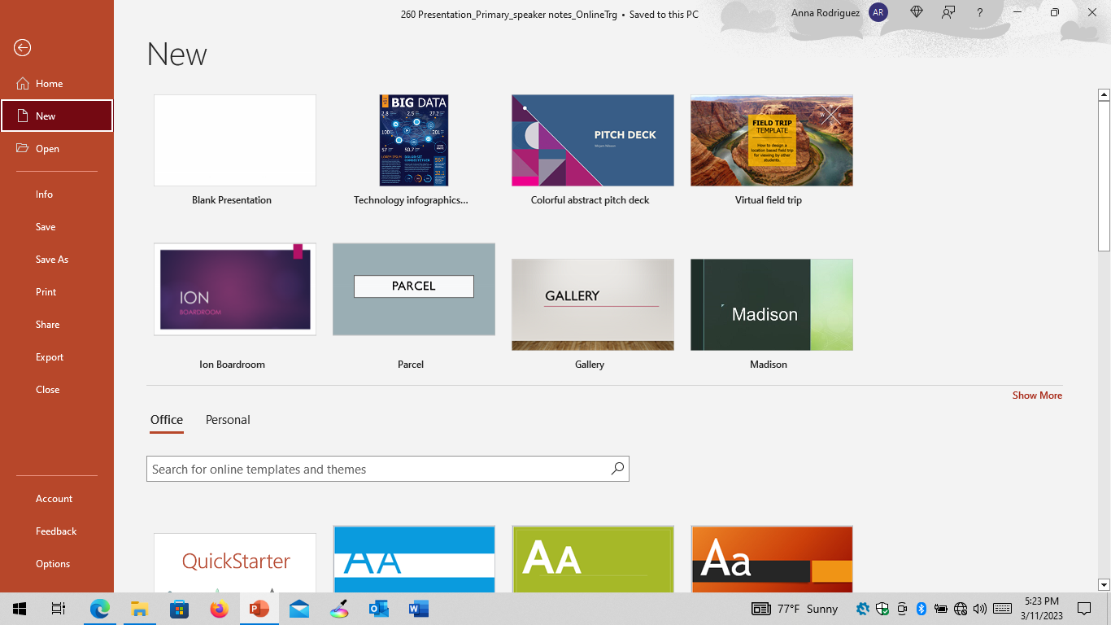
Templates
Notes:
To get to this view:
Click File tab
Select New

Slide 12
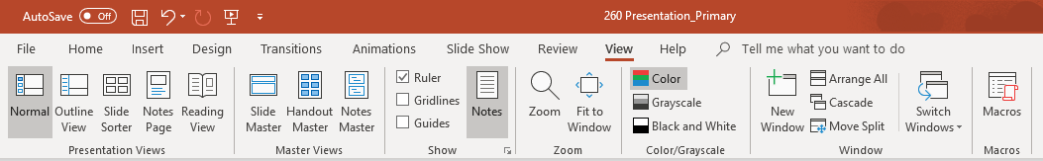
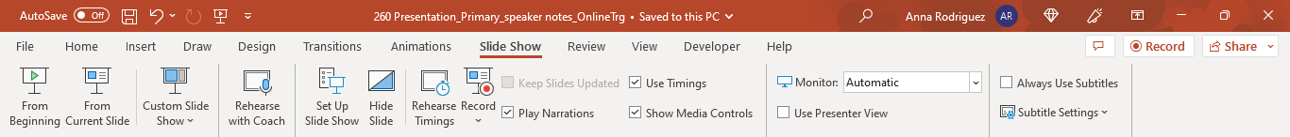
Views
Notes:
Normal view is the default view for PowerPoint and used primarily to create slide content but also to manage slides in the thumbnails pane and place notes in the Notes pane.
Outline View:
Click View tab
Select Outline View
Thumbnails pane replaced with text outline format that shows the text in the Title placeholder and any content placeholders; this text can also be entered directly in the outline; this view is also very helpful in identifying accessibility issues (which we’ll discuss in much more detail when we cover accessibility)
Slide Sorter:
Click View tab
Select Slide Sorter
Thumbnails displayed on the entire screen; this view is for managing the slides rather than the slide content and provides more of a table top view of your slides
Notes Page:
Click View tab
Select Notes Page
Displays a small image of the slide with a place to enter text, graphics, tables, diagrams, or charts
Note: If you’ve added notes to your slides in the Notes Pane, be sure to check the Notes Page View because you can run off the page. It may not make a difference, depending on your specific situation, but if you plan to print your Notes Page for handouts or notes, be aware that any text that runs off the page will result in a second page/multiple pages of notes.
Reading View:
Click View tab
Select Reading View
Displays a preview of the presentation, where each slide fills the screen, but contains navigation buttons to move through or jump to specific slides; arrow keys will move forward and backward through the slide show, and the End key will display the last slide; clicking on the menu icon (or right-clicking on the slide) will bring up a menu to move to a specific slide; the zoom function allows the presenter to zoom in on specific portions of the slide
Gridlines and Guides:
Click View tab
Check Gridlines and/or Guides boxes to display
Gridlines mark off specific units of measure, and their spacing can be adjusted in the Grid and Guidelines dialog box, which is displayed by clicking on the arrow in the lower right corner of the Show group
Guides are vertical and horizontal alignment tools that can be dragged to a desired location on the slide
Switch Windows (allows the user to pull up another open presentation on a split screen and copy slides from one slide show to another):
Click View tab
Select Switch Windows, which will open the other slide show
Select Arrange All to see a split screen with both slide shows
Start Slide Show:
Click Slide Show tab
To begin a slide show, select From Beginning or From Current Slide
Presenter View:
Click Slide Show tab
To use the Presenter View with one monitor, run the slide show; at the right end of the pop-up toolbar (located at the bottom left of the screen), click Slide Show Options (labeled…) button or right-click on the slide then select Show Presenter View from the menu that appears OR use Alt+F5 from any of the Presentation Views
To use the Presenter View with multiple monitors, in the Monitors group, click the monitor you want to display the full screen slide show on and then check the Use Presenter View box

Slide 13
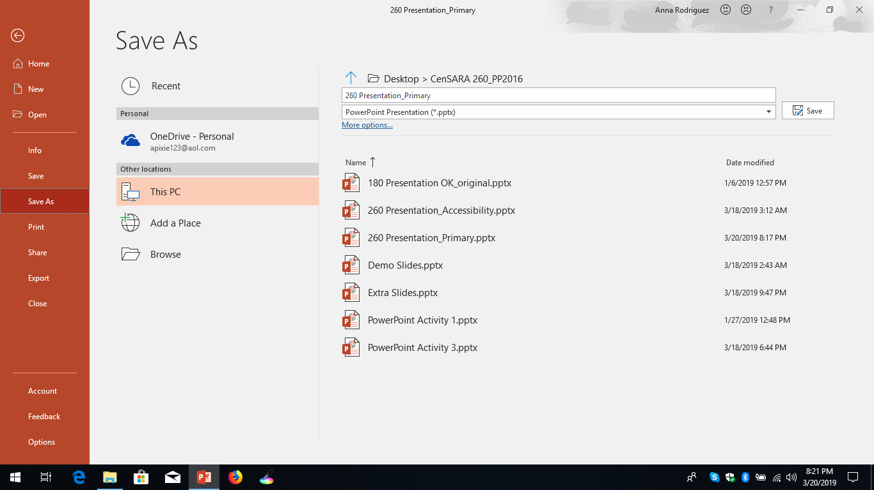
Saving Files/Compatibility with Earlier Versions
Notes:
To Save a Presentation:
Click the File tab
Select Save As
Select Browse to find the location where you want to save the file
In the Save as Type box, through the pull-down menu, select PowerPoint Presentation to save as a .pptx file or select PowerPoint 97-2003 Presentation to save as a .ppt file; .ppt files can be opened in PowerPoint 2016, but the newer features of PowerPoint are not available; the file can be saved as a .pptx file to make the newer features available, or the file can be converted by clicking File>Info>Check for Issues>Check Compatibility

Slide 14
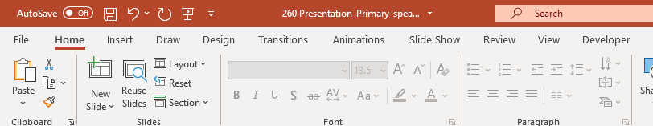
Slide Layouts
Notes:
To select the desired slide layout:
Click the Home tab
Select Layout and then select the desired layout from the options shown
To create a slide layout in the slide master:
Click the View tab
Select Slide Master
Duplicate one of the existing layouts
Make the necessary changes with placeholders and text boxes
Rename the layout to help you recognize it
Close the Master View and return to Normal View
Click the Home tab
Select Layout to find the newly created layout from the options shown
Add a new slide by:
Clicking the Insert tab then selecting New Slide and selecting the desired layout OR
Right-clicking on the slide you want to precede the new slide; the new slide will take on the layout of the previous slide; you can change the layout by clicking the Home tab, selecting Layout, and choosing the desired layout
Removing a slide:
Select the slide you want to delete and press the DELETE button
Right click on the slide you want to delete and select Delete Slide from the pull-down menu

Slide 15

Practice Activity 1
Apply a Template
Add 6 New Slides
Remove the Slide with the X

Slide 16
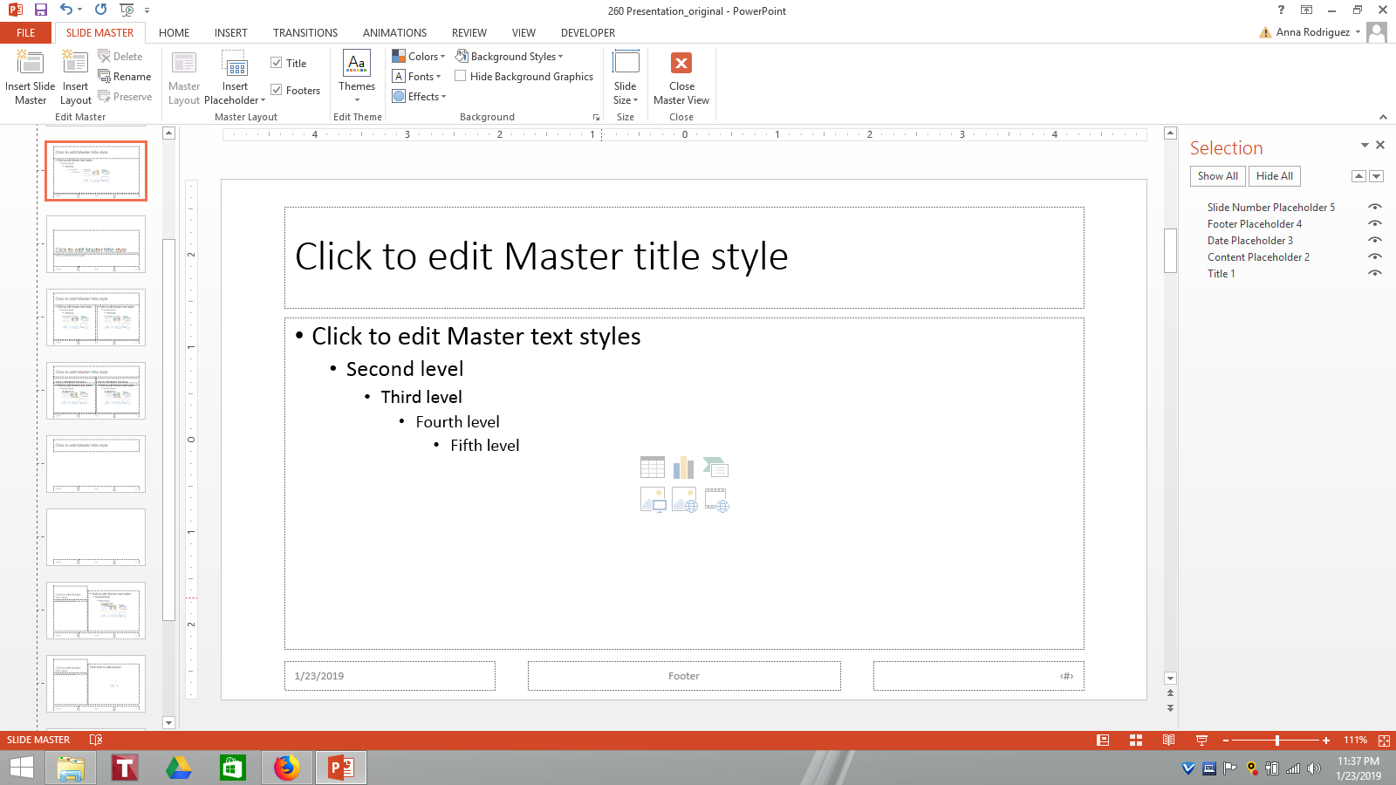
Importing Slides from Word
Slide Title
(Word Title, Subtitle, Heading 1, any bulleted list level, or any numbered list level)
Heading 2 (Word first-level bulleted list item)
  Heading 3 (Word second-level bulleted list item)
    Heading 4 (Word third-level bulleted list item)
      Heading 5 (Word fourth-level bulleted list item)
        Heading 6 (Word fifth-level bulleted list item)
          Heading 7 (Word sixth-level bulleted list item)
            Heading 8 (Word seventh-level bulleted list item)
              Heading 9 (Word eighth-level bulleted list item)
Notes:
To create a new presentation by importing a Word document:
Click the File tab
Select Open
Browse to the folder containing the structured Word document (File>Open>Browse>All Files)
Double-click the Word document to create a new slide show
Select all of the slides
Click the Home tab
Select the Reset button to reset all the fonts to the default (Calibri)
To create slides in an existing presentation by importing a Word document:
Select the slide after which you want to insert the new slides
Select the Home tab
Select New Slide to open the pull-down menu; below the gallery, click Slides from Outline… to open the Insert Outline dialog box
Browse to the folder containing the structured Word document (File>Open>Browse>All Files)
Double-click the Word document
Review the new slides to ensure consistency (font, font size, theme, etc.) with the rest of the slide show

Slide 17
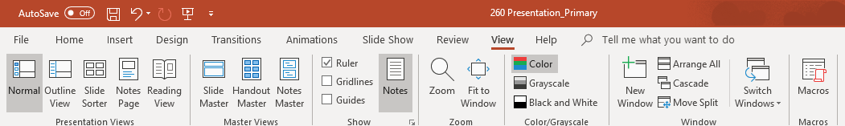
Dividing Presentation Into Sections/Rearranging
Notes:
To Divide a Slide Show Into Sections:
Click the View tab
Select Normal View or Slide Sorter View
Select the first slide of the new section
Select the Home tab
In the Slides group, click the Section button
Click Add Section
Right-click the Untitled Section name and give the section a title
To move a section:
Click the title of the section you want to move to select all the slides in the section
Drag the section to its new location

Slide 18
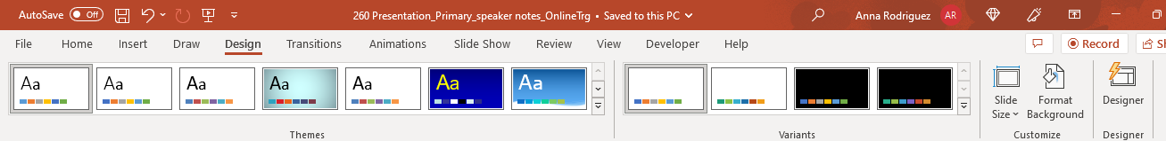
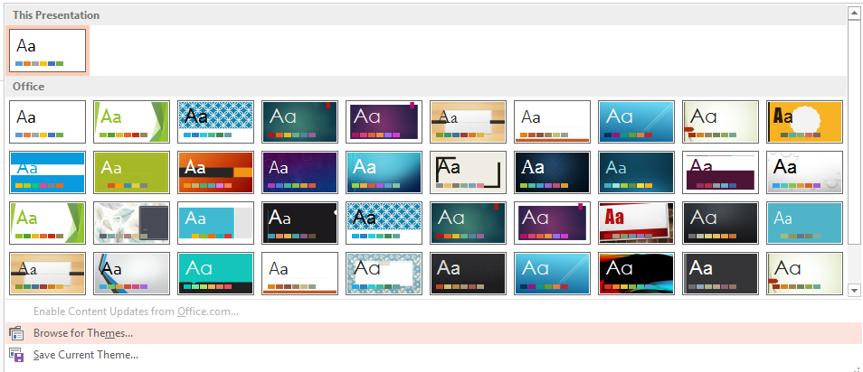
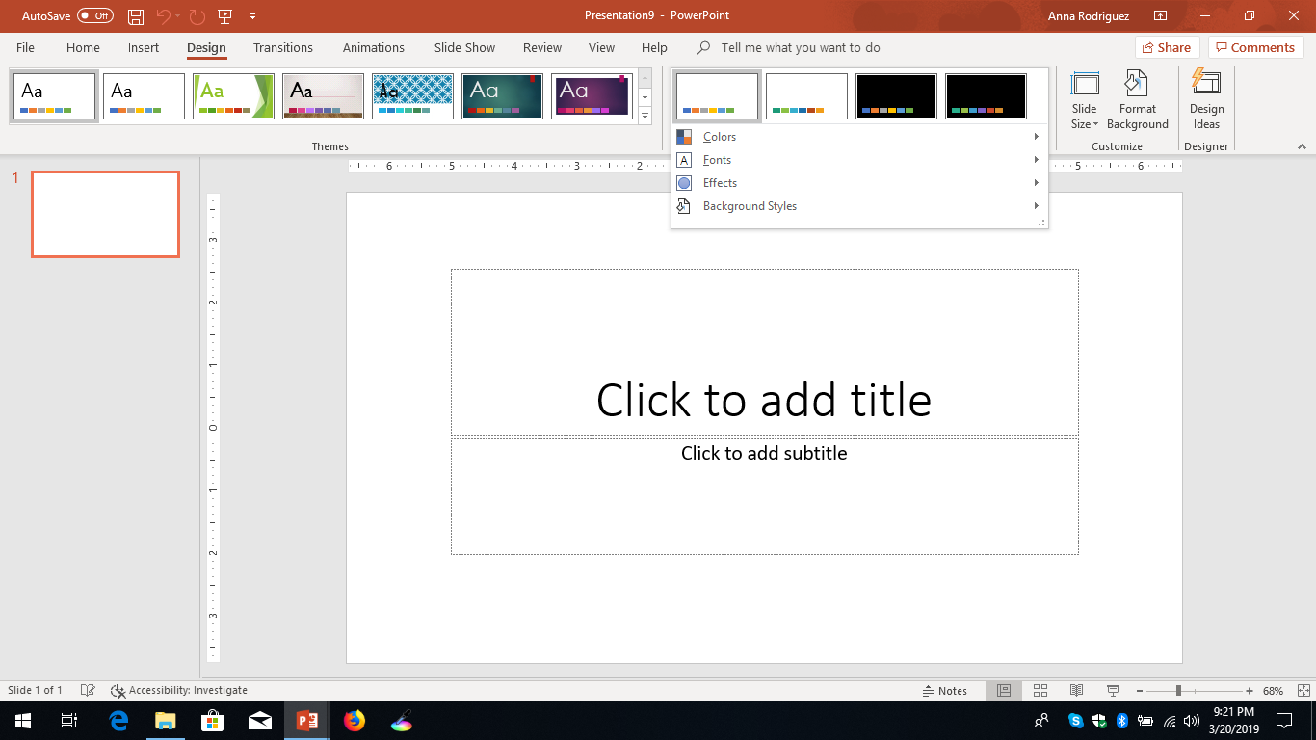
Applying Themes
Notes:
To apply a standard theme:
Click the Design tab
In the Themes group, click the More button (below the scroll arrows) to display the Office theme gallery and any custom templates on your computer
Point to the thumbnails in the gallery to preview the effect of applying the themes to your slide show
Select a theme thumbnail to apply that theme to the entire slide show
To Change the Color Scheme:
Click the Design tab
In the Variants group, select a thumbnail or click the More button (below the scroll arrows) to expand the Variants menu
Select Colors
Select the color set you want to apply (you can also select Customize Colors… to apply your own custom colors)
To Change the Font Set:
Click the Design tab
In Variants group, click the More button (below the scroll arrows) to expand the Variants menu
Select Fonts
Select the font you want to apply (you can also select Customize Fonts… to apply your own custom fonts)
To Change the Effect Style:
Click the Design tab
In Variants group, click the More button (below the scroll arrows) to expand the Variants menu
Select Effects
Select the effect style you want to apply
**Themes or theme variants can be applied to specific portions of a slide show by creating and using slide sections**

Slide 19
Practice Activity 2
Divide Into 3 Named Sections
Move Middle Section to End
Import Slides from Word Document

Slide 20
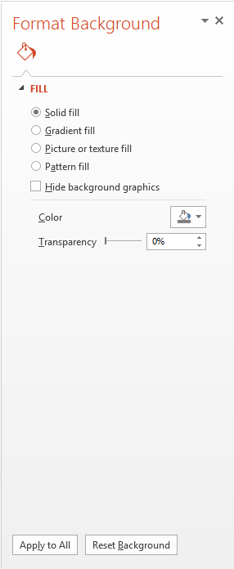
Changing Slide Backgrounds
Notes:
Solid Fill:
Click Design tab
In Customize group, select Format Background to display the Format Background pane
Select Solid fill
Click the Color pull-down menu arrow to display the color palette
Select a theme color, standard color, or a recently used color OR click More Colors to select a custom color
If desired, move the Transparency slider to adjust the background color transparency or set a specific transparency percentage
Click Apply to All button if you want the selected background color to be applied to all the slides in the slide show
Click Reset Background button to reset to the previous background
Gradient Fill:
Click Design tab
In Customize group, select Format Background to display the Format Background pane
Select Gradient fill
Click the Preset gradients button to display the color palette
Select a gradient option based on the current color palette
OR for a more in-depth gradient--
In the Type list, select Linear, Radial, Rectangular, Path, or Shade from title
In the Direction list, select the direction of the gradient flow
If you selected the linear type, specify the angle you want the gradient to move along by entering the angle in the Angle box
If you want to add more gradient stops, in the Gradient Stop area, click the Add gradient stop button, reposition the marker that appears on the slider, and click the slider in the approximate location where you want to insert the gradient stop; in the Gradient stops area, select the color, position, transparency, and brightness for each gradient stop
Click Apply to All button if you want the selected gradient background color to be applied to all the slides in the slide show
Click Reset Background button to reset to the previous background
Picture or Texture Fill:
Click Design tab
In Customize group, select Format Background to display the Format Background pane
Select Picture or texture fill
To insert a picture saved on your computer (From a File) or from PowerPoint’s Stock Images, Online Pictures, or PowerPoint’s icons (From Icons), click the Insert button under Picture source
To insert a textured background, click the Texture list to display the texture gallery
Select the texture to be applied
Move the Transparency slider to adjust the background color transparency or to set a specific transparency
Additional adjustments can be made by specifying the Offset X, Offset Y, Scale X, Scale Y, Alignment, and Mirror Type (these should only be needed if you need the design have very specific placement)
Click Apply to All button if you want the selected picture or texture background to be applied to all the slides in the slide show
Click Reset Background button to reset to the previous background
Pattern Fill:
Click Design tab
In Customize group, select Format Background to display the Format Background pane
Click Pattern fill to display the pattern palette
Select the pattern to be applied
Click the Foreground list to select the primary pattern color
Click the Background list to select the secondary pattern color
Click Apply to All button if you want the selected pattern background to be applied to all the slides in the slide show
Click Reset Background button to reset to the previous background
Hide background graphics:
Check this box to remove the background graphics that are part of the template and any background colors

Slide 21
Practice Activity 3
Change Slide Backgrounds

