Slide 1

CenSARA 260 – Accessibility for PowerPoint Presentations
Accessible CenSARA 260
Notes:
Section 508 of the Rehabilitation Act requires that individuals with disabilities have access to and use of information and data that is comparable to those who are not individuals with disabilities, unless an undue burden would be imposed on the agency. Section 508 compliance is a requirement for federal agencies, but some states incorporate Section 508 rules while others define accessibility in their own rules and regulations. It has also been interpreted that any organization that receives federal funding or aid must make their web sites accessible; although, this exact requirement is not in the federal statute (https://www.section508.gov/blog/do-section-508-accessibility-standards-apply-to-mywebsite).
What I’m going to cover here is what you can do to your PowerPoint slides to make them as accessible as possible during your presentation and for any slide show that will be posted to your agency’s web site as a PowerPoint file (.ppt or .pptx).

Slide 2

Easy to Use by Those With:
Limited Mobility
Hearing Impairments
Visual Impairments
Cognitive Disabilities
Other Disabilities
Notes:
The true goals of accessibility are to deliver the same information, meaning, and experience and provide a clear and intuitive interface to all who use the posted document, slide show, web page, etc. while also respecting the needs and wishes of individuals with disabilities.
In layman’s terms, accessibility means that electronic information is easy to use by people with:
Limited mobility, including Quadriplegia and spinal cord injuries;
Hearing impairments, such as hard of hearing and deafness;
Visual impairments, like low vision, blindness, and color blindness;
Cognitive disabilities, including dyslexia and Attention Deficit Disorder; and
Other disabilities

Slide 3
A Bit of History on Section 508
Enforcement of new rule begins
New rule published
1986
1998
2006
2017
2018
Added to Workforce Rehabilitation Act
Enforcement started with a revised version
Committee organized to revise this and other standards
Notes:
It’s always a good idea to look at the history of accessibility because most people are surprised to learn that it’s been around a lot longer than just the last few years.
The original Section 508, added to the Workforce Rehabilitation Act in 1986, dealt with electronic and information technologies in recognition of the growth of this field.
In 1998, there was a revised version that also triggered enforcement of the rule.
In 2006, a committee was organized to revise Section 508, along with some other standards. The work of this committee took several years and is referred to as a refresh designed to have the rule focus more on functionality and less on specific technology.
The new rule was published in 2017, and enforcement of the new rule began in 2018.

Slide 4

WCAG?
Web Content Accessibility Guidelines
Created by the W3C
International standard
Adopted by U.S. as law in 2017
Adopted by many other countries as law
Notes:
It’s pronounced wikag and WCAG is an acronym for Web Content Accessibility Guidelines. It’s important because Section 508 adopted WCAG.
WCAG was created by the W3C, which is the World Wide Web Consortium; these are the governors of the internet and have a group focused on Web accessibility. The W3C defers to this group of experts, unlike the government had done when Section 508 was first added to the Act.
It’s important to note that WCAG are not the law (they’re standards), but the U.S. government has made them the law as of 2017, as have other countries as well as state and local governments.
WCAG 2.1 is the most current set of guidelines, which are grouped into four principles (perceivable, operable, understandable, and robust). For each of the guidelines, there are testable success criteria, which are organized under three levels: A, AA, and AAA.

Slide 5
Levels of WCAG
A
  Most basic level of accessibility
AA
  U.S. based standard for new and updated postings
AAA
  Strictest standards
Notes:
Level A conformance level (success criteria) achieves the most basic level of accessibility.
Level AA success criteria, which incorporates Level A criteria, addresses additional issues of accessibility and is reasonably achievable. All web sites subject to Section 508 requirements must meet Level AA since it is the U.S based standard for new and updated web postings. So, if you add new web content or you update existing web content, this information must meet Level AA standards.
Level AAA success criteria, which incorporates Levels A and AA criteria, achieves WCAG’s strictest standard for accessibility. Web sites subject to Section 508 requirements do not necessarily have to meet Level AAA criteria since these standards often have such a significant impact that they would impose an undue hardship on the agency and therefore, cannot be met.
So, if you’re trying to meet WCAG standards, Level AA is typically what you want to strive for, unless your organization has a different set of guidelines.
WCAG 2.1 features can be found at https://www.w3.org/TR/WCAG21/#new-features-in-wcag-2-1.

Slide 6
Accessibility Principles In Action
Contrast
Consistency
Images
Motion
Notes:
So, you know you need to meet Level AA standards. What does that mean as far as what you actually need to check and then do to your slide show? Let’s put that in context with respect to accessibility principles.
We’ll start with contrast (perceivable). Can the user see the objects and text in the foreground? This affects everyone because it’s directly related to legibility. If no one can read or see something (disability or not), it must be corrected. Some practices to ensure you’ve got adequate contrast are:
Ask about the lighting in the room you’ll be presenting in – if you’ll be in a dark room, use a dark background and a light foreground; if you’ll be in a well-lit room, use a light background and dark foreground
Use a contrast checker to ensure a contrast ratio of 4.5:1 (a Level AA requirement) for normal text and 3:1 for large text and graphics; WCAG Level AAA requires a contrast ratio of at least 7:1 for normal text and 4.5:1 for large text; large text is defined as 14 point (typically 18.66px) and bold or larger, or 18 point (typically 24px) or larger; a free color contrast checker can be found at https://webaim.org/resources/contrastchecker/
Print the slide show in black and white or review it in gray scale on the screen to check contrast
Consistency (understandable) – your slide show colors, shapes, images, background design, line spacing, and fonts should all be consistent; a consistent slide show is easy to follow and helps the audience make connections; use a sans serif font and a minimum font size of 24 point
Images (perceivable/robust) can be made accessible by:
Briefly describing images, charts, graphs, and other illustrations in alt text
Grouping related images into one object to minimize the number of individual objects on a slide requiring alt text
Adding more detail about charts, graphs, or illustrations in the Notes Pane
Motion (operable) is distracting to everyone, even more so to people with attention deficits or other cognitive disabilities. If motion is essential to your presentation content, use it but be sure it stops at the end of the first cycle (only have it go through the motion once). Under the current WCAG rules, web pages cannot contain anything that flashes more than three times in any one second period.

Slide 7
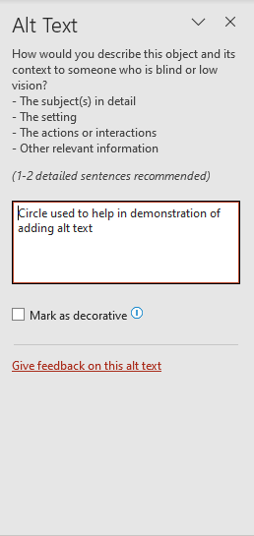
Adding Alt Text
Notes:
Alt text is the primary way to describe objects on a slide to someone with a visual impairment. A screen reader recognizes and then reads the descriptive text.
To add Alt Text:
Select object or image
Click the Review tab
In the Accessibility group, select Check Accessibility and then Alt Text from the pull-down menu to display the Alt Text Pane
Add alt text to the Description box
OR
Select object or image
Right click to display menu
Select View Alt Text… to display the Alt Text Pane
Add alt text to the Description box

Slide 8
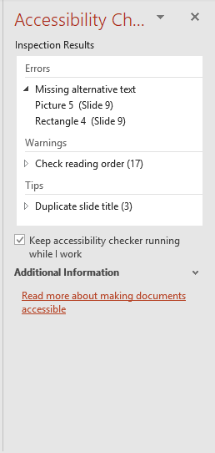
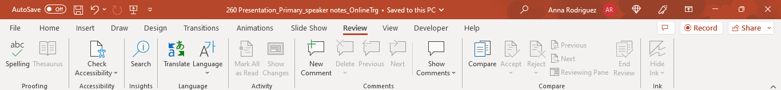
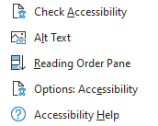
Using the Accessibility Checker
Notes:
PowerPoint has a built-in accessibility checker to ensure that slides contain alt text and titles, which are required to avoid accessibility errors in PowerPoint.
To run the Accessibility Checker:
Click the Review tab
Click Check Accessibility button to display the pull-down menu
Select Check Accessibility to display the Accessibility Checker Pane; there should be no errors, and tips and warnings can be ignored
Having the accessibility checker confirm no errors with respect to alt text and slide titles does not ensure accessibility regarding contrast, motion, animation, etc. Checking the Outline view will show what text will definitely be read, and using a screen reader will confirm that text, alt text, and the reading order of all objects on the slide are correct.
Slide content must be interpreted by assistive technologies. Screen readers are the most common form of assistive technology, and there are many available. NVDA is a free download while others, like JAWS, are available for purchase under a variety of licenses.

Slide 9


Closed Captions
Notes:
Alt text also applies to audio, video, and synchronized audio. Alt text is required to briefly describe the video, but captioning is also required to address hearing disabilities.
For YouTube videos, the easiest way to address this issue is to link to the video because YouTube often has closed captioning that the user can activate. If there’s no closed captioning already available, you may need to create a transcript that can be made available in an accessible format. If you have any questions as to whether what you’re planning (captioning or a transcript) meets accessibility requirements, speak with your agency’s accessibility coordinator.
If you have to create your own captioning, you will most likely have to purchase or download a Microsoft add-in designed for this purpose, or you can follow Microsoft’s instructions on how to use Notepad to create captioning.

Slide 10

Audio Control
Notes:
If audio plays automatically for more than three seconds, there must be a way to pause, stop, or control the volume independently. This requirement is included to keep the screen reader and the audio from overlapping. The screen reader is always relaying information to the listener, so it may be providing alt text, instructions, or navigation key strokes while the video is playing.
The best way to address this issue is to play the video in YouTube. As a set up to that, the video should be started in PowerPoint with a setting to start automatically on a delay. In YouTube, once the video is playing, the user can navigate to the video play bar by using the Tab key.
If the video must be played in PowerPoint, it will be necessary to set a long enough delay to allow the screen reader to finish its narrative. Again, if you have any questions as to whether what you’re planning meets accessibility requirements, speak with your agency’s accessibility coordinator.

Slide 11
Information and Relationships
Category | A | B | C | D
1 | 21.4 tons | 56.9 tons | 97.9 tons | 85.4 tons
2 | 90.1 tons | 67.3 tons | 76.0 tons | 44.3 tons
3 | 99.4 tons | 40.8 tons | 55.3 tons | 30.8 tons
4 | 88.2 tons | 29.6 tons | 60.1 tons | 72.9 tons
5 | 49.7 tons | 87.3 tons | 68.5 tons | 59.4 tons
Notes:
Tables, inserted in their initial formats, are not accessible. They can be made accessible by adding alt text and by providing more detailed information about the data in the Notes Pane. Tables should always contain grid lines between the cells for contrast, and data tables should contain a header row and/or a first column. In addition, neither columns nor rows should be left blank. Someone using a screen reader may think that the table has ended if they encounter a blank row. If more separation is needed between rows, use the cell margins (on the Layout tab in the Alignment group) to increase the top and bottom margins of each cell.
The table’s individual cells will still be read by the screen reader, and they’re read row by row, left to right, which doesn’t convey the true relationships of the rows and columns, so it can be argued that the best way to make a table accessible is to copy or cut the table and paste it onto a slide as an image/picture. Alt text can then be added to the image. The alt text needs to be written in a way that relays the message of the table. If that can’t be done briefly in the alt text Description box, the table’s more detailed information should be included in the Notes Pane. The brief alt text description can end with a statement that more information can be found in the Notes Page; that way, the user knows to go to the Notes Page for the screen reader to read the text there. This can also apply to charts and graphs but be sure you keep the original table or chart because once it’s converted to an image, the image cannot be edited.
Avoid nested tables; it is very difficult, if not impossible, to describe them well enough to make them accessible.

Slide 12
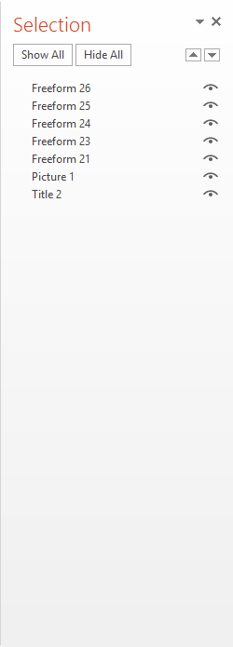
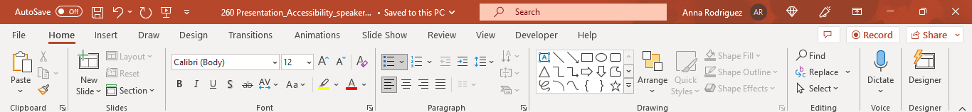
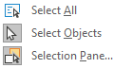
Selection Pane
Notes:
The Selection Pane is crucial in ensuring that the reading order of the objects on the slide is correct.
To display the Selection Pane:
Click the Home tab
Click Select
Click Selection Pane… to display the Selection Pane
On the Selection Pane, you can then see all of the objects on the slide, their order, and whether they are currently visible
Note that the reading order in the Selection Pane is from bottom to top, so that’s the order in which the screen reader will read the text or alt text for each object listed.

Slide 13
Sensory Characteristics
See the example below for details. When you’re done, click the green button.
Notes:
Persons with disabilities cannot rely solely on sensory characteristics of components such as shape, size, location, and color.
Read this and tell me what words you think are problematic. Any suggestions for improvements?

Slide 14
Use of Color
The best color for stimulating learning is:
  *
Notes:
Is this example accessible? Why?

Slide 15
Use of Color
The best color for stimulating learning is:
  Blue
  Red
  Green
  Orange
  Yellow
Notes:
Example: The best color for stimulating learning is:
Blue
Red
Green
Orange
Yellow
Is this example accessible? Why?

Slide 16
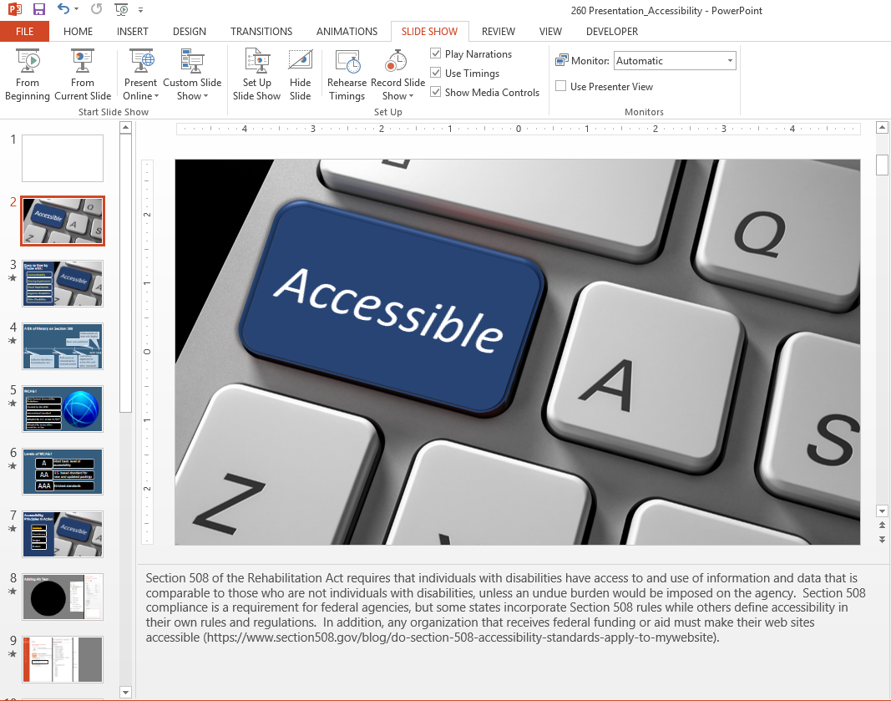
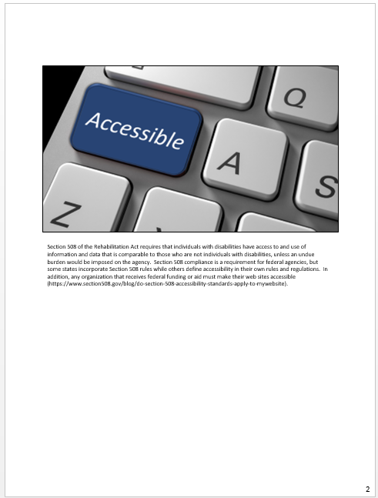
Using the Notes Pane and Notes Page
Notes:
Evaluation of test groups has shown that some users with visual impairments don’t run the slide show at all. They immediately open the Notes Page to gain their information. If you haven’t added anything in the Notes Pane, the Notes Page will also be blank. One of the best ways to ensure accessibility is to replicate the information on the slide (including the slide title and information in alt text fields, SmartArt, charts, and tables) in the Notes Pane. If you also plan to use the Notes Pane for your own speaker notes, include the slide information first and follow it with the speaker notes. Separate each with a descriptive text heading.
The other advantage of including information in the Notes Pane is that the notes can then be printed and used as a handout. It’s recommended that the font be a minimum 14 point. You can also convert the Notes Pages to a Word document or a PDF. If you plan to post the PDF or Word document to your web site, they must also meet accessibility requirements.
For any hyperlinks included in the slide show, it’s best not to use only the URL. The context of the hyperlink should be what’s displayed on the slide, and it should provide enough information so that users can decide whether or not they should follow that link. You can include the full URL after the context description and/or in the Notes Pane for additional reference and copying into a browser. Hyperlinks should be underlined to differentiate them from other text, and the hyperlink color needs to meet Level AA guidelines for contrast.

Slide 17
Animation and Accessibility
The best color for stimulating learning is:
Blue, red, green, orange, yellow
  *
Notes:
Animation often hinders accessibility. This is obvious when you run a slide show with animation through a screen reader. The most common issue is that the screen reader will not read the alt text for any object or image that contains animation and will not read the text in a content placeholder or text box that contains animation. There are several options available to remedy this:
Include the information in the Notes Pane, so the screen reader can access it from the Notes Page. You can also include hidden text on the slide that lets the user know the information is in the Notes Page (i.e., “All information may be found on the Notes Page.”) and make sure this text is in the proper reading order using the Selection Pane.
Use multiple slides and transitions between slides to give the illusion of animation and avoid using actual animations on individual objects and text. The Morph transition is great for creating the appearance of motion paths.
Create a second slide show for web posting that doesn’t include animation.

Slide 18
CenSARA 260 – Accessibility for PowerPoint Presentations
Accessible CenSARA 260
Notes:
Resources:
MicroAssist Accessibility Series: Creating Accessible PowerPoints
Training Magazine Webinar – E-Learning Accessibility: How Changing Section 508 Laws Can Impact Your Design
Training Magazine Webinar – E-Learning Accessibility Challenges: When Closed Captions and Alt Text Aren’t Enough
eLearning brothers – eLearning Accessibility: Checklist & Resources for Designing More Effective Learning for Everyone, Curated by Susi Miller

