Slide 1

240 CenSARA
Excel
Statistics
Instructor: Steve Hiebsch
Email: steve.hiebsch@gmail.com

Slide 2
Course’s Agenda
Approx. Time | Day 1 | Day 2 | Day 3
8:30 – 8:35 | Set up Check-In | Check-In & Review Day 1 | Check-In & Review Day 2
8:35 – 9:20 | Introductions Pre-Test & Overall Goal | Module 3 Central Tendency | Module 5 Linear Regression
9:20 – 10:10 | Module 1 Excel Basics | Module 3 Practice | Module 5 Practice
10:10 – 10:30 | Break | Break | Break
10:30 – 11:10 | Module 2 Describing Data | Module 4 Confidence Interval | Module 6 Lognormal Distribution
11:10 – 11:40 | Module 2 | Module 4 Practice | Module 6 Practice & Quick Review
11:40 – 11:50 | Practice | Review | Course Review
11:50 – 12:00 | Q&A over day | Q&A over day
Post-Test Instructions

Slide 3
Introductions
Introduce yourself
  Name and position
  Your work location
  Education and/or work background
  Something more personal about yourself
  e.g. hobbies, special talent, something you accomplished of which you are proud, something nobody knows about you, etc. (optional)

Slide 4
Start Pre-Test
Open Microsoft Word file named
“0 Pre-Test Excel…”
on the Website for this course.
Then follow the instructions.
Pre-Test 240CenSARA

Slide 5
Purpose of Class
Emphasis is on learning to use
Microsoft Excel for statistical purposes.
  While we will have some amount of statistical learning, this is not the main emphasis.
  We will use some environmental type data, but again that is not the primary purpose.
Primary Purpose is to prepare student for some classes where there is need to use Excel in specific Statistical Analysis.

Slide 6
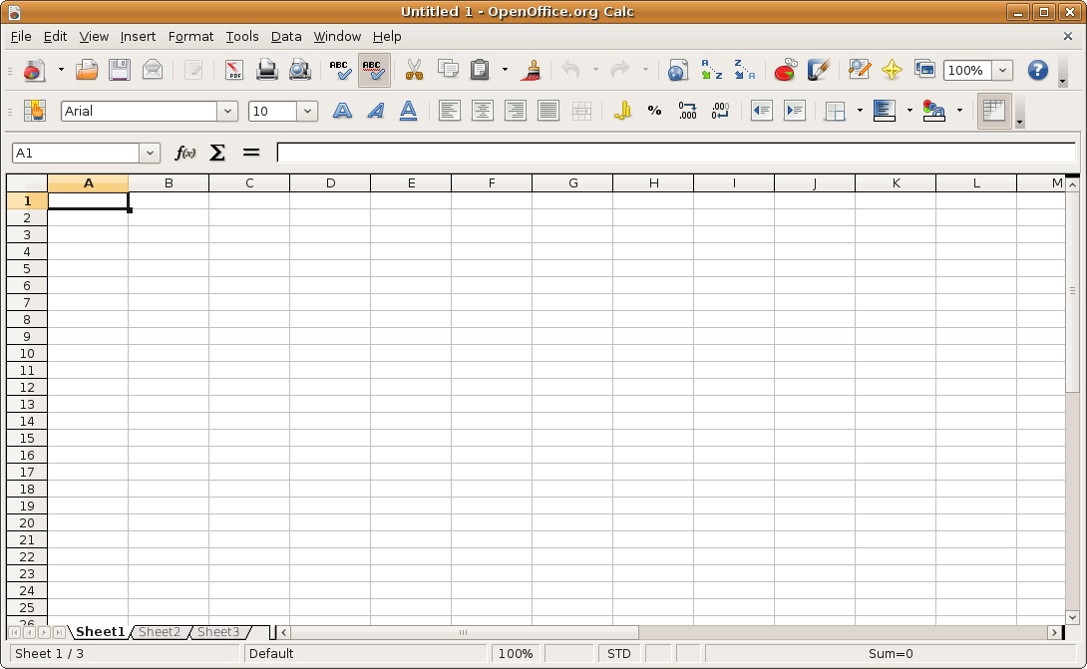
Module 1:
Using Microsoft Excel Worksheets
After completing this module, the
student will be able to:
Understand why Excel is useful as a
statistical tool
Define what is meant by a worksheet and a
workbook (worksheet commonly called a spreadsheet)
Enter data into a worksheet
Create formulas and solve problems with a
worksheet using basic arithmetic functions
Edit data that is in a worksheet
Edit data by using right-click functions, copy with cross hairs, F4 key cell ($) modifiers

Slide 7

Module 2:
Describing Data - Graphical Presentations
After completing this module, the student will be able to:
Use Excel to create common graphic presentations as pie chart, bar charts, simple histograms, line charts, and
scatter plots.
Edit and modify charts

Slide 8
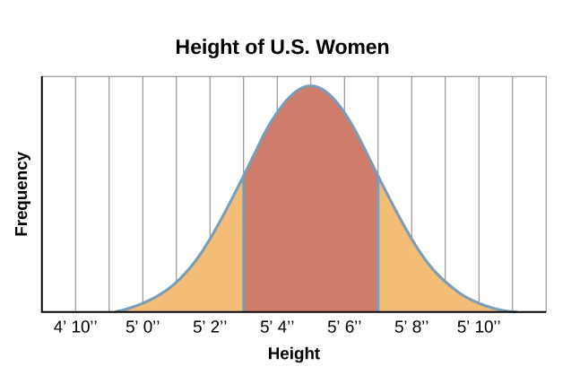
Module 3:
Describing Data – Measures of Central Tendency
After completing this module, the student will be able to:
Explain the characteristics and uses of measures of central tendency
Explain the characteristics and
uses of measures of dispersion
Use Excel functions to calculate the
arithmetic mean, median, mode, and
standard deviations
Use Excel’s Analysis ToolPak add-in to find measures of central tendency and dispersion
This Photo by Unknown Author is licensed under CC BY

Slide 9
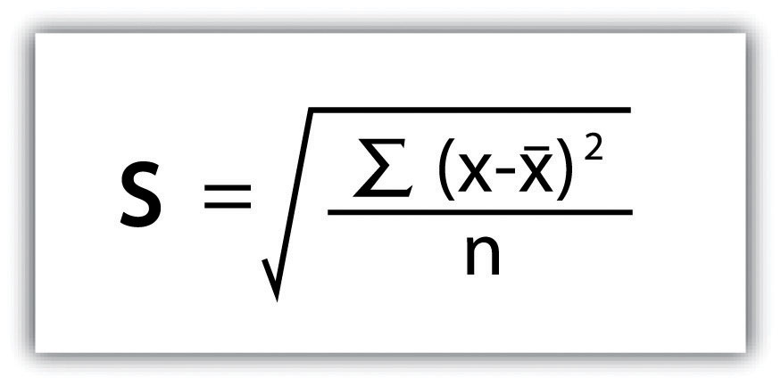
Module 4:
Estimation & Confidence Interval
After completing this module, the student will be able to:
Define point estimate
Define level of confidence
Use one Excel function to
calculate a confidence interval
for a population when the sample size is 30 or larger
AND when the sample size is 30 or less use an alternative
Excel confidence interval function.
Use Excel Functions (not Formulas)

Slide 10
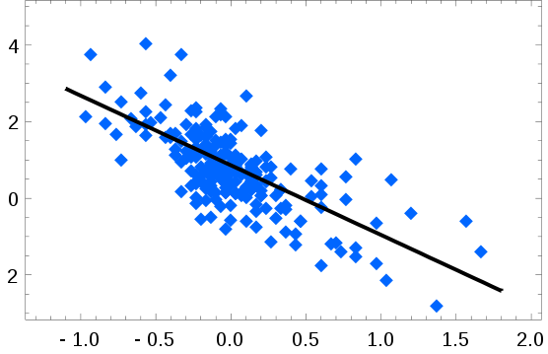
Module 5:
Linear Regression
After completing this module, the student will be able to:
Explain linear regression
Use Excel to draw a scatter
diagram
Use Excel to find a least
squares regression line
Use Excel and the least squares regression equation to predict the value of a dependent variable based on an independent variable(s)
Dependent Variable
Independent Variable

Slide 11
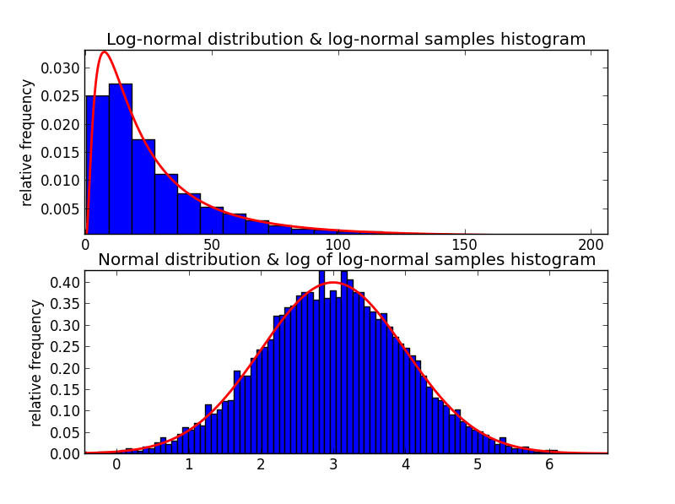
Module 6:
Lognormal Function
After completing this module, the student will be able to:
Explain lognormal distribution
Use Excel Lognormal functions
to create a lognormal
distribution probability

Slide 12

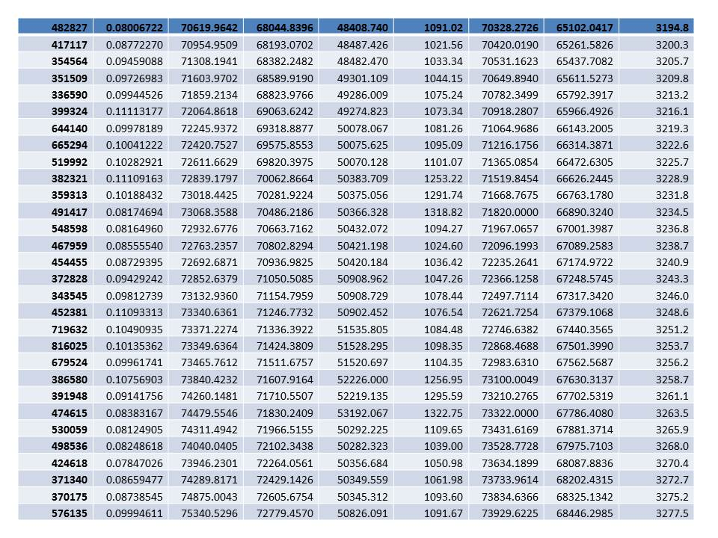
Module 1:
Using Microsoft Excel Spreadsheets
Today’s Meaningless Data -- Review Carefully
Revised

Slide 13
What is a Spreadsheet Program?
Spreadsheets have been around for decades.
  These were commonly called “ledgers”
  or “green sheets.”
Today, it is primarily referring to a
computer program that stores data in a
tabular format.
A computer program with features and/or
capabilities that include
  Data is stored in rows and columns
  Can be used for the calculations of formulas
  Can be used to produce of charts and graphics
  Data analysis tools capable of handling large quantities of data.

Slide 14
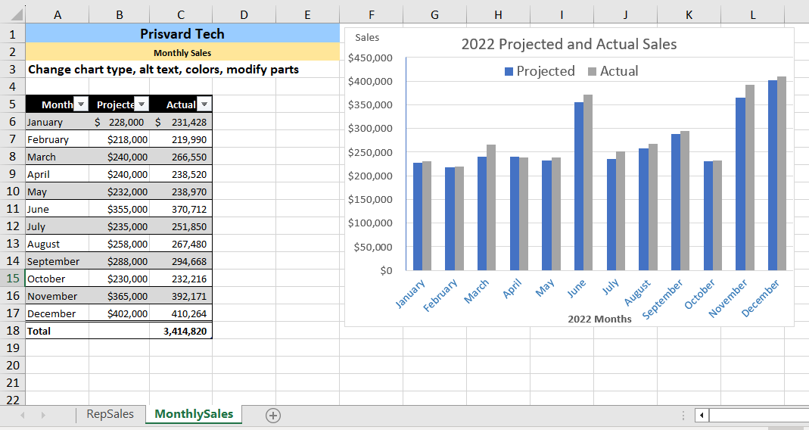
What is a Spreadsheet?
Spreadsheet packages are used to help the user understand and solve numerical problems
  Used in almost every field of business, government, and academia.
Microsoft Excel is popular spreadsheet package
Others
  VisiCalc – one of the original
  Lotus 1-2-3 – first big package (still available)
  Open Office – originally by Oracle
  WordPerfect Office – Quattro Pro
  Microsoft – Works (in 2009 out of production)
  became Microsoft – Office Starter Edition
  Online Spreadsheet – Google Docs (cannot duplicate Excel)
    Google Docs is intended for the more casual user.

Slide 15
Basics of Excel
Spreadsheet packages use worksheets of columns and rows to view the data.
A collection of worksheets make up a workbook.
  Old default in MS Excel was 3 worksheets
  Now you can add worksheets as needed.
A spreadsheet program, such as Excel, is used to create workbook files that contain one or more worksheets which contains tabular data.
  Hint: Make sure to name each sheet.
  Document the work.

Slide 16
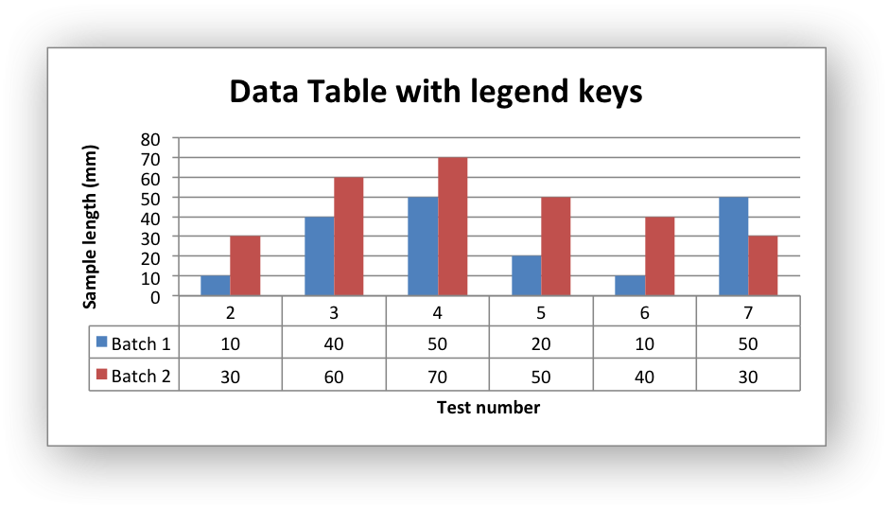
Excel as a Statistical Tool
Useful functions in spreadsheet package
  Enter data that is related
  Develop relationship using math & statistical tools
  Look at results when changes occur
Present data in “more easily” understandable manner
  Charts
  Tables
  Graphs
Help in decision making

Slide 17
Excel Basics
Entering Data in Excel discussed in this class.
  Fill – series data
  Create formula
  Copy – Icons vs. cross hair vs. key strokes
  Locking on “Key Cell” with F4 function key
    Use of $ in formula
  Naming an array for repeated future use
Creating formulas and solve problems
  Sum function vs. keying in plus symbol
  Product function vs. keying in multiplication symbols
  Power function vs. keying in ^ for exponential
  Count function vs. counting cells and values
Edit data that is in a worksheet
Go to Worksheet – Basic Excel

Slide 18

Making the Complex
look Simple –
Understood at glance
Module 2:
Describing Data: Graphical Presentations

Slide 19
Good Graphical Presentations
Graphics can aid a presentation’s understandability
Use Excel to create common graphic presentations
  pie chart,
  bar charts,
  simple histograms,
  line charts, and
  scatter plots.
Edit and modify charts

Slide 20
Bar Chart vs. Pie Chart
BAR CHART - A graph in which the qualitative classes are reported on the horizontal axis and the class frequencies on the vertical axis. The class frequencies are proportional to the heights of the bars.
  Microsoft Excel calls this a “Column Chart”
PIE CHART - A chart that shows the proportion, percent or relative frequency that each class represents of the total number of frequencies.

Slide 21
Bar Chart vs. Column Chart
“BAR” Chart
Months | Monthly US Housing Inventory
April 2023 | 435,663
May 2023 | 582,441
June 2023 | 614,326
July 2023 | 647,135
August 2023 | 669,145
Sept. 2023 | 702,434

Slide 22
Graphics made easy with Excel
Seniority of Employees | Frequency | Relative Frequency
0-5 years | 16 | 19.3%
6-10 | 19 | 22.9%
11-15 | 29 | 34.9%
16-20 | 8 | 9.6%
21-25 | 6 | 7.2%
Over 25 | 5 | 6.0%
Total Employees | 83

Slide 23
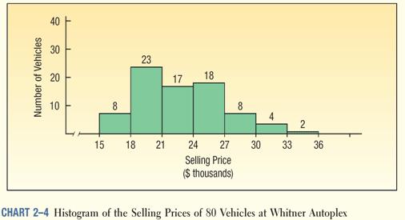
Other Graphics
Histogram
  Histogram vs. Bar Charts
  Continuous data vs Discrete data
Line Charts – Good for showing
changes in data over time.
Scatter Plots - similar to line graphs
  Both vertical & horizontal access to plot data points.
  Show if one variable is related to another – called correlation .
Ace’s Car Corner
Best Used Cars Anywhere

Slide 24
Line Charts
Precipitation by Year
for 3 State Capitals
Year | Des Moines | Okla. City | Baton Rouge
2011 | 36.88 | 30.37 | 54.10
2012 | 27.07 | 29.49 | 78.95
2013 | 34.99 | 52.79 | 74.89
2014 | 42.27 | 28.38 | 65.64
2015 | 47.39 | 55.07 | 69.33
2016 | 36.84 | 26.32 | 87.78
2017 | 31.71 | 33.67 | 86.43
2018 | 45.89 | 45.83 | 93.12
2019 | 44.22 | 45.36 | 84.76
2020 | 31.65 | 38.57 | 81.31
Average | 37.89 | 38.59 | 77.63
Median | 36.86 | 36.12 | 80.13
Source: https://www.noaa.gov
See precipitation data

Slide 25
Line Charts and Bar Charts
Precipitation by Year
for 3 State Capitals
Year | Des Moines | Okla. City | Baton Rouge
2011 | 36.88 | 30.37 | 54.10
2012 | 27.07 | 29.49 | 78.95
2013 | 34.99 | 52.79 | 74.89
2014 | 42.27 | 28.38 | 65.64
2015 | 47.39 | 55.07 | 69.33
2016 | 36.84 | 26.32 | 87.78
2017 | 31.71 | 33.67 | 86.43
2018 | 45.89 | 45.83 | 93.12
2019 | 44.22 | 45.36 | 84.76
2020 | 31.65 | 38.57 | 81.31
Average | 37.89 | 38.59 | 77.63
Median | 36.86 | 36.12 | 80.13

Slide 26
Graphics Aid to Understanding
Seniority of Employees | Mid Point | Average Income
0-5 years | 2.5 | 42,195
6-10 | 7.5 | 52,315
11-15 | 12.5 | 67,685
16-20 | 17.5 | 77,819
21-25 | 22.5 | 108,939
Over 25 | 30 | 76,724
Employee # | Seniority of Employee (years) | Income
1001 | 1 | 39,940
1002 | 5 | 67,949
1003 | 7 | 53,696
1004 | 15 | 38,003
1005 | 21 | 43,586
1006 | 23 | 190,876
1007 | 4 | 40,434
1008 | 4 | 78,514
1009 | 2 | 37,620
1010 | 3 | 34,217
1011 | 15 | 94,216
1012 | 11 | 90,094
1013 | 24 | 58,048
1014 | 21 | 67,194
1015 | 16 | 52,377
1016 | 14 | 133,509
1017 | 4 | 35,310
1018 | 17 | 38,711
1019 | 20 | 60,697
1020 | 15 | 101,961
1021 | 23 | 79,014
Go to Worksheet - Graphics

Slide 27

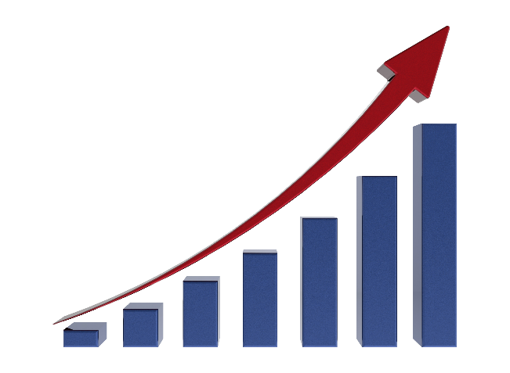
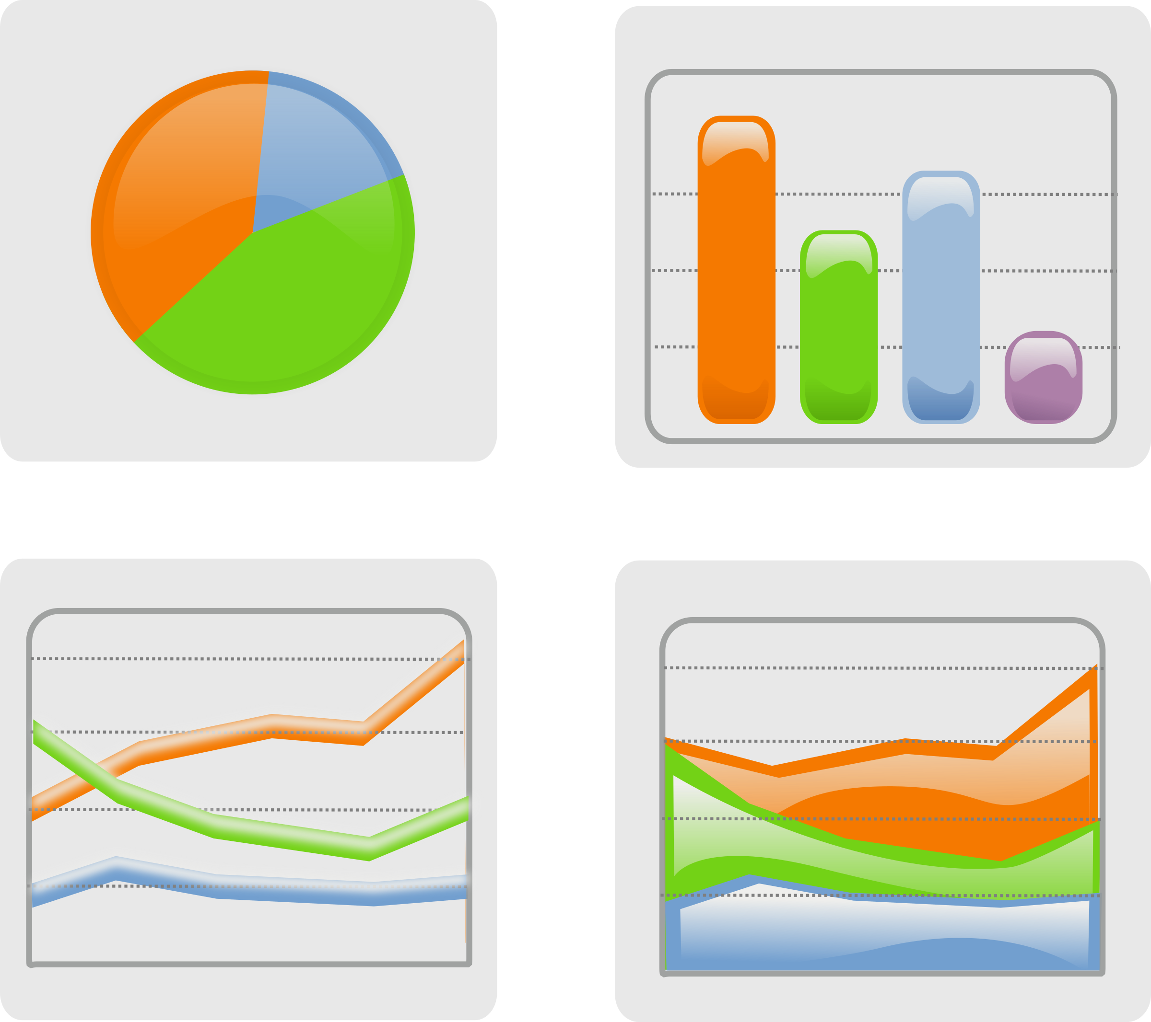

Let’s go back quickly plus add some points
Review:
Module
1 & 2
Worksheet - review

Slide 28
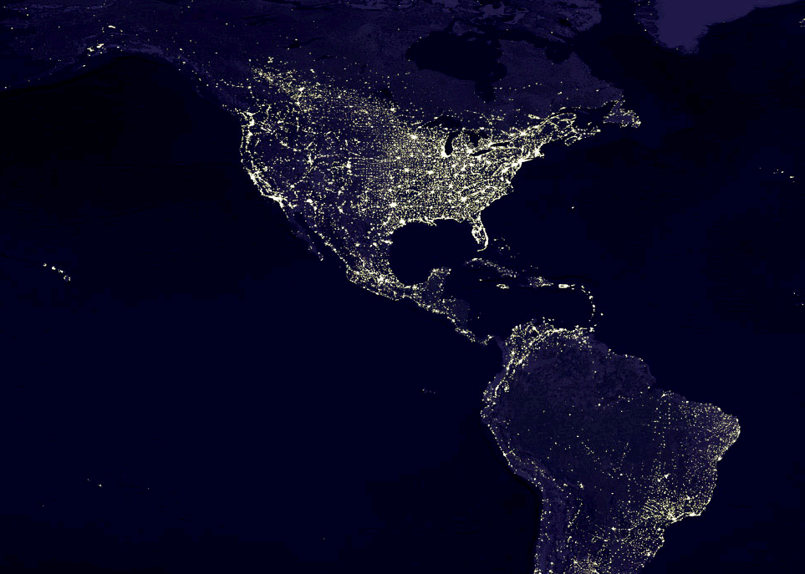

Module 3:
Describing Data – Measures of Central Tendency
Pictures are worth a 1,000 words – Numbers give the true details

Slide 29
Subjects Covered in Module 3
Explain the characteristics and uses of measures of central tendency: Mean, Median and Mode
Explain the characteristics and
uses of measures of dispersion
around the central tendency
Use Excel functions to calculate the
arithmetic mean, median, mode,
and standard deviations
Use Excel’s Analysis ToolPak add-in to find measures of central tendency and dispersion

Slide 30
Meaning of Central Tendency
A single value that attempts to describe a set of data by identifying some central position within that set of data.
  A measure of location
  Sometimes referred to as
  point estimate
  Most common is
  Average (Mean)
    Often called expected value
    or normal value
  Others are Median and the Mode.
    Median often called middle value
    Mode often called the favorite or most popular

Slide 31
Other similar values to Central Tendency
Other singular values that help to describe a set of data and results of estimates.
  Average growth rate – Geometric Mean
  Coefficient of Correlation (discussed in Module 5)
  Coefficient of Determination (discussed in Module 5)
  Standard Error of the estimate (discussed in Module 5)
  Percentile (only covered briefly in this course)
  Skewness (only covered briefly here and in Module 6)
  Kurtosis (not covered in this course)

Slide 32
What is Dispersion?
Measures of Dispersion help to know the spread of the data.
  Range – give difference between high & low
  Standard Deviation – how clustered are the values around the central tendency.
    Indication of likelihood of values relatively near central tendency or relatively far away.
    Steve’s definition – Standard Deviation is the average of the deviations around the mean.
Knowing mean is wonderful,
knowing dispersion gives more understanding.

Slide 33
Statistical Function in Excel
Common measures of central tendency
  Average (mean) =AVERAGE(array)
  Median =MEDIAN(array)
  Mode =MODE(array)
Common measures of dispersion
  Range =MAX(array) ̶ MIN(array)
  Standard Deviation = STDEV.S(array) for sample
  & =STDEV.P(array) for population
    Think of the Standard Deviation as the average dispersion around the mean

Slide 34
“Data Analysis” Toolpak
Column1
Mean | 43670.14012
Standard Error | 4006.646402
Median | 29834.87583
Mode | #N/A
Standard Deviation | 36502.28592
Sample Variance | 1332416877
Kurtosis | 6.66484503
Skewness | 2.623861794
Range | 164780.6589
Minimum | 18906.44908
Maximum | 183687.108
Sum | 3624621.63
Count | 83
Using an array of data, the following results can easily be obtained.
Go to Worksheet – Central Tendency

Slide 35

Module 4:
Confidence Interval
Sweat the small stuff – You have done all the work, but is it right.

Slide 36
What’s a Confidence Interval?
Suppose you conduct a study and arrive at some statistics from your study, e.g. :
  Sample Mean
  Sample Standard Deviation
  Sample Range
How certain are you that your sample statistics represents the Population’s parameters?
Need to introduce some terminology.

Slide 37
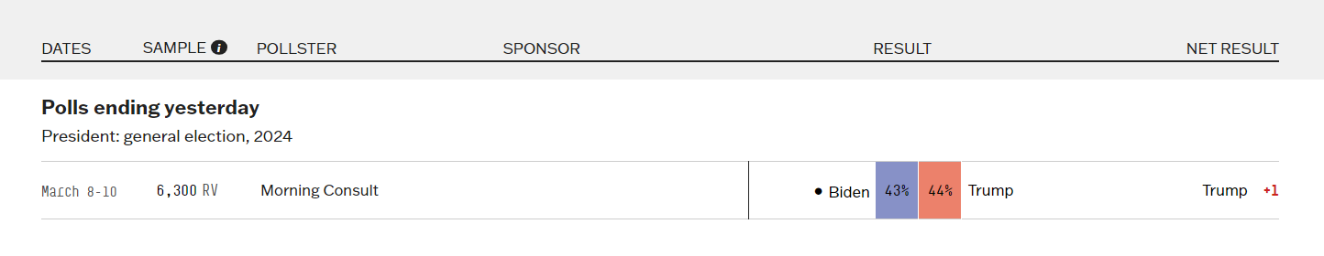
What’s a Confidence Interval?
Summary of the results of a recently concluded survey
Results of a poll of 6,300 Register Voters completed March 10th
  If this poll had been taken on November 4th, the day before the election on the 5th, do you believe the results would perfectly measure the election results?

Slide 38
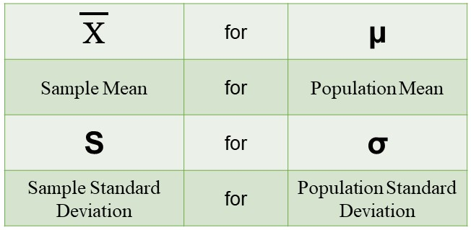
Terminology – Point Estimate
A Point Estimate is a single value developed using sample data to produce a sample statistic. The sample statistic is the best estimate of a population parameter.
Sample Statistic Population Parameter

Slide 39
Terminology – Confidence Interval
Confidence Interval is a technique used to indicate the reliability of a sample’s statistic as an estimator of the population parameter.
  Samples do not perfectly replicate the population.
  A Confidence interval is a range of values (interval) that likely contain the population parameter.
  Confidence Interval = point estimate ± sample error

Slide 40
Determinants of Confidence Interval
What determines the width of a confidence interval?
    1. The sample size, n.
    2. The dispersion in the population, usually σ estimated by s.
    3. The desired level of confidence.
Potential µ
X

Slide 41
How to Calculate the Confidence Interval
s
C.I. = X t
∓
√
n
Sampling error
C.I. = Confidence Interval
X = sample mean
t = t statistic value
s = sample standard deviation
(s/n^0.5) is called the standard error of the mean
n = sample size
Go to Worksheet – Confidence Interval

Slide 42
Review:
Module
3 & 4
s
C.I. = X t
∓
√
n
Let’s go back quickly. Touch up some points
Worksheet -1st Review
Worksheet – 2nd Review

Slide 43
Module 5:
Linear Regression
Are these two variables related? --
How much?

Slide 44
Linear Regression
Purpose is to develop a better understanding the relationship between two variable being studied.
  Independent variable
  Dependent variable
Goal in Linear Regression:
  Develop an equation to express the relationship b/t variables.
  Use the equation to estimate the value of the dependent variable using the independent variable as a predictor.

Slide 45
Terminology
The dependent variable (criterion) is the variable being predicted or estimated.
The independent variable (predictor) provides the basis for estimation.
Examples :
  Smoking cigarettes increases the likelihood of a person getting lung cancer.
    Lung cancer is the dependent variable.
    Smoking is the independent variable
  Larger house have a higher selling price
    Selling price is the dependent variable
    Square footage is the independent variable

Slide 46
Start with Scatter Diagram
Remember back in Module 2
Square Footage | House Prices
3,840 | 300,000
1,510 | 71,500
435 | 36,000
3,150 | 114,500
1,626 | 135,000
1,014 | 32,000
1,529 | 110,000
1,056 | 75,000
1,201 | 108,500
1,892 | 370,000
2,070 | 506,666
2,041 | 380,000
1,959 | 340,000
1,199 | 230,000
1,254 | 100,000
9,24 | 22,000
Does there appear to be a relationship?

Slide 47
What is a Correlation?
Terminology
Correlation is numerical measures used to express the strength of the relationship between two variables.
Many examples of a relationship of correlations:
  MPG and the car’s weight.
  Quantity of fuel burned and CO₂ emissions
  Number of red squirrels in Ohio and Stock Market Prices
  Ice cream quantity consumed and shark attack numbers.
  The square footage of a house and the selling price.
Does correlation mean causation?

Slide 48
Terminology
The numerical measure of correlation is called the Coefficient of Correlation (r).
The “correlation coefficient” shows the direction and the strength of the linear relationship between two interval or ratio-scale variables.
  Correlations ranges from –1.00 to +1.00
    Values of –1.00 or +1.00 indicate perfect or strong
    Values close to 0.0 indicate weak correlation.
    Negative values indicate an inverse relationship
    Positive values indicate a direct relationship.
See precipitation data

Slide 49
Start with a Simple Regression Model
The independent variable (X) is used to estimate the dependent variable (Y).
The Regression Equation below is an equation that expresses the linear relationship between two variables.
A math process called least squares technique is used to determine the equation.
  Minimizes the sum of the squares of the vertical distances between the actual Y values and the predicted values of Y, called Y hat.
^
= a + b X
Y

Slide 50
Least Squares approach
A
Modeled Regression Line
B

Slide 51
What Determines a Good Regression Line?
Rules to follow:
  Logical relationship – relationship between X and Y variables is logical.
  Correlation Coefficient (r) is good
  Coefficient of Determination (r²) is good
  Standard error is low
  b slope of the line (coefficient of X) is correct
  t-value > 2.2 (rule of thumb)
  β coefficient is less than the significant level.
Follow these rules for a (non-simple) regression model
Go to Worksheet – Regression Model

Slide 52

Module 6:
Lognormal
Distribution
Congratulations
Jimmi Lynn
--
First Prize

Slide 53
What is Lognormal?
Lognormal – a distribution of a random variable for which the logarithm of the variable has a normal distribution.
Positively skewed distributions are particularly common when:
  Mean values are low,
  Variances large
  Values are not zero, and
  Values cannot be negative

Slide 54
What is Lognormal?
Log-normal – a distribution of a random variable for which the logarithm of the variable has a normal distribution.

Slide 55
Examples of Lognormal Distributions
Skewed distributions often closely fit the log-normal distribution - examples:
  Lengths of latent periods of infectious diseases,
  Distribution of mineral resources in the Earth’s crust
  Inheritance of fruit and flower size
  Return on equities in stock market
  Survival rates of cancer patients
  Failure rates in product tests.
  Rainfall in Las Vegas (not perfect example)

Slide 56
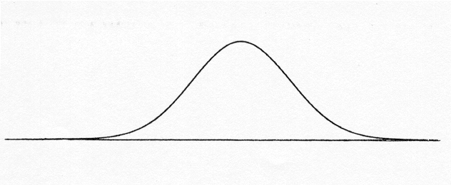
First – Discuss a Normal Distribution
Some may remember the z-distribution
The Excel function is
P(X) =NORM.DIST(X,µ,σ,Cumulative)
Where Norm Function gives probability of area < X:
        X = observation
        µ = Mean
        σ = Standard Deviation
        Cumulative is either true or false
Before Excel:
1st Solve for Z
Z=(X-µ)/σ
2nd Use a Z table to find
the probability
µ
X
=NORM.S.DIST((LN(X) - Mu)/Sigma,Cumulative)
Z=(LN(X)-µ)/σ

Slide 57
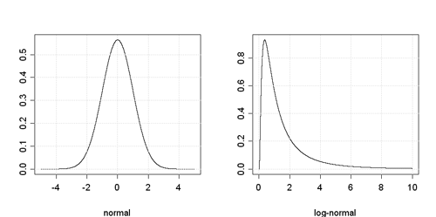
Lognormal Distribution
  However, our data is not following a Normal distribution
  Our data is a Lognormal Distribution; i.e., the LN(X) is normal
  Suppose you get monthly data for Rainfall in Las Vegas.
    The data has the characteristics of Lognormal
    Mean is low and Variance is fairly large
What if
µ = 0.3519
Median = 0.110
σ = 0.572
What is
P(X) > 4
Go to Worksheet – Lognormal Worksheet

Slide 58
Review:
Module
5 & 6
Review Module 5 & 6
^
= a + b X
Y
Worksheet - review

Slide 59
Review:
Course
Quick Review (if desired)
^
= a + b X
Y
Let’s go back quickly. Touch up some points
Worksheet - review

Slide 60
Start Post-Test
Open Microsoft Word file named
“0 Post-Test Excel…”
on the Website for this course.
Then follow the instructions.
Post-Test 240CenSARA

